Slide 1
Career Pathways Trust
Presented
June 23, 2014

Slide 2
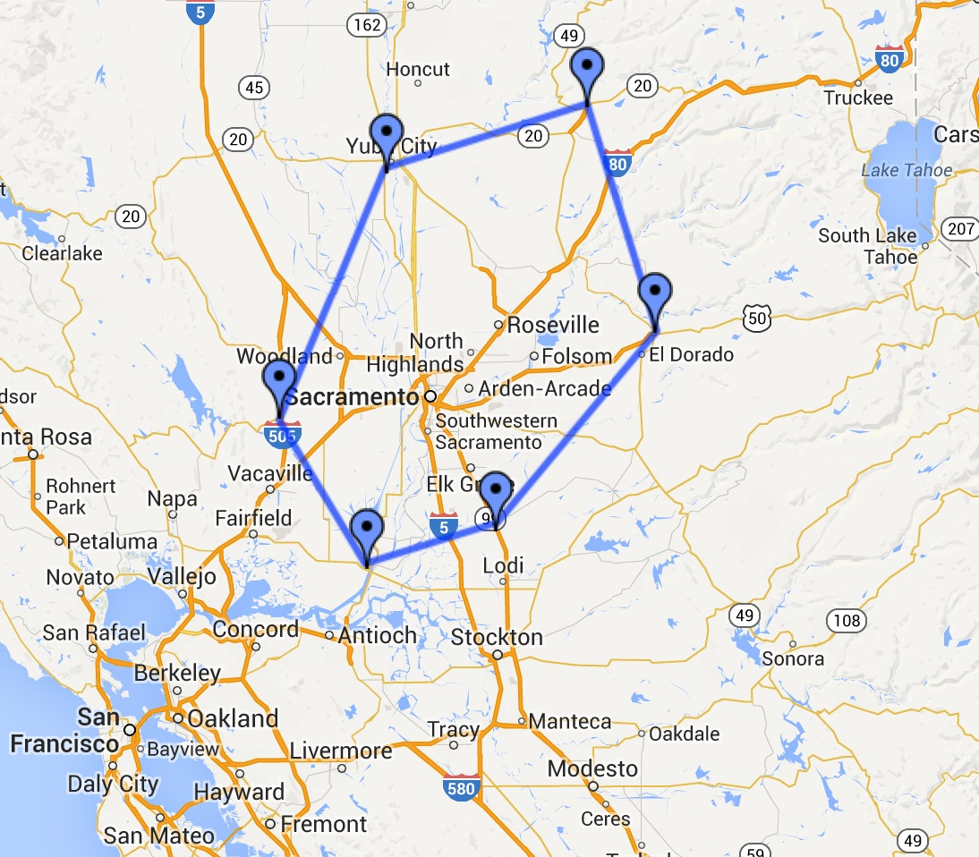

Slide 3
CRANE Aligns Pathways with Regional Economic Growth Plan
Capital Region - Next Economy
Targets six growth clusters
CRANE
Invests in pathways aligned with Next Economy growth clusters

Slide 4
Scope and Span of CRANE
7 Counties
18 Districts and 4 COEs
6 CCs, UCD, Sacramento State
4 private postsecondary
NextEd
Business Engagement

Slide 6
68 Pathways
14 | Ag, Food Production, and Natural Resources
7 | Advanced Manufacturing
5 | Construction and Energy
17 | Engineering and Engineering Services
13 | Life Sciences and Health Sciences
12 | Information and Communications Technology

Slide 7
Themes Across Pathway Clusters
Finance
Entrepreneurism
Public Service
Community Service

Slide 8
Forging Business Partnership Platform
Pathways complete inventory of existing partnerships and projected need
NextEd and Workforce Investment Boards (WIBs) fill need, post in Work Based Learning (WBL) inventory and new LaunchPath Internship Database
Notes:
LaunchPath is the Chase funded Internship Matching site under construction within the Foundation for CA Community Colleges office.

Slide 9
Partnership Goals w/ Regional WIBs
Leverage Capital Region WIB support for CRANE pathway students
Sacramento WIB
Golden Sierra WIB
Yolo County WIB
Maximize CRANE student interaction with One Stops / WIB Youth Services

Slide 10
Regional Support Structure
Program Manager
Six Cluster Teams
Each Team
Cluster Coordinator (1)
Career Specialists (2)

Slide 11
Regional Support - SCOE
Three Teams
Ag, Food Production, and Natural Resources
Engineering and Engineering Services
Life Sciences and Health Sciences

Slide 12
Regional Support - PCOE
Three Teams
Advanced Manufacturing / Construction and Energy
Information and Communications Technology
Finance / Entrepreneurism/Public Service

Slide 13
Site Support
Career Specialist
School Year (on campus student support)
Summer (off campus WBL student support)

Slide 14
Annual WBL Inventory
Pathways complete census of existing WBL placements
Identify WBL placements needed for the following year by December 15
NextEd fills needed placements

Slide 15
Annual Program Outcome Measures
Enrollment by pathway
Pathway completers
WBL completers
Diplomas earned
CTE certificate earners

