Slide 1
Visual and Performing Arts
In a Transitional Kindergarten (TK) Classroom
Notes:
Approximate Presentation Duration: 2 hours
Target Audience: Primarily TK Teachers
Note to trainer: You may choose to decorate the tables with different visual performing arts tools such as paint brushes, dancing ribbon, instruments, adapted art tools, modeling clay, etc.
One of the activities presented in the Powerpoint is to create a lesson for a sculpting activity. You may want to supply modeling clay on the tables to inspire your participants.
Ask a teacher ahead of time to lead some new songs and/or dances. Incorporate 2-3 songs throughout the session. Consider choosing different types of songs (i.e., one finger play, one rhyme and repetition, and one song that requires full body movement.

Slide 2

Acknowledgements
The following county offices of
education developed the TK
professional development modules:
With contributions from:
Fresno County Office of Education
Merced County Office of Education
CCSESA’s CISC School Readiness Subcommittee
Contra Costa County Office of Education
Humboldt County Office of Education
Orange County Department of Education
Sacramento County Office of Education
Santa Clara County Office of Education
Shasta County Office of Education
Coordinated by:
Sacramento County Office of Education
Funding provided by:
Notes:
2
Several county offices of education contributed to the development of the TK professional development modules… either by developing the content and/or by conducting a pilot session with school district teachers and administrators.
This project was coordinated by the Sacramento County Office of Education through funding from the David and Lucile Packard Foundation.

Slide 3

WELCOME
Notes:
The information in this presentation is based on:
The Alignment of the California Preschool Learning Foundations and Key Early Education Resources
California Preschool Learning Foundations, Volume 2
Current Research

Slide 4
Norms
Start and end on time
Silence cell phones
Listen to and contribute thoughts and ideas

Slide 5
Session Outcomes
Examine the alignment between the Preschool Learning Foundations and the Visual and Performing Arts Content Standards for California Public Schools
Identify instructional strategies for transitional kindergarten (TK) to support a modified kindergarten curriculum that is age and developmentally appropriate

Slide 6
Background
California was one of just four states (along with Connecticut, Michigan, and Vermont) with a cut-off date later than December 1. In most states, children must turn five by September 1 in order to start kindergarten
Research indicates that beginning kindergarten at an older age improves children’s social and academic development
(Cannon, J.S. & Lipscomb S., 2008)

Slide 7
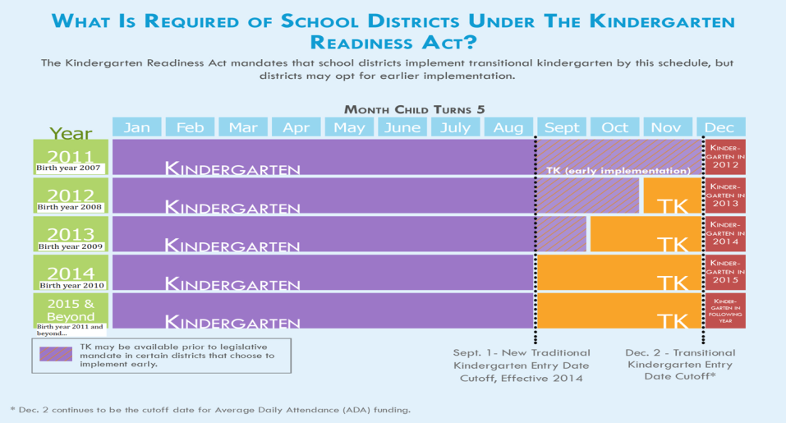
Senate Bill 1381 (Simitian)
The Kindergarten Readiness Act of 2010
Source: Early Edge California
Notes:
Senate Bill 1381 provides flexibility for districts in implementing TK that best meet the needs of students.
It is important to note, that all kindergarten regulations apply to TK. Children are not mandated to attend TK as the existing statute does not require parents to enroll children in kindergarten.
Children are not mandated to attend, but district must offer TK for birthdays between September 2 and December 2 ([Education Code Section 48000]; CCSESA, 2011).
In 2012-13, school districts began to offer a TK program for children whose fifth birthdates fall from November 2 through December 2.
The date will continue moving back one month over each subsequent year so that by 2014-15 and, each year thereafter, children who are five on or before September 1 are eligible for kindergarten.
The law also requires school districts to develop a transitional kindergarten program, for children who will no longer be age eligible for kindergarten.
Transitional kindergarten is the first year of a two-year program that provides a “modified kindergarten curriculum that is age and developmentally appropriate” (Education Code section 48000).

Slide 8
Developmentally Appropriate Practice
Developmentally Appropriate Practice
“…involves teachers meeting young children where they are (by stage of development), both as individuals and as part of a group; and helping each child meet challenging and achievable learning goals”
Knowing about child development and learning
Knowing what is individually appropriate
Knowing what is culturally important
National Association for the Education of Young Children (www.naeyc.org/DAP)
Notes:
As districts work to provide the “modified kindergarten curriculum that is age and developmentally appropriate ”we need to clarify our definition of “developmentally appropriate”.
Developmentally appropriate practice, often shortened to DAP, is an approach to grounded teaching both in the research on how young children develop and learn and in what is known about effective early education. Its framework is designed to promote young children’s optimal learning and development. For more information, visit the National Association for the Education of Young Children website: www.naeyc.org/DAP
www.naeyc.org/dap/3-core-considerations
3 Core Considerations of DAP
Knowing about child development and learning – Knowing what is typical at each age and stage of early development is crucial. This knowledge, based on research, helps us decide which experiences are best for children’s learning and development.
Knowing what is individually appropriate – What we learn about specific children help us teach and care for each child as an individual. By continually observing children’s play and interaction with the physical environment and others, we learn about each child’s interests, abilities and developmental progress.
Knowing what is culturally important – We must make an effort to get to know the children’s families and learn about the values, expectations, and factors that shape their lives at home and in their communities. The background information helps us provide meaningful, relevant, and respectful learning experiences for each child and family.
8

Slide 9
Developmentally Appropriate Practice
Principles of Child Development and Learning – Developmentally Appropriate Practice in Early Childhood Programs Serving Children from Birth through Age 8
Copple, C., & Bredekamp. S., (Eds.). (2009). Developmentally Appropriate Practice in Early Childhood Programs Serving Children from Birth Through Age 8. 3rd ed. Washington, DC: National Association for the Education of Young Children, (pp. 10-15).
Notes:
The NAEYC has published a valuable resource that can be utilized to support the implementation of developmentally appropriate TK programs.
Have participants read the principles and select one that resonates with you. Be ready to quickly share why you selected it. Depending on time available and group dynamics, participants might share in pairs, small groups, or as a whole group.
If time permits, additional pair, small group, or whole group discussion might focus on sharing current practices that exemplify or are connected to selected principles.
Review the handout “Developmentally Appropriate Practice in Early Childhood Programs Serving Children B-age 8”. Review this document with the group.

Slide 10
Universal Design for Learning
Provide Multiple Means of Representation
  Perception
  Language expressions and symbols
  Comprehension
Provide Multiple Means of Action and Expression
  Physical action
  Expression and communication
  Executive function
Provide Multiple Means of Engagement
  Recruiting interest
  Sustaining effort and persistence
  Self-regulation
http://www.udlcenter.org/aboutudl/udlguidelines
Notes:
As developmentally appropriate TK programs are planned, implemented, and refined, it is also critical to assure that they are grounded in Universal Design for Learning to ensure access to all components of the program for all students. UDL principles promote highly individualized and flexible instruction and are designed to move all learners from novice to expert as they become strategic learners prepared for a lifetime of learning.
http://www.udlcenter.org/aboutudl/udlguidelines
The goal of education in the 21st century is the mastery of the learning process–novice learners become expert learners who want to learn, know how to learn strategically, and who, in their own highly individual and flexible ways, are prepared for a lifetime of learning.
UDL
Universal Design for Learning (UDL) is access to all aspects of learning for all students. Through careful planning for modifying their curriculum, instruction, grouping, and assessment techniques, teachers can be well prepared to adapt to the diversity in their classrooms.

Slide 11
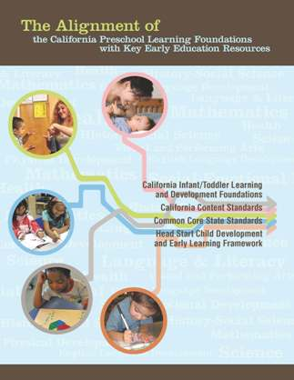
The Alignment of the California
Preschool Learning Foundations with Key Early Education Resources
All domains of the Preschool Learning Foundations correspond to the California Kindergarten Content Standards
Preschool Learning Foundations Language and Literacy domain aligns with the California Common Core State Standards (CCSS) for English Language Arts
Preschool Learning Foundations Mathematics
domain aligns with the California Common Core
State Standards for Mathematics
Notes:
Alignment Document includes key early education resources:
CA Infant/Toddler Learning and Development Foundations
• CA Content Standards
• Common Core State Standards
• Head Start Child Development Early Learning Framework
Optional:
Provide copies of the CA Preschool Learning Foundations, and the VAPA Content Standards for each table; give each participant a copy of the Alignment Document.
Highlight (if needed, browse through the document with participants):
The Preschool Learning Foundations are a critical step in the California Department of Education’s efforts to strengthen preschool education and school readiness and to close the achievement gap in California. The Foundations cover the following domains:
Social-Emotional Development
Language and Literacy
English-Language Development (for English learners)
Mathematics
Visual and Performing Arts
Physical Development
History-Social Science
Science
Together, these domains represent crucial areas of learning and development for young children.
Competencies are included as foundations for children “at around 48 months of age” and “at around 60 months of age.”
Source: Expanding Access to High Quality Preschool Programs, 2003 California School Boards Association
11

Slide 12
Overview of Alignment
California Preschool Learning Foundations | California Kindergarten Content Standards | Common Core State Standards
Social-Emotional Development | Health, Education Mental, Emotional, and Social Health
Language and Literacy | English-Language Arts | English-Language Arts
English-Language Development | English-Language Development
Mathematics | Mathematics | Mathematics
Visual and Performing Arts | Visual and Performing Arts
Physical Development | Physical Education
Health | Health Education
History-Social Science | History-Social Science
Science | Science
Source: The Alignment of the California Preschool Learning Foundations with Key Early Education Resources, CDE, 2012.
Notes:
This table represents an overview of the alignment among the nine domains of the Preschool Learning Foundations have with the content of the CA Kindergarten Content Standards and the Common Core State Standards (CCSS).
The alignment demonstrates that early learning is a significant part of the educational system and that the knowledge and skills of young children are foundational to future learning.
Understanding the links between the different ages and different early childhood services allows educators to build on children’s earlier learning and prepare them for the next educational challenge.
12

Slide 13
Overview of Visual and Performing Arts
Source: The Alignment of the California Preschool Learning Foundations with Key Early Education Resources, CDE, 2012
Notes:
The Preschool Learning Foundations in the Visual and Performing Arts are organized in four strands (each representing an art discipline): Visual, Art, Music, Drama, and Dance. The sub strands center on key competencies related to the arts. Notice, respond, and engage relates to the interest, enjoyment, and interaction of children with materials and methods of an art form. Develop skills refers to the basic skills of performing, inventing, and creating through the arts, while create, invent, and express describes the ways children use their skills to invent and express through the arts.
The Preschool Learning Foundations are aligned with VAPA Content Standards for Visual Arts, Music, Theatre, and Dance.

Slide 14
Overview of Visual and Performing Arts
Source: The Alignment of the California Preschool Learning Foundations with Key Early Education Resources, CDE, 2012
Notes:
“The skills and knowledge in the Visual and Performing Arts are built on ones that children develop in the Language, Perceptual, Motor, Cognitive, and Social–Emotional Development domains. Whether children improvise vocally and instrumentally or act out with others through music and movement, the visual arts, music, drama, and dance tap children’s intellectual, social, and physical competencies. Children’s developing capacity to communicate, express themselves verbally, move their bodies with competence, engage in symbolic play, interact with peers and adults cooperatively, along with other skills, form the foundation of their development in the Visual and Performing Arts. For this reason, as Table 1.12 indicates, the Visual and Performing Arts domain is aligned with all four developmental domains in the infant/toddler foundations: Social–Emotional Development, Language Development, Cognitive Development, and Perceptual and Motor Development. Each domain plays a role in children’s development in the Visual and Performing Arts” (CDE, 2012, Alignment Document, p. 94).

Slide 15
Overview of Visual and Performing Arts
Source: The Alignment of the California Preschool Learning Foundations with Key Early Education Resources, CDE, 2012
Notes:
“The Preschool Learning Foundations in visual art, music, drama, and dance are also aligned with the kindergarten content standards in the corresponding domains: Visual Arts, Music, Theatre, and Dance. The kindergarten content standards in each artistic domain are organized by the following main categories (strands): artistic perception, creative expression, historical and cultural context, aesthetic valuing, and connections, relationships, applications. Table 1.12 shows the alignment between preschool sub strands and kindergarten strands in Visual Arts, Music, Theatre, and Dance. Table 1.13 details the alignment between specific preschool foundations and kindergarten content standards in the Visual and Performing Arts domains“ (CDE, 2012, Alignment Document, pp. 94-95).
VAPA supports social-emotional growth, provides multiple access points to curriculum, builds confidence, and fosters self expression for ALL students.
Optional Activity: Ask participants to discuss why the Alignment Document is important and how it can be used for planning.

Slide 16
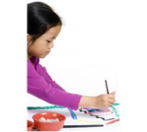
Integration of Arts
The arts are a unique way of knowing, but they also support learning across the curriculum. Engagement in the arts can be an effective means through which important early childhood skills and dispositions are developed—such as empathy and cooperation, curiosity in and knowledge about linguistic and cultural differences, ease with differences among people, vocabulary, symbolic understanding, and math concepts such as number, size, and shape.
California Department of Education (2011) Preschool Curriculum Framework, Volume 2 p. 44
Notes:
“Because children learn holistically, the arts should be presented in a way that is integrated with other domains of learning”. (CDE, 2011, PCF, p.44)

Slide 17
Integration
Fine motor development - A child is working on developing emergent writing skills while making straight and curved lines during visual art activity
Spatial awareness - A child is developing awareness about their body in space while participating in a dance activity which is also enhancing the child’s spatial awareness and physical development
Language development - A child verbally reflects on music while using expanded vocabulary to communicate with others
Notes:
The arts integrate so naturally across all domains. Here are some examples while working on building fine motor development, body awareness, and language development.
Optional Activity:
Ask participants to discuss how they have integrated the visual and performing arts. Share out in the larger group.

Slide 18
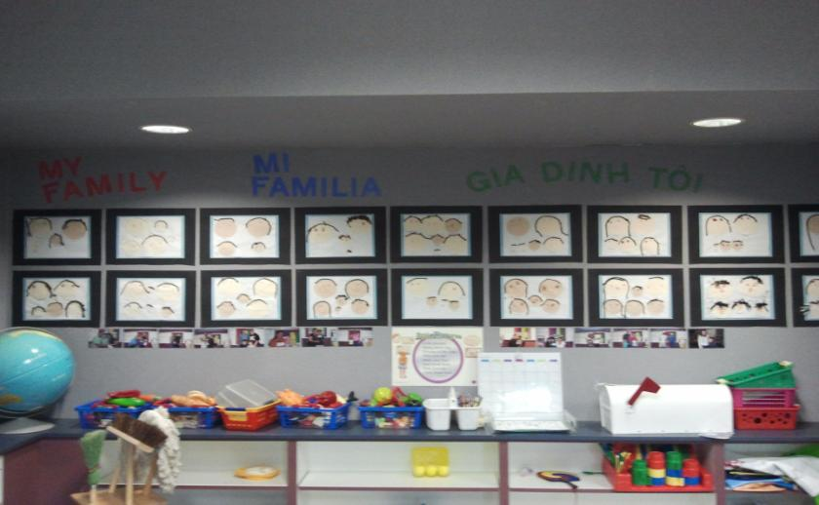
TK Learning Environment
(Provide examples)
Notes:
Ask participants to discuss what they notice about the environment and how the artwork is displayed.
Possible responses:
Display of diverse families and languages
Artwork carefully matted, arranged to showcase students’ artwork
This picture demonstrates the integration of social-emotional/visual art and social studies.

Slide 19

TK Learning Environment
Children learn best in an environment that …
Reflects the diverse cultures represented in the classroom
Is organized, clearly labeled
Incorporates active and quiet work areas
Supports engagement and interactions

Slide 20
TK Learning Environment
Provide adaptive materials to ensure that ALL children can participate successfully
Create an art center that includes a variety of drawing materials and open-ended opportunities for creative expression
Provide indoor and outdoor spaces and materials for interactive musical experiences, dance, and theater
Provide props and a variety of materials (that rotate over time) to promote exploration of visual arts, music, theatre, and dance
Notes:
The environment conveys the message that this is a place where adults have thought about the quality and the instructive power of space. The layout of the physical space is welcoming and fosters encounters, communication, and relationships. The arrangement of structures, objects, and activities encourages choices, problem solving, and discoveries in the process of learning.
(L. Gandini Curtis & Carter, 2003) (adapted from EISS©: Early Intervention for School Success Handbook, 2012)

Slide 21
Alignment between Preschool Learning Foundations and Kindergarten Standards
Notes:
Let’s look at the continuum of a specific sub strand on creation, invention, and expression through drama. This graph demonstrates where a child’s skills may lie at 48 months, then 60 months and by the end of kindergarten. Provide additional information for participants and provide time for discussion as time permits.
Share an example of an activity that reflects the continuum of development:
For students with emerging skills, the child may dress-up, collect and/or make props, choose a role, actively participate in dramatizing the story
As students progress, they may participate in the development of the play, retells the story and performs in front of others

Slide 22
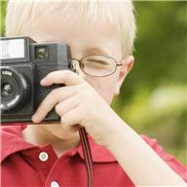
Assessment Approaches
Using Multiple Measures
Observation/anecdotal notes
Video/audio recording
Photographs
Checklist of skills
Notes:
Video and audio recording could be done in the classroom to assess a child’s participation in the arts.
Ask participants for additional ideas.

Slide 23
Differentiating Instruction
Differentiating instruction for all learners may include:
Providing a wide range of materials, adapted materials as needed for students with special needs
Introducing a variety of roles/responsibilities to encourage students to engage at all levels
Providing multiple opportunities for students to engage in the arts through both verbal and non-verbal interactions
Focusing on the process (rather than the product) by providing ample time needed to explore and create
Notes:
Here are some strategies for differentiating your instruction so all children can participate.

Slide 24
Strategies for English Learners
Some strategies to support English learners:
Read “The Three Bears” in English and in another language. Use an expressive voice while reading aloud and re-read the story multiple times
Send the book home in the child’s first language and ask the parents to read the book at home
Introduce key vocabulary words and concepts
Provide visual supports and realia to pre-teach vocabulary
Provide a safe haven for students who choose to observe
Notes:
Visual supports i.e., realia, gestures, facial expressions

Slide 25
Strategies for Children with Disabilities
Guiding Questions to Support Access for All Children:
Can a child navigate the classroom environment with minimal teacher assistance?
Is there a defined space for large-group activities identified by a large carpet or carpet squares?
Are there a variety of props and costumes that are easily accessible, and materials to actively engage students?
Is the art area stocked with a variety of adapted scissors, pencil and paintbrush grips, and colored tape?
(Sadao and Robinson, 2010, Assistive Technology with Young Children)
Notes:
Let’s take a look at some strategies to support students with special needs. These strategies are good for ALL students
Link to http://www.scoe.net/SEEDS/resources/at/atToolkit.html for adaptation ideas

Slide 26
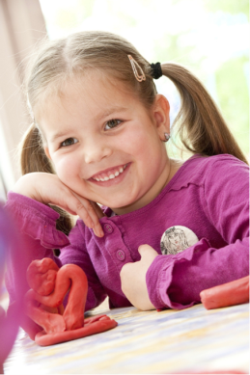
Let’s Practice
Review Visual and Performing Arts
2.0 - Develop Skills in Visual Art
When introducing a lesson focusing on visual art, how would you differentiate and adapt materials for all the learners in your classroom. Consider strategies to support English learners and children with special needs.
Notes:
Handout: Alignment Document, pp 102 – 103
Ask participants to break into small groups to discuss and identify differentiated strategies to support ALL children.
Allow 15 minutes for small group discussion and 5 minutes for sharing out with whole group.

Slide 27
Resources
TK Online Resources
The Alignment of the California Preschool Learning Foundations with Key Early Education Resources | http://www.cde.ca.gov/sp/cd/re/documents/psalignment.pdf
California County Superintendents Educational Service Association (CCSESA) Information and resources for early education are posted on the CCSESA Web site under School Readiness Transitional Kindergarten (TK) Planning Guide – A Resource for Administrators of California Public School Districts | http://www.ccsesa.org/index/sp_prek.cfm http://www.ccsesa.org/index/documents/TransitionalKindergartenGuide-webversion.pdf
California Department of Education (CDE) Kindergarten in California Transitional Kindergarten FAQs Transitional Kindergarten Implementation Guide | http://www.cde.ca.gov/ci/gs/em/
California Kindergarten Association An association to support kindergarten teachers | http://www.californiakindergartenassociation.org/transitional-kindergarten/
California Preschool Instructional Network (CPIN) CPIN, funded by CDE, conducts professional development on CDE publications such as the Preschool Learning Foundations, Preschool Curriculum Framework and Preschool English Learners Guide | http://www.cpin.us
Changing the Kindergarten Cutoff Date: Effects on California Students and Schools Cannon, J. S. and Lipscomb, S. | www.ppic.org/content/pubs/op/OP_508JCOP.pdf

Slide 28
Resources
TK Online Resources
National Association for the Education of Young Children Resources to promote Developmentally Appropriate Practice (DAP) | www.naeyc.org/DAP
Preschool Curriculum Framework, Volume 1, 2, and 3 Aligned with the foundations, the curriculum framework provides guidance on planning learning environments and experiences for young children | http://www.cde.ca.gov/sp/cd/re/documents/psframeworkkvol1.pdf http://www.cde.ca.gov/sp/cd/re/documents/psframeworkvol2.pdf http://www.cde.ca.gov/sp/cd/re/documents/preschoolframeworkvol3.pdf
Preschool English Learners: Principles and Practices to Promote Language, Literacy, and Learning A resource guide to educate preschool English learners | http://www.cde.ca.gov/sp/cd/re/documents/psenglearnersed2.pdf
Preschool Learning Foundations, Volume 1, 2, and 3 The foundations for preschool-age children identify key domains of learning and guide instructional practice | http://www.cde.ca.gov/sp/cd/re/documents/preschoollf.pdf http://www.cde.ca.gov/sp/cd/re/documents/psfoundationsvol2.pdf http://www.cde.ca.gov/sp/cd/re/documents/preschoolfoundationsvol3.pdf
Transitional Kindergarten (TK) California Online resources to support the successful implementation of transitional kindergarten | http://www.tkcalifornia.org/

Slide 29
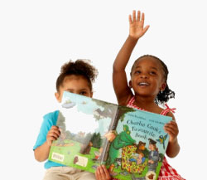
Questions?

Slide 30
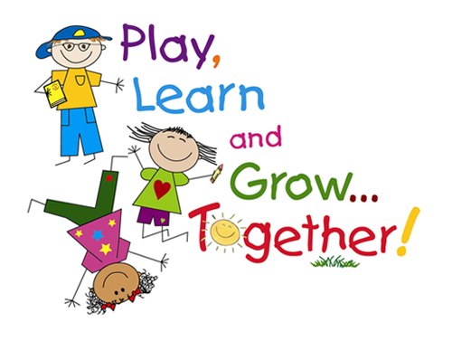
Thank You

