Slide 1
Physical Education and Health
In a Transitional Kindergarten (TK) Classroom
Notes:
Approximate Duration: 3 Hours
Target Audience: Primarily TK Teachers

Slide 2
Acknowledgements
The following county offices of education developed the TK professional development modules:
With contributions from:
Fresno County Office of Education
Merced County Office of Education
CCSESA’s CISC School Readiness Subcommittee
Contra Costa County Office of Education
Humboldt County Office of Education
Orange County Department of Education
Sacramento County Office of Education
Santa Clara County Office of Education
Shasta County Office of Education
Coordinated by:
Sacramento County Office of Education
Funding provided by:
Notes:
2
Several county offices of education contributed to the development of the TK professional development modules… either by developing the content and/or by conducting a pilot session with school district teachers and administrators.
This project was coordinated by the Sacramento County Office of Education through funding from the David and Lucile Packard Foundation.

Slide 3
WELCOME
Notes:
The information in this presentation is based on:
The Alignment of the California Preschool Learning Foundations and Key Early Education Resources
California Preschool Learning Foundations, Volume 2
Current Research

Slide 4
Norms
Start and end on time
Silence cell phones
Listen to and contribute thoughts and ideas
Notes:
In order for the group to accomplish our goals today, we ask for your full attention and participation.

Slide 5
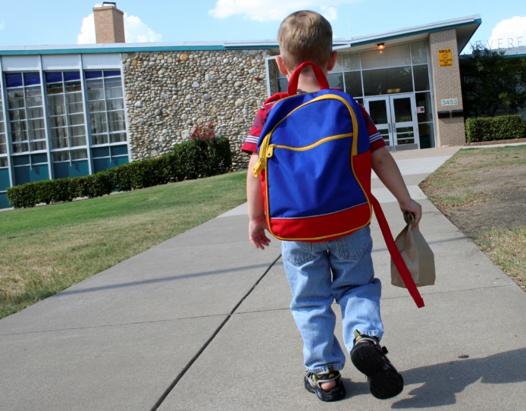
Warm-Up Activity
Think back to your early memories of attending kindergarten
Talk to your neighbor, what do you remember about your experience in terms of play and physical activity. What stood out in your memories of your kindergarten experience?

Slide 6
Background
California was one of just four states (along with Connecticut, Michigan, and Vermont) with a cut-off date later than December 1. In most states, children must turn five by September 1 in order to start kindergarten
Research indicates that beginning kindergarten at an older age improves children’s social and academic development

Slide 7
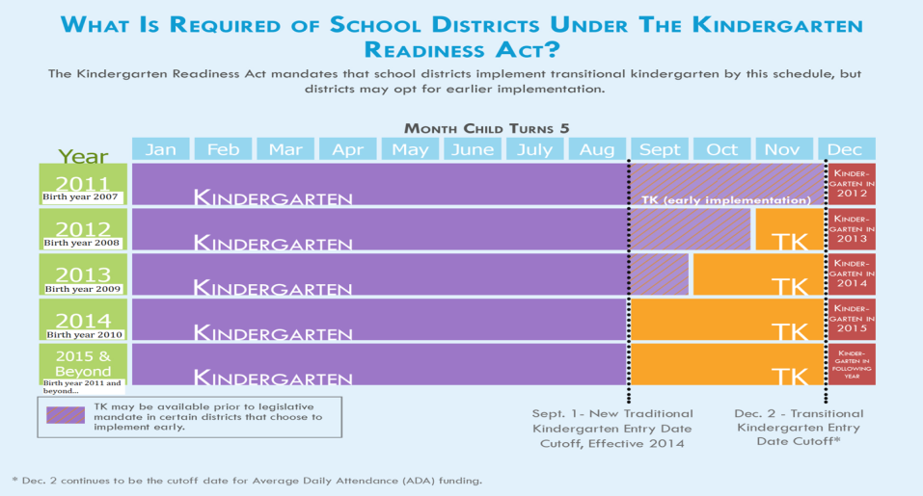
Senate Bill 1381 (Simitian) The Kindergarten Readiness Act of 2010
Source: Early Edge California
Notes:
Senate Bill 1381 provides flexibility for districts in implementing TK that best meet the needs of students.
It is important to note, that all kindergarten regulations apply to TK. Children are not mandated to attend TK as the existing statute does not require parents to enroll children in kindergarten.
Children are not mandated to attend, but district must offer TK for birthdays between September 2 and December 2 ([Education Code Section 48000]; CCSESA, 2011).
In 2012-13, school districts began to offer a TK program for children whose fifth birthdates fall from November 2 through December 2.
The date will continue moving back one month over each subsequent year so that by 2014-15 and, each year thereafter, children who are five on or before September 1 are eligible for kindergarten.
The law also requires school districts to develop a transitional kindergarten program, for children who will no longer be age eligible for kindergarten.
Transitional kindergarten is the first year of a two-year program that provides a “modified kindergarten curriculum that is age and developmentally appropriate” (Education Code section 48000).

Slide 8
Developmentally Appropriate Practice
Developmentally Appropriate Practice
“…involves teachers meeting young children where they are (by stage of development), both as individuals and as part of a group; and helping each child meet challenging and achievable learning goals”
Knowing about child development and learning
Knowing what is individually appropriate
Knowing what is culturally important
National Association for the Education of Young Children (www.naeyc.org/DAP)
Notes:
As districts work to provide the “modified kindergarten curriculum that is age and developmentally appropriate ”we need to clarify our definition of “developmentally appropriate”.
Developmentally appropriate practice, often shortened to DAP, is an approach to grounded teaching both in the research on how young children develop and learn and in what is known about effective early education. Its framework is designed to promote young children’s optimal learning and development. For more information, visit the National Association for the Education of Young Children website: www.naeyc.org/DAP
www.naeyc.org/dap/3-core-considerations
3 Core Considerations of DAP
Knowing about child development and learning – Knowing what is typical at each age and stage of early development is crucial. This knowledge, based on research, helps us decide which experiences are best for children’s learning and development.
Knowing what is individually appropriate – What we learn about specific children help us teach and care for each child as an individual. By continually observing children’s play and interaction with the physical environment and others, we learn about each child’s interests, abilities and developmental progress.
Knowing what is culturally important – We must make an effort to get to know the children’s families and learn about the values, expectations, and factors that shape their lives at home and in their communities. The background information helps us provide meaningful, relevant, and respectful learning experiences for each child and family.
8

Slide 9
Developmentally Appropriate Practice
Principles of Child Development and Learning – Developmentally Appropriate Practice in Early Childhood Programs Serving Children from Birth through Age 8
Copple, C., & Bredekamp. S., (Eds.). (2009). Developmentally Appropriate Practice in Early Childhood Programs Serving Children from Birth Through Age 8. 3rd ed. Washington, DC: National Association for the Education of Young Children, (pp. 10-15).
Notes:
The NAEYC has published a valuable resource that can be utilized to support the implementation of developmentally appropriate TK programs.
Have participants read the principles and select one that resonates with you. Be ready to quickly share why you selected it. Depending on time available and group dynamics, participants might share in pairs, small groups, or as a whole group.
If time permits, additional pair, small group, or whole group discussion might focus on sharing current practices that exemplify or are connected to selected principles.
Review the handout “Developmentally Appropriate Practice in Early Childhood Programs Serving Children B-age 8”. Review this document with the group.

Slide 10
Universal Design for Learning
Provide Multiple Means of Representation
Perception
Language expressions and symbols
Comprehension
Provide Multiple Means of Action and Expression
Physical action
Expression and communication
Executive function
Provide Multiple Means of Engagement
Recruiting interest
Sustaining effort and persistence
Self-regulation
http://www.udlcenter.org/aboutudl/udlguidelines
Notes:
http://www.udlcenter.org/aboutudl/udlguidelines
The goal of education in the 21st century is the mastery of the learning process–novice learners become expert learners who want to learn, know how to learn strategically, and who, in their own highly individual and flexible ways, are prepared for a lifetime of learning.
Universal Design for Learning (UDL) is access to all aspects of learning for all students. Through careful planning for modifying their curriculum, instruction, grouping, and assessment techniques, teachers can be well prepared to adapt to the diversity in their classrooms.

Slide 11
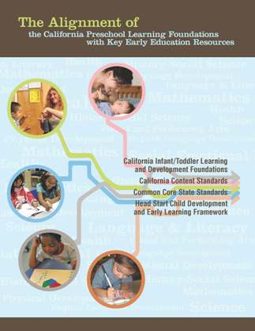
The Alignment of the California Preschool Learning Foundations with Key Early Education Resources
All domains of the Preschool Learning Foundations correspond to the California Kindergarten Content Standards
Preschool Learning Foundations Language and Literacy domain aligns with the California Common Core State Standards (CCSS) for English Language Arts
Preschool Learning Foundations Mathematics
domain aligns with the California Common Core
State Standards for Mathematics
Notes:
Alignment Document includes key early education resources:
CA Infant/Toddler Learning and Development Foundations • CA Content Standards • Common Core State Standards • Head Start Child Development Early Learning Framework
Optional:
Provide copies of the CA Preschool Learning Foundations, and the Common Core State Standards for each table; give each participant a copy of the Alignment Document.
Highlight (if needed, browse through the document with participants):
The Preschool Learning Foundations are a critical step in the California Department of Education’s efforts to strengthen preschool education and school readiness and to close the achievement gap in California. The Foundations cover the following domains:
Social-Emotional Development
Language and Literacy
English-Language Development (for English learners)
Mathematics
Visual and Performing Arts
Physical Development
History-Social Science
Science
Together, these domains represent crucial areas of learning and development for young children.
Competencies are included as foundations for children “at around 48 months of age” and “at around 60 months of age.”
Source: Expanding Access to High Quality Preschool Programs, 2003 California School Boards Association
11

Slide 12
Overview of Alignment
California Preschool Learning Foundations | California Kindergarten Content Standards | Common Core State Standards
Social-Emotional Development | Health, Education Mental, Emotional, and Social Health
Language and Literacy | English-Language Arts | English-Language Arts
English-Language Development | English-Language Development
Mathematics | Mathematics | Mathematics
Visual and Performing Arts | Visual and Performing Arts
Physical Development | Physical Education
Health | Health Education
History-Social Science | History-Social Science
Science | Science
Source: The Alignment of the California Preschool Learning Foundations with Key Early Education Resources, CDE, 2012.
Notes:
This table represents an overview of the alignment among the nine domains of the Preschool Learning Foundations have with the content of the CA Kindergarten Content Standards and the Common Core State Standards (CCSS).
The alignment demonstrates that early learning is a significant part of the educational system and that the knowledge and skills of young children are foundational to future learning.
Understanding the links between the different ages and different early childhood services allows educators to build on children’s earlier learning and prepare them for the next educational challenge.
Visual and Performing Arts, Physical Development, Health, History-Social Science, and Science are all separate domains in the Preschool Learning Foundations. The Common Core includes English Language Arts & Literacy in History/Social Studies, Science, and Technical Subjects.
12

Slide 13
Overview of Physical Development
Source: The Alignment of the California Preschool Learning Foundations with Key Early Education Resources, CDE, 2012
Notes:
The foundations are organized in three strands: fundamental movement skills, perceptual-motor skills and movement concepts, and active physical play (CDE, 2012, Alignment Document, p. 116).
The standards cover a broad range of concepts and skills organized by categories such as movement concepts, body management, locomotor movement, manipulative skills, rhythmic skills, fitness concepts, and aerobic capacity. Table 1.14 shows the alignment between strands and substrands in the domain of Physical Development with key content standards for kindergarten in physical education (CDE, 2012, Alignment Document, p. 117)

Slide 14
Overview of Physical Development
Source: The Alignment of the California Preschool Learning Foundations with Key Early Education Resources, CDE, 2012

Slide 15
Key Concepts In the Physical Development Domain
Fundamental Movement Skills
Perceptual-Motor Skills
Active Physical Play
Notes:
As Table 1.14 indicates, for every strand and substrand in the preschool learning foundations in Physical Development, there are kindergarten content standards that reflect the content of those preschool foundations (CDE, 2012, Alignment Document, p. 117).
The strands fundamental movement skills and perceptual-motor skills and movement concepts are aligned with the kindergarten physical education standards focusing on skills and knowledge of movement. The strand active physical play is aligned with the kindergarten standards focusing on skills and knowledge of physical fitness (CDE, 2012, Alignment Document, p. 117).

Slide 16
Overview of Health
Source: The Alignment of the California Preschool Learning Foundations with Key Early Education Resources, CDE, 2012
Notes:
The preschool foundations in Health describe developmentally appropriate health concepts, skills, and behaviors young children master during the preschool period. The foundations in this domain are organized in three strands: health habits, safety, and nutrition (CDE, 2012, Alignment Document, p. 129).
The kindergarten standards in health education cover a broader range of content areas, and include more aspects of health concepts, behaviors, and skills (CDE, 2012, Alignment Document, p. 129).
Table 1.16 shows the alignment of the kindergarten strands in health education with the strands in the preschool foundations (CDE, 2012, Alignment Document, p. 130).

Slide 17
Overview of Health
Source: The Alignment of the California Preschool Learning Foundations with Key Early Education Resources, CDE, 2012

Slide 18
Key Concepts of the Health Domain
Health Habits
Safety
Nutrition
Notes:
The first preschool strand, health habits, is aligned with two of the kindergarten strands (personal and community health and growth and development). The preschool strand, safety, is aligned with the kindergarten strand injury prevention and safety, and nutrition is aligned with the kindergarten strand nutrition and physical activity (CDE, 2012, Alignment Document, p. 130).

Slide 19
Integration of Physical Development
Incorporate fundamental movement skills of characters during storybook reading ( i.e., balancing, hopping on two feet or one, squatting arm swinging)
During math time use manipulatives for counting to promote active movement (i.e., bean bag toss, foam balls into bucket, block play, count the number of steps to the door).
Use body mechanics when learning letters and shapes (i.e., “Can your arms make an O?”)
Develop directional concepts through physical activities (i.e., behind, inside, over, under, higher than, lower than).
Notes:
There are many ways to incorporate physical development into the TK curriculum. Young children learn through kinesthetic, hands-on activities and physical activity is important for their development. Here are some examples of how you can integrate physical development in this slide.

Slide 20
Integration of Health
Read books about nutrition
“Growing Vegetable Soup” by Lois Ehlert
“The Giant Carrot” by Jan Peck and Barry Root
“Delicious: A Pumpkin Soup Story” by Helen Cooper
Read books about health & physical activity
“Hop, Skip and Jump” by Fiona Watt
“The Busy Body Book” by Lizzy Rockwell
“Wash Your Hands!” by Tony Ross
“Germs Make Me Sick!” by Melvin Berger
Read books about life cycles and growing
“Inch by Inch The Garden Song” by David Mallett
“A Handful of Dirt” by Raymond Bial
Notes:
One of the significant ways you can teach a transitional kindergartner about health is through story time. Here is an example of some stories that focus on Nutrition, Physical Activity, Health, and Life Cycles.

Slide 21
Very Hungry Caterpillar Activity
Make two red caterpillar faces
Cut a mouth in two green caterpillar socks
Trace, color, and cut caterpillar food on white fabric
Shared writing and dramatization with caterpillar puppets
Notes:
Read The Very Hungry Caterpillar Story and have a partner help to tell story with
flannel apron/board.
Discuss what happens when we eat foods that are unhealthy.
Discuss what happens with our bodies when we eat healthy foods?
What are some healthy foods we enjoy eating?
Refer to Very Hungry Caterpillar handout for activity.

Slide 22
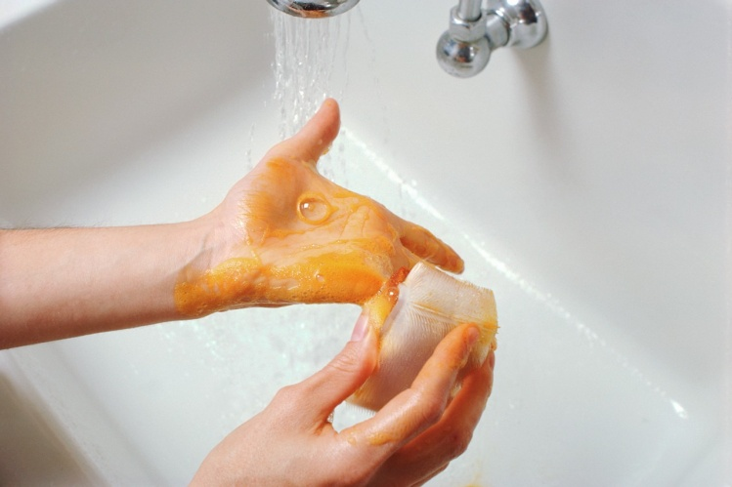
Integration of Health
Incorporate math into health activities
Count in a variety of ways through songs and chants
Health can be woven throughout science curriculum
Study germs by observing a whole apple and a peeled apple over the course of 5 days while the peeled apple decays
Set up smelling, tasting, and touch stations to explore healthy foods
Grow fruits and vegetables in a garden or individual planters
Plan activities related to the sun and incorporate sun safety
Take walks to explore weather conditions and ways to promote healthy practices and well-being.
Notes:
Health concepts naturally fit into the curriculum as four-year-old children are still very ego-centric, they are learning about their bodies, their emotions, and their world around them. Health naturally integrates with Science but can fit into all aspects of the curriculum.

Slide 23
Hand Washing Activities
“Wash, Wash, Wash Your Hands” (sing to the tune of Row Your Boat”)
Wash, Wash, Wash your hands
wash them nice and clean
scrub them here (together)
scrub them there (on tops of hands)
and scrub them in-between (between fingers)
Notes:
Have participants sing along and do movements.

Slide 24
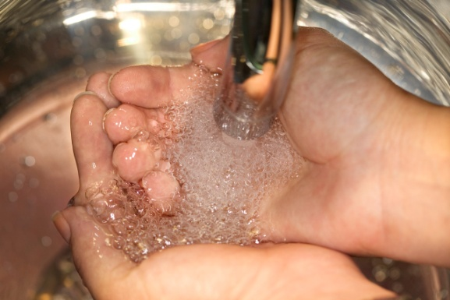
Another Hand Washing Song!
“This is the Way We Wash Our Hands” Tune: Mulberry Bush
This is the way we wash our hands, wash our hands, wash our hands
This is the way we wash our hands… before we eat our food
Variations:
….after we play outside
….after we pet our dog
….after we use the potty
….after we sneeze or cough (have children generate others)
Notes:
Have participants sing along and do movements.

Slide 25
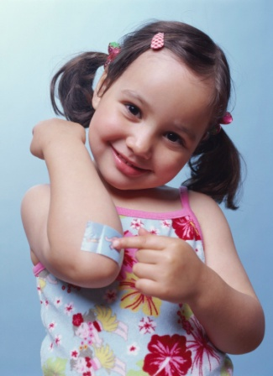
TK Learning Environment
Dramatic Play Area:
Items to promote vocabulary and language
development
Vitamin bottles
Play thermometer/stethoscope
Healthy foods and food containers
Doctor/Nurse dress-up clothes
Bandages
Hard hats/Firefighter hats
Safety signs
Include photographs of children engaged in physical activity and a variety of healthy food choices
Notes:
While not all classrooms will have a specific “Dramatic Play Area”, dramatic play can be woven into English Language Arts, and Social Studies. Role playing is an opportunity to build vocabulary and language skills; it also provides children with an expanded opportunity to explore practices that enhance and maintain their health and well-being.

Slide 26
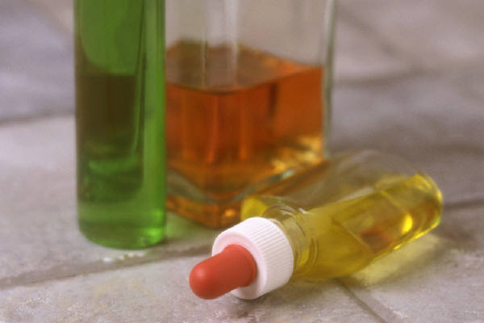
TK Learning Environment
Brainstorm ideas to integrate health into other areas:
Art
Math and Manipulatives
Science and Discovery
Language and Literacy (i.e., writing)
Reading
Notes:
Think of all of the sensory activities that help young children learn and make a cognitive connection.
Ask participants to break into small groups to discuss ideas that promote the integration of health into other learning areas. Groups will share out after the small group brainstorming session.

Slide 27
Alignment between Preschool Learning Foundations and Kindergarten Standards
Domain
Strand
Substrand
The Physical Development Domain consists of the following 3 strands: Fundamental Movement Skills, Perceptual Motor Skills and Movement Concepts, and Active Physical Play
Source: The Alignment of the California Preschool Learning Foundations with Key Early Education Resources, CDE, 2012.
Notes:
The Domain represents crucial areas of learning and development for young children. In this slide it is Physical Development
There are three strands in physical development in the Preschool Learning Foundations:
Fundamental Movement Skills
Perceptual-Motor Skills and Movement Concepts
Active Physical Play (shown on this slide)
Each strand consists of substrands.

Slide 28
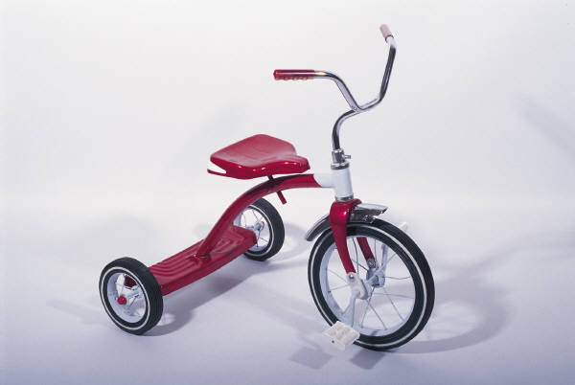
Preschool Learning Foundations
Active Physical Play (Strand)
Active Participation (Substrand)
At or about 48 months of age
Foundation 1.1: Initiate or engage in simple physical activities for short to moderate periods of time
Examples:
Rides tricycle on playground for a period of time alone or with another child who is also riding a tricycle.
During outside play, engages a friend to race to the fence and back.
Communicates to another child, “Want to swing on the swings with me?”
Preschool Learning Foundations, Volume 2, CDE, 2010.
Notes:
Under the Active Participation substrand, you see in this slide that “the foundations describes competencies – knowledge and skills – that most children can be exhibited in a high-quality program as they complete their first year of preschool” CDE, 2010, Preschool Learning Foundations, vol. 2, p. xi)

Slide 29
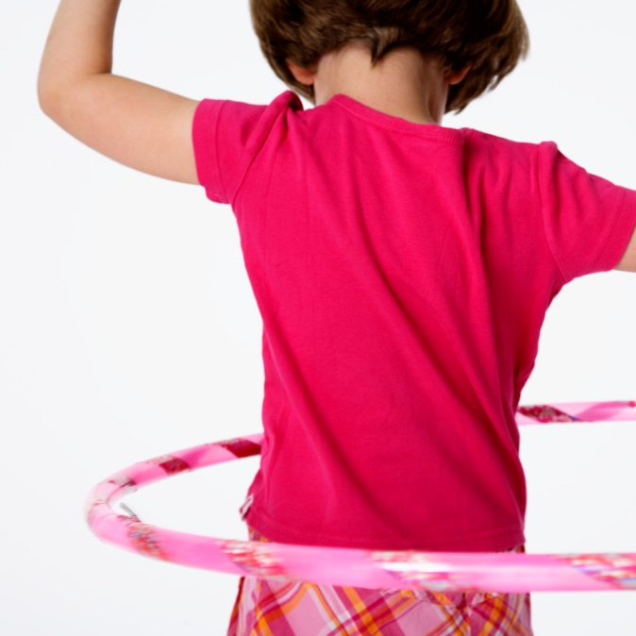
Preschool Learning Foundations
Active Physical Play (Strand)
Active Participation (Substrand)
At or around 60 months of age
Foundation 1.1: Initiate more complex physical activities for a sustained period of time
Examples:
Rides a tricycle for an extended period of time alone or in a made-up game with another child who is also riding a tricycle.
Sits and bounces on a “bouncy ball.”
Rolls a hula hoop or a ball and runs beside it with a friend or alone.
Preschool Learning Foundations, Volume 2, CDE, 2010.
Notes:
In this slide you see in the Preschool Learning Foundations where the child would be typically at about 60 months.

Slide 30
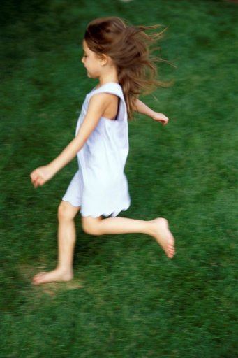
Let’s Begin
Preschool Learning Foundations | Kindergarten Standards
Strand: Active Physical Play | Standard 3: Students assess and maintain a level of physical fitness to improve health and performance.
 | Standard 4: Students demonstrate knowledge of physical fitness concepts, principles, and strategies to improve health and performance. concepts
The Alignment of the California Preschool Learning Foundations with Key Early Education Resources, CDE, 2012
Notes:
Review the handout of Table 1.15 for Cardiovascular Endurance/Aerobic Capacity.

Slide 31
Differentiating Instruction
Example of TK Instructional Strategy
Have children feel their hearts while at rest. Have them run around the playground then stop and feel their hearts beating. Ask what is different, why are their hearts beating faster? Talk about their breathing. Ask if it is slower or faster after running?
Example for Combination TK/K Instructional Strategy
Extend this lesson for kindergarten children in small groups by talking about the location of the heart and lungs. Talk with children about the role of physical activity to increase breathing and heart rate.
Notes:
This slide shows the same example of a lesson for the TK student, but also an additional example of how to extend the lesson for the traditional kindergarten student in a TK combination class.

Slide 32
Assessment Approaches
Using Multiple Measures
Health | Physical Development
Teacher performs daily health checks when greeting children each morning. Teacher asks, “How are you feeling today?” Teacher performs visual scan of child to gauge health status | Teacher observation/movement portfolio of locomotor skills, endurance, and how often the child chooses to engage in moderate to vigorous physical activity
Parent Surveys: Sleeping and eating patterns/habits and oral health status | Child self assessment: Child can draw or tell teacher how they feel after engaging in physical activity
Teacher monitors and records child’s health patterns: illness, alertness, hunger, and accidents | Teacher utilizes growth chart to monitor growth for each child during the school year
Notes:
Health and physical development can be assessed and monitored in many ways. For children with a health care protocol, it may be necessary to include the school nurse for monitoring a child’s health and development.
Teachers will be the primary observer and, in coordination with the parent, can record the progress towards health and physical development of each child.

Slide 33
Strategies for Children with Disabilities
Preschool Learning Foundations Substrand | Kindergarten Standards
Active Physical Play | Standard 3: level of physical fitness
 | Standard 4: knowledge of physical fitness concepts
For children who have limited mobility, it may be necessary to provide physical assistance so they can experience physical activity that will raise their heart rate
For children with a visual impairment, they may require physical guidance
It may be necessary to modify the environment so that there are no obstacles or equipment that would create a danger for children
Notes:
For children with special needs, there may be a variety of individual needs. The Individualized Educational Plan (IEP) team will identify goals and will create a plan to support the individualized needs of children with an IEP (or a 504 plan may also be established when the disability does not fall under IDEA).

Slide 34
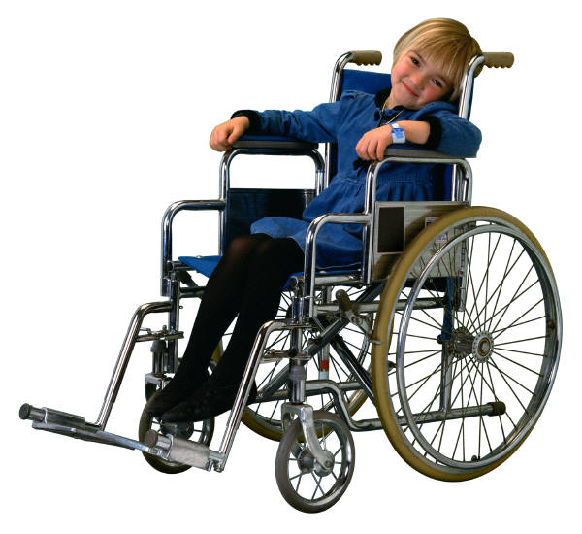
Activity
Consider a child you have worked with that had special needs
Consider strategies that have worked to promote health and physical education
Discuss three things you could do to assist with concepts that relate to health or physical for those particular children

Slide 35
Let’s Practice
Review the preschool substrand for Cardiovascular Endurance and the kindergarten standard for Aerobic Capacity
In small groups of 3-4 develop a TK lesson based on the substrand and kindergarten standard
Prepare to share out in 15 minutes
Notes:
Now we want you to have an opportunity to create a TK lesson that is a bridge between the Preschool Learning Foundations and the Kindergarten Standards.

Slide 36
Resources
TK Online Resources
The Alignment of the California Preschool Learning Foundations with Key Early Education Resources | http://www.cde.ca.gov/sp/cd/re/documents/psalignment.pdf
California County Superintendents Educational Service Association (CCSESA) Information and resources for early education are posted on the CCSESA Web site under School Readiness Transitional Kindergarten (TK) Planning Guide – A Resource for Administrators of California Public School Districts | http://www.ccsesa.org/index/sp_prek.cfm http://www.ccsesa.org/index/documents/TransitionalKindergartenGuide-webversion.pdf
California Department of Education (CDE) Kindergarten in California Transitional Kindergarten FAQs Transitional Kindergarten Implementation Guide | http://www.cde.ca.gov/ci/gs/em/
California Kindergarten Association An association to support kindergarten teachers | http://www.californiakindergartenassociation.org/transitional-kindergarten/
California Preschool Instructional Network (CPIN) CPIN, funded by CDE, conducts professional development on CDE publications such as the Preschool Learning Foundations, Preschool Curriculum Framework and Preschool English Learners Guide | http://www.cpin.us
Changing the Kindergarten Cutoff Date: Effects on California Students and Schools Cannon, J. S. and Lipscomb, S. | www.ppic.org/content/pubs/op/OP_508JCOP.pdf

Slide 37
Resources
TK Online Resources
National Association for the Education of Young Children Resources to promote Developmentally Appropriate Practice (DAP) | www.naeyc.org/DAP
Preschool Curriculum Framework, Volume 1, 2, and 3 Aligned with the foundations, the curriculum framework provides guidance on planning learning environments and experiences for young children | http://www.cde.ca.gov/sp/cd/re/documents/psframeworkkvol1.pdf http://www.cde.ca.gov/sp/cd/re/documents/psframeworkvol2.pdf http://www.cde.ca.gov/sp/cd/re/documents/preschoolframeworkvol3.pdf
Preschool English Learners: Principles and Practices to Promote Language, Literacy, and Learning A resource guide to educate preschool English learners | http://www.cde.ca.gov/sp/cd/re/documents/psenglearnersed2.pdf
Preschool Learning Foundations, Volume 1, 2, and 3 The foundations for preschool-age children identify key domains of learning and guide instructional practice | http://www.cde.ca.gov/sp/cd/re/documents/preschoollf.pdf http://www.cde.ca.gov/sp/cd/re/documents/psfoundationsvol2.pdf http://www.cde.ca.gov/sp/cd/re/documents/preschoolfoundationsvol3.pdf
Transitional Kindergarten (TK) California Online resources to support the successful implementation of transitional kindergarten | http://www.tkcalifornia.org/

Slide 38
Resources
TK Online Resources
Kids Health Teaching resources | www.kidshealth.org
PBS Learning Media Health and Physical Education teaching resources | www.pbslearningmedia.org
Youth Physical Activity Lesson Plans University of Arizona | http://cals.arizona.edu/pubs/health/az1408/
SPARK Teacher resources and lesson plans | www.sparked.org
Whole Kids Foundation – Better Bites: More Nutrition in Every Bite Teacher Resources | www.wholekidsfoundation.org
Healthy and Active Preschoolers | www.healthypreschoolers.com
Head Start Body Start | www.aahperd.org/headstartbodystart/
Harvest of the Month | http://www.harvestofthemonth.cdph.ca.gov/download.asp
I Am Moving, I Am Learning | www.choosykids.com
Kids Health in the Classroom | http://classroom.kidshealth.org/
Notes:
Here are some specific resources for teachers such as lesson plans that are focused on Health and Physical Education.

Slide 39
Questions?

