Slide 1
Mathematics
In a Transitional Kindergarten (TK) Classroom
Notes:
Approximate duration of the presentation: 2 1/2 hours
Targeted audience: Primarily TK teachers
Discover who is in the room by facilitating the activity “LIKE ME”
Instructions: When I state information that is true for you, please stand and say “Like Me.”
For example, I live in the state of CA (all would stand and say “like me.”)
I am teaching a TK class this year.
I am an administrator, supporting TK teachers and classrooms.
I am a college instructor or other stakeholder interested in TK.
My TK class is an TK/K combination.
My TK class has children with special needs.
My TK class supports English Learners.
I am here to understand how to better support TK students in their learning. (All should stand on this one.)
-----------------------
The information in this presentation is based on the
The Alignment of the California Preschool Learning Foundations and Key Early Education Resources,
California Preschool Learning Foundations, Volume 1.

Slide 2

Acknowledgements
The following county offices of
education developed the TK
professional development modules:
With contributions from:
Fresno County Office of Education
Merced County Office of Education
CCSESA’s CISC School Readiness Subcommittee
Contra Costa County Office of Education
Humboldt County Office of Education
Orange County Department of Education
Sacramento County Office of Education
Santa Clara County Office of Education
Shasta County Office of Education
Coordinated by:
Sacramento County Office of Education
Funding provided by:
Notes:
2
Several county offices of education contributed to the development of the TK professional development modules… either by developing the content and/or by conducting a pilot session with school district teachers and administrators.
This project was coordinated by the Sacramento County Office of Education through funding from the David and Lucile Packard Foundation.

Slide 3
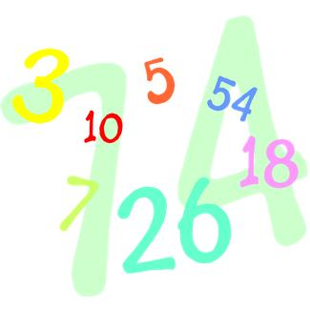
WELCOME
Mathematics IN A TRANSITIONAL KINDERGARTEN (TK) CLASSROOM
Notes:
Early Predictors of High School Mathematics Achievement
Authors: Robert S. Siegler1, Greg J. Duncan2, Pamela E. Davis-Kean3, Kathryn Duckworth4,
Amy Claessens5, Mimi Engel6, Maria Ines Susperreguy3, and Meichu Chen3
http://www.psy.cmu.edu/~siegler/Siegler-etal-inpressPsySci.pdf
Knowledge of mathematics is crucial to educational and financial success in contemporary society and is becoming ever more so. *High school students’ mathematics achievement predicts college matriculation and graduation, early-career earnings, and earnings growth (Murname, Willett, & Levy, 1995; National Mathematics Advisory Panel (NMAP),
2008).
The strength of these relations appears to have increased in recent decades, probably due to a growing percentage of well-paying jobs requiring considerable mathematical proficiency (Murname, et al.,1995). However, many students lack even the basic mathematics competence needed to succeed in typical jobs in a modern economy. Children from low-income and minority backgrounds are particularly at risk for poor mathematics achievement (Hanushek & Rivkin,
2006). Marked individual and social class differences in mathematical knowledge are present even in preschool and kindergarten (Case & Okamoto, 1996; Starkey, Klein, & Wakeley, 2004) These differences are stable at least from kindergarten through fifth grade; children who start ahead in mathematics generally stay ahead, and children who start behind generally stay behind. (Duncan et al., 2007; Stevenson & Newman, 1986). Substantial correlations between early and later knowledge are also present in other academic subjects, but differences among children in mathematics knowledge are even more stable than in reading and other areas (Case, Griffin, & Kelly, 1999; Duncan, et al., 2007).

Slide 4
Session Outcomes
Examine the alignment between the Preschool Learning Foundations and the kindergarten California Kindergarten Common Core Standards for Mathematics
Identify strategies for transitional kindergarten (TK) to support a modified kindergarten curriculum that is age and developmentally appropriate

Slide 5

Norms
Start and end on time
Silence cell phones
Listen to and contribute thoughts and ideas
Notes:
Revise as needed for audience.

Slide 6
Background on
Transitional Kindergarten
California was one of just four states (along with Connecticut, Michigan, and Vermont) with a cut-off date later than December 1. In most states, children must turn five by September 1 in order to start kindergarten
Research indicates that beginning kindergarten at an older age improves children’s social and academic development
(Cannon, J.S. & Lipscomb, S., 2008)

Slide 7
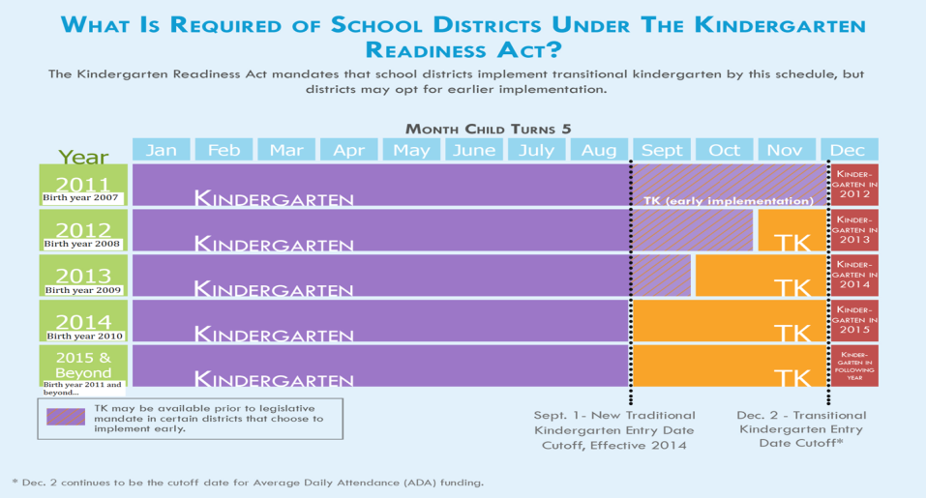
Senate Bill 1381 (Simitian)
The Kindergarten Readiness Act of 2010
The bill changes the required birthday for admission to kindergarten:
December 2 of the 2011-12 school year
November 1 of the 2012-13 school year
October 1 of the 2013-14 school year
September 1 of the 2014-15 school year
and each year thereafter
Source: Early Edge California
Notes:
Senate Bill 1381 provides flexibility for districts in implementing TK that best meet the needs of students.
It is important to note, that all kindergarten regulations apply to TK. Children are not mandated to attend TK as the existing statute does not require parents to enroll children in kindergarten.
Children are not mandated to attend, but district must offer TK for birthdays between September 2 and December 2 ([Education Code Section 48000]; CCSESA, 2011).
In 2012-13, school districts began to offer a TK program for children whose fifth birthdates fall from November 2 through December 2.
The date will continue moving back one month over each subsequent year so that by 2014-15 and, each year thereafter, children who are five on or before September 1 are eligible for kindergarten.
The law also requires school districts to develop a transitional kindergarten program, for children who will no longer be age eligible for kindergarten.
Transitional kindergarten is the first year of a two-year program that provides a “modified kindergarten curriculum that is age and developmentally appropriate” (Education Code section 48000).

Slide 8
Principles of
Child Development and Learning Developmentally Appropriate Practice
All the domains of development and learning are interrelated
Learning follows a sequence and builds on previously acquired skills
Early experiences impact development
Social and cultural contexts influence learning
Secure, consistent relationships are critical to healthy development
Copple, C., & S. Bredekamp. (Eds.). (2009). Developmentally Appropriate Practice in Early Childhood Programs Serving Children from Birth Through Age 8. 3d ed. Washington, DC: National Association for the Education of Young Children p. 10-15.
Notes:
Early childhood, birth to eight years, is a time of remarkable physical, cognitive, social and emotional development.
Neuroscientists have found early experiences – particularly from birth to age five – shape brains in developing a strong foundation for thinking and learning, regulating emotions and behavior.
Best practice is based on the knowledge of how children learn and develop (12 Principles of Child Development and Learning that Inform Practice).
Developmentally appropriate practice ensures that goals and experiences are suited to children’s learning and development and challenging enough to promote their progress and interest.
OPTIONAL ACTIVITY:
Review the document “Developmentally Appropriate Practice in Early Childhood Programs Serving Children B-age 8” pages 10-15. As you read, select one principle that resonates with you and why? What do you do currently in your program to ensure this principle is followed or what do you plan to do when you start teaching TK?

Slide 9
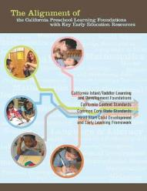
The Alignment of the California
Preschool Learning Foundations with Key Early Education Resources
All domains of the Preschool Learning Foundations correspond to the California Kindergarten Content Standards
Preschool Learning Foundations Language and Literacy domain aligns with the California Common Core State Standards (CCSS) for English Language Arts
Preschool Learning Foundations Mathematics
domain aligns with the California Common
Core State Standards for Mathematics
Notes:
Alignment Document includes key early education resources:
CA Infant/Toddler Learning and Development Foundations
CA Content Standards
Common Core State Standards
Head Start Child Development Early Learning Framework
Optional:
Provide copies of the CA Preschool Learning Foundations, and the Common Core State Standards for each table; give each participant a copy of the Alignment Document.
Highlight (if needed, browse through the document with participants):
The Preschool Learning Foundations are a critical step in the California Department of Education’s efforts to strengthen preschool education and school readiness and to close the achievement gap in California. The Foundations cover the following domains:
Social-Emotional Development
Language and Literacy
English-Language Development (for English learners)
Mathematics
Visual and Performing Arts
Physical Development
History-Social Science
Science
Together, these domains represent crucial areas of learning and development for young children.
Competencies are included as foundations for children“ at around 48 months of age” and “at around 60 months of age.”
Source: Expanding Access to High Quality Preschool Programs, 2003 California School Boards Association

Slide 10

Overview of Alignment
California Preschool Learning Foundations | California Kindergarten Content Standards | Common Core State Standards
Social-Emotional Development | Health, Education Mental, Emotional, and Social Health
Language and Literacy | English-Language Arts | English-Language Arts
English-Language Development | English-Language Development
Mathematics | Mathematics | Mathematics
Visual and Performing Arts | Visual and Performing Arts
Physical Development | Physical Education
Health | Health Education
History-Social Science | History-Social Science
Science | Science
Source: The Alignment of the California Preschool Learning Foundations with Key Early Education Resources, CDE, 2012.
Notes:
This table represents an overview of the alignment among the nine domains of the Preschool Learning Foundations with the content of the CA Kindergarten Content Standards and the Common Core State Standards (CCSS).
The alignment demonstrates that early learning is a significant part of the educational system and that the knowledge and skills of young children are foundational to future learning.
Understanding the links between the different ages and different early childhood services allows educators to build on children’s earlier learning and prepare them for the next educational challenge.
Visual and Performing Arts, Physical Development, Health, History-Social Science, and Science are all separate domains in the Preschool Learning Foundations. The Common Core includes English Language Arts & Literacy in History/Social Studies, Science, and Technical Subjects.
10

Slide 11
Overview of Mathematics
California
Source: The Alignment of the California Preschool Learning Foundations with Key Early Education Resources, CDE, 2012.
Notes:
Explain this Table; share its location in the Alignment Document.
The Preschool Learning Foundations and the CCSS in Mathematics cover the same key areas of learning.
(Principle, #2)
“Many aspects of children’s learning and development follow well-documented sequences, with later abilities, skills, and knowledge building on those already acquired. “
For every sub strand of the Preschool Learning Foundations, there is a category in the CCSS with corresponding content.
This Table shows the alignment between strands and sub strands in the preschool foundations and the content categories in the CCSS for Mathematics.
Show how the Foundations and CCSS are aligned, indicating a continuum of learning:
The sub strands under Number Sense-understanding numbers and quantities and understanding number relationships and operations-correspond directly to the CCSS in the categories Counting and Cardinality and Operations and Algebraic Thinking, respectively.
Content in Number and Operations in Base Ten of the CCSS is too advanced for there to be corresponding content in the Preschool Learning Foundations.
The preschool sub strand addressing Sorting and Classifying Objects aligns with the CCSS of Classify Objects and Count the Number of Objects in Each Category.
Preschool sub strand 2.0 on Patterning has no corresponding content in the CCSS; there is, however, a connection to Math Practice Standard #7: Look For and Make Use of Structure.

Slide 12
Overview of Mathematics
Source: The Alignment of the California Preschool Learning Foundations with Key Early Education Resources, CDE, 2012.
Notes:
Using the Alignment Document, continue to ask participants to dialogue at their tables with an “Elbow Partner” about how the Preschool Learning Foundations and CCSS are aligned (a continuum of learning).
The preschool strand for Measurement, comparing, ordering, and measuring objects, is aligned with the kindergarten CCSS for Measurement and Data - Describe and compare measurable attributes.
The preschool sub strand for Geometry, children identify and use a variety of shapes in their environment, is aligned with the standards in the CCSS categories for Geometry: identify and describe shapes and analyze, compare, create, and compose shapes.

Slide 13
Overview of Mathematics
Mathematical Practices
Source: The Alignment of the California Preschool Learning Foundations with Key Early Education Resources, CDE, 2012.
Notes:
Using the Alignment Document, continue to ask participants to dialogue at their tables with an “Elbow Partner” about how the Foundations and CCSS are aligned (a continuum of learning).
The preschool sub strand, children use mathematical thinking to solve problems in their everyday environment, for the strand Mathematical Reasoning is aligned with the CCSS for Mathematical Practices.
These include processes that involve mathematical problem solving such as make sense of problems and persevere in solving them, and reason abstractly and quantitatively.

Slide 14
Alignment between Preschool Learning Foundations and CCSS for Mathematics
Source: The Alignment of the California Preschool Learning Foundations with Key Early Education Resources, CDE, 2012.
Notes:
Explain and show how the structure of the Foundations and CCSS are similar: Domain, Strand, Age, Sub Strand, Foundation/Standard.
Table 1.9 (this slide is one part of Table 1.9): Close inspection of this table also reveals substantial similarities in content between the Preschool Foundations and the CCSS in Mathematics.
All Preschool Learning Foundations have corresponding content except for the following: subitizing (number sense 1.3), patterning (algebra and functions 2.1; 2.2), and measuring length (measurement 1.3).
The CCSS for Mathematics mainly emphasize two content areas in kindergarten: (1) representing, relating, and operating on whole numbers, initially with sets of objects, corresponding to the Preschool Learning Foundations in number sense; and (2) describing shapes and space, corresponding to the preschool foundations in geometry.
The alignment, as seen above, illustrates a progression in learning and development of mathematical concepts and skills across age levels. For example, while preschool children gradually learn to count up to 20 with increasing accuracy, by the end of kindergarten, as specified in the CCSS, they count up to 100 by ones and tens, and can count forward beginning from a given number within the known sequence (instead of having to begin at 1).
Similarly, in the area of geometry, preschool children’s ability to identify, describe, and construct a variety of shapes, as described by the preschool foundations in geometry, continues to develop. By the end of kindergarten, as described in the CCSS, they correctly name shapes regardless of their orientation or overall size and analyze and compare two-and three-dimensional shapes in different sizes and orientations.
The CCSS also include differentiated standards in mathematical reasoning.

Slide 15
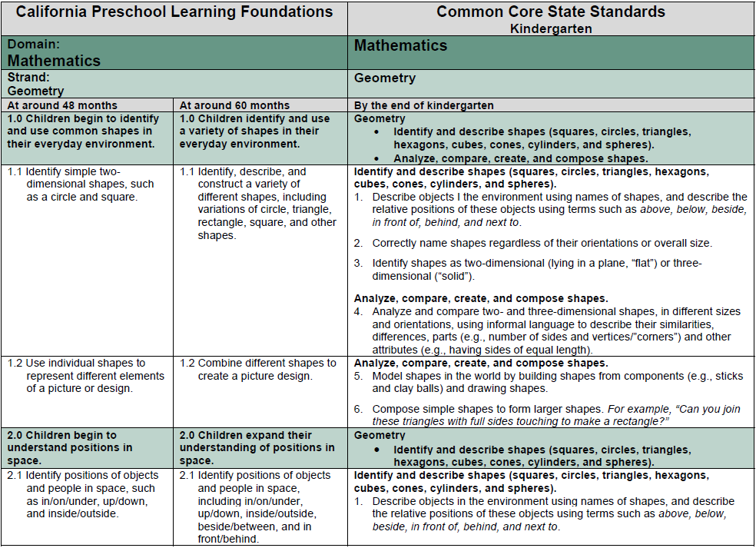
Alignment between Preschool Learning Foundations and CCSS for Mathematics
Source: The Alignment of the California Preschool Learning Foundations with Key Early Education Resources, CDE, 2012.
Notes:
Similarly, in the area of geometry, preschool children’s ability to identify, describe, and construct a variety of shapes, as described by the Preschool Learning Foundations in geometry, continues to develop. By the end of kindergarten, as described in the CCSS, they correctly name shapes regardless of their orientation or overall size and analyze and compare two- and three-dimensional shapes in different sizes and orientations.

Slide 16
Alignment between Preschool Learning Foundations and CCSS for Mathematics
Source: The Alignment of the California Preschool Learning Foundations with Key Early Education Resources, CDE, 2012.
Notes:
The CCSS also include differentiated standards in mathematical reasoning.

Slide 17
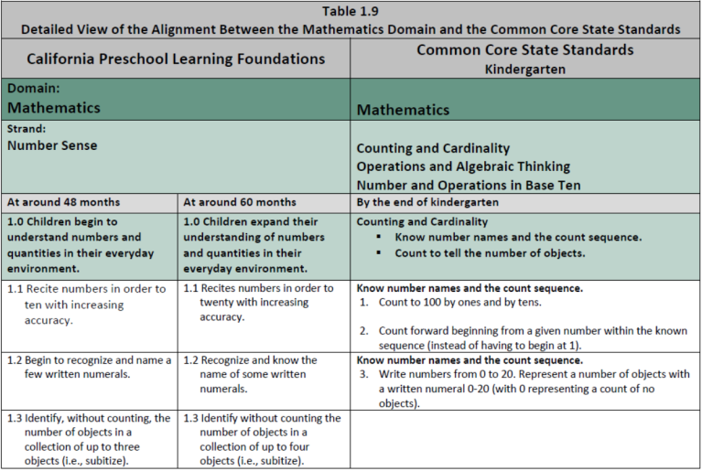
From Content to Practice
Source: The Alignment of the California Preschool Learning Foundations with Key Early Education Resources, CDE, 2012.
Notes:
Explain the example showing the continuum of learning across the levels (Preschool Learning Foundations 1.1 at 48 and 60 months and CCSS 1 and 2 for kindergarten)
Share some ideas/strategies that could be used in the classroom to support this continuum of learning identified above:
At Around 48 months – i.e., Sings a song or recites a poem with numbers one to ten, in order
At Around 60 months – i.e., Chants one to twenty while swinging; marches while counting to twenty
By the end of kindergarten – i.e., Puts ten beans in ten cups and then counts to 100 by tens

Slide 18
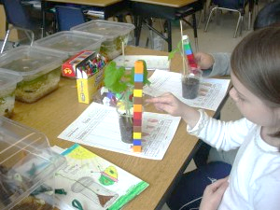
Integration of Science, English
Language Arts, and Mathematics
The purpose of an integrated curriculum is to make content meaningful and accessible to young children.
Active Experiences for Active Children-Mathematics, Seefeldt and Galper, 2008
Integrated Mathematics
Notes:
As discussed earlier (Handout 1: Principles of Child Development and Learning that Inform Practice), young children learn math concepts best through “hands-on, minds-on” experiences with concrete objects, providing children with a wonderful sense of discovery and empowerment as they explore mathematical concepts.
Experiences should be designed to help children see relationships and interconnections in mathematics, providing a continuity of learning. One experience builds on another-forming a complete, coherent, whole, integrated curriculum for young children. “Thinking skills, used together in rich, well-designed learning activities and projects, improve the effectiveness and longevity of learning results.”
http://literacy-matters.org/21st-century-literacy/summary/
Early childhood curriculum is often integrated across content domains or subject matter disciplines. Integration is the blending together of two or more content areas in one activity or learning experience (Schickedanz, 2008). The purpose of an integrated curriculum is to make content meaningful and accessible to young children. Integration also enables more content to be covered during the limited school day. Math experiences can stem from content areas: literacy, art, science, social studies, and even outdoor play. (Handout 1: Principles of Child Development and Learning that Inform Practice, # 1)
Integration approaches to a mathematics content goal could include the following: storybook reading, writing project, a drama area to “use” math in a real life-like setting, songs and movement, etc.
Another way of integrating curriculum is to use a broad topic of study, a theme (such as animals or plants), or a project of interest to children through which mathematics content goals are addressed. Projects are extended investigations into a topic that intellectually engages and interests children, such as how to create a garden or build a house (Katz and Chard, 1989).
Demonstrate math integration by sharing several strategies: Handout 2: Integrated Mathematics.

Slide 19
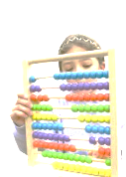
Differentiating Instruction
Teachers who differentiate instruction begin where children are. They provide multiple options for children to acquire information, make sense of ideas, and express what they learn.
The Differentiated Classroom: Responding to the Needs of All Learners,
Carol Ann Tomlinson,1999
Example:
CA Preschool Learning Foundations Common Core Standards -K
Number Sense Counting and Cardinality
At around 48 months At around 48 months By the end of Kindergarten
1.1 Recite numbers in 1.1 Recite numbers in 1. Count to 100 by ones
order to ten with order to twenty with and tens.
increasing accuracy. increasing accuracy.
Notes:
Children’s prior knowledge, life experiences and interests vary considerably; therefore, children’s needs vary considerably. In order to address each child’s individual needs, the teacher must do whatever is necessary to ensure that all have access to learning, that they grow to their potential. These include struggling to advanced learners, children from diverse linguistic and cultural backgrounds, students with disparate experiences, and children with special challenges. (adapted from EISS©: Early Intervention for School Success Handbook, 2012)
The teacher must differentiate instruction to meet the needs of diverse students; one size does not fit all.
Content, process, and products can be differentiated to meet various needs of children. Teachers identify children’s readiness, interests, and learning profiles, and use these data to effectively differentiate these three areas (Tomlin, 2001). (adapted from EISS©: Early Intervention for School Success Handbook, 2012)
Review Handout 1: Principles, #3, #4, #5, #6.
Review the Number Sense strand alignment mentioned earlier. Emphasize how one classroom might have a span of learners that would follow this continuum (children learn at different rates). Also indicate how this would most certainly occur in at TK/K combination class. Ask: What instructional strategies might you use to differentiate in your classroom to meet the needs of students as indicated on this continuum of learning?
After receiving audience answers, using the Differentiated Opportunities: CA Preschool Learning Foundations- Number Sense and the CCSS-Counting and Cardinality handout, continue to share examples. (choose examples)

Slide 20
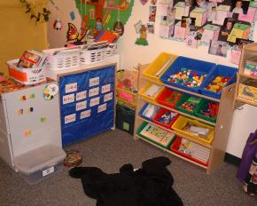
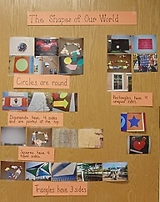
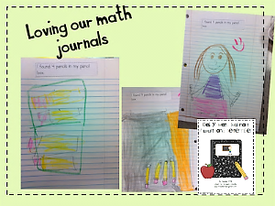
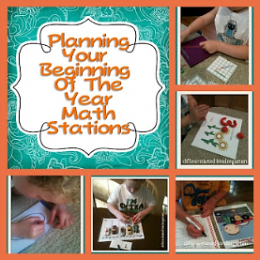
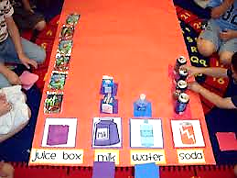
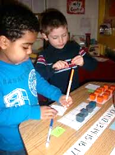
TK Learning Environment
Notes:
Effective learning environments for children are defined by characteristics such as the following: clearly established and consistently maintained expectations for behavior, safe learning environments where children are treated fairly and respectfully as they assume responsibility for themselves and the classroom community, and physical learning environments that engage all children in purposeful learning activities (CA Commission on Teacher Credentialing and CA Dept. of Education, 1997) (adapted from EISS©: Early Intervention for School Success Handbook, 2012).
Reiterate Handout 1: Principles, #7, 8.
The environment conveys the message that this is a place where adults have thought about the quality and the instructive power of space. The layout of the physical space is welcoming and fosters encounters, communication, and relationships. The arrangement of structures, objects, and activities encourages choices, problem solving, and discoveries in the process of learning.
(L. Gandini Curtis & Carter, 2003) (adapted from EISS©: Early Intervention for School Success Handbook, 2012)
A variety of familiar materials gathered from the child’s world enables a teacher to begin where the child is, in his or her world, and with them, to gradually build a bridge to the adult world of abstraction. Because the materials are real, and physically present before the child, they engage the child’s senses, and are, in themselves, enjoyable and rewarding. The materials provide motivation for learning at the same time that they provide the tools for explorations and problem solving. Children become learners who actively construct knowledge by interacting with real world materials.
Reiterate Handout 1: Principles, #9, #10.

Slide 21

Strategies for English Learners
“…young children have varying cultural, linguistic,
home, and community experiences on which to build mathematics learning…
…to achieve equity and educational effectiveness, teachers must know as much as they can about such differences and work to build bridges between children’s varying experiences and new learning.”
NAEYC and NCTM, 2010
Notes:
A substantial and increasing number of children come from homes where English is not the primary language, and some children are not experiencing success in school. Educators and business leaders are concerned about our children’s (those born in the U.S. and outside of the States) mathematics achievement.
Math is inherent in children’s play (Handout 1: Principles, #10). Engage all students in mathematical activities that develop mathematical thinking. Some teachers tend to excuse English language learners from certain aspects of the academic work in order to not damage their self-esteem. Berzins and Lopez (2001) describe this as the pobrecito (poor little one) syndrome. Teachers must believe in, and provide engaging opportunities and connections for young English learners. They can become successful mathematicians! (Handout 1: Principles, #11, #12)
Ask participants to share ELD strategies they use to support mathematical learning.
A variety of strategies has been identified as best practices for meeting the needs of English learners including the following: Total Physical Response (TPR) - coordinating physical movement with verbal input, (connect with rhyme and repetition) Specially-Designed Academic Instruction in English (SADIE) - providing comprehensible input (realia, manipulatives, visuals, graphic organizers, collaborative learning, thematic units, (adapted from Gluck and Silverstein, 1997), accessing the prior knowledge of students and making connections to new information, and connecting new learning to real life. Repetition also allows time for/reinforcing learning and is engaging for students. Handout 1: Principles, #9.
Again ask for strategies from participants for this continuum of learning and reinforce appropriate ELD activities by sharing from Differentiated Opportunities: CA Preschool Learning Foundations-Number Sense and the CCSS-Counting and Cardinality handout and choose those learning activities that include TPR, realia, manipulatives, visuals, drama, repetition, connection to real life, etc. (they choose activities that could support EL in math).

Slide 22
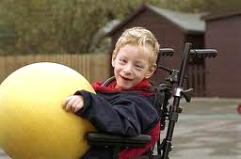
Strategies for Children with Disabilities
Adaptations, accommodations, and modifications need to be individualized for students, based upon their needs and their personal learning styles and interests
National Dissemination Center for Children with Disabilities
Notes:
The education of children with disabilities is a top national priority. Our nation’s special education law, the Individuals with Disabilities Education Act (IDEA), sets high standards for their achievement and guides how special help and services are made available in schools to address their individual needs.
For many students with disabilities—and for many without—the key to success in the classroom lies in having appropriate adaptations, accommodations, and modifications made to the instruction and other classroom activities.
Adaptation: adapting the content, methodology, and/or delivery of instruction
Accommodation: making changes so that a student can overcome or work around the disability
Modification: making changes in what is taught, and/or how a child works at school
Examples:
Scheduling: giving the student extra time to complete assignments or assessments
Setting: working in a small group, working one-on-one with the teacher
Materials: providing audiotaped books, using large print books, or Braille
Instruction: scaffolding degrees of support based on ability levels, using a student/peer tutor for peer models and assistance
Student Response: providing multiple opportunities for students to respond in a variety of ways; i.e., answers to be given orally or dictated, using sign language, a communication device, Braille, or native language if it is not English. National Dissemination Center for Children with Disabilities
With Response to Instruction and intervention (Rti²), schools use data to identify students at risk for poor learning outcomes, monitor student progress, provide evidence-based interventions and adjust the intensity and nature of those interventions depending on a student’s responsiveness, and identify students with learning disabilities or other disabilities. Rti² can be used to ensure appropriate identification of students with disabilities by encouraging practitioners to implement early intervention; Rti² implementation should improve academic performance and behavior, simultaneously reducing the likelihood that students are wrongly identified as having a disability.
Provide examples from Differentiated Opportunities: CA Preschool Learning Foundations-Number Sense and the CCSS-Counting and Cardinality, and choose learning activities that include different levels of complexity; that are visual, auditory, or kinesthetic; that can be scaffolded and involve repetition; that are motivating and interesting; that allow for various expressions of learning, etc.

Slide 23
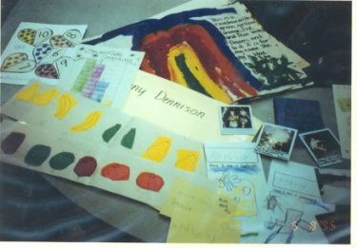
Assessment Approaches
Extensive research on assessment and learning shows that skilled use of formative assessment has a significant positive effect on student learning
Educational Leadership November 2009, Vol. 67, number 3, “Multiple Measures,” pgs. 85-86 , T.A. Huebner
Notes:
The primary goal of assessment is to find out what children know and can do. Based on assessment data collected, this information guides the teacher for planning and developing appropriate instruction. This formative assessment is an ongoing practice throughout the year, using various means for assessing.
Teachers must become skillful assessors who systematically identify individual strengths by understanding how learners are developing. Assessments are used by reflective practitioners as they select materials and resources to implement the goals stated in the foundations, standards and/or curriculum.
Formal tests alone cannot provide an accurate picture of the “whole-child.”
Multiple measures, various forms of assessment must be used to secure information regarding children’s learning: observation, anecdotal records, photos/copies, video, audiotape, children’s work, interviews, etc. A portfolio can be used to collect ongoing data that shows the story of growth.
In summary, assessment provides:
-an ongoing evaluation of children’s age-appropriate development—including concepts, values, interests, and abilities
-a basis for educators to make informed decisions about appropriate curriculum and instructional strategies
-a continuous process for reflection of program goals and accountability
(adapted from EISS©: Early Intervention for School Success Handbook, 2012)

Slide 24
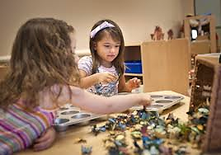
Let’s Practice
Making It REAL!
Notes:
Share that the group will now have a chance to “make it real” by looking at the Alignment document and brainstorm teaching strategies.
Now that you have modeled the Number Sense/Counting and Cardinality strands, this will be their opportunity to brainstorm strategies that differentiate, support English learners, and meet the needs of children with special needs.
Divide participants into groups (of no more than four in a group).
Using their Alignment document, ask them to brainstorm strategies using the following Foundations-Algebra and Functions/CCSS-Measurement and Data (refer to Alignment Document, CDE, 2012). (This content area has been chosen because teachers of young children can often be hesitant about teaching “algebra.” This is a teachable moment as they realize what algebra “is” for children at this age; they will realize that they can teach higher math skills and are equipped to do so.)
Provide chart paper and markers for teams to write. Give each team one minute for a “quick share.”
Refer to (page 78 in Alignment Doc):

Slide 25
Let’s Practice
Source: The Alignment of the California Preschool Learning Foundations with Key Early Education Resources, CDE, 2012.
Brainstorm strategies that integrate, differentiate, and include all students.
Notes:
Keep this slide projected as a reference.

Slide 26
Resources
TK Online Resources
The Alignment of the California Preschool Learning Foundations with Key Early Education Resources | http://www.cde.ca.gov/sp/cd/re/documents/psalignment.pdf
California County Superintendents Educational Service Association (CCSESA) Information and resources for early education are posted on the CCSESA Web site under School Readiness Transitional Kindergarten (TK) Planning Guide – A Resource for Administrators of California Public School Districts | http://www.ccsesa.org/index/sp_prek.cfm http://www.ccsesa.org/index/documents/TransitionalKindergartenGuide-webversion.pdf
California Department of Education (CDE) Kindergarten in California Transitional Kindergarten FAQs Transitional Kindergarten Implementation Guide | http://www.cde.ca.gov/ci/gs/em/
California Kindergarten Association An association to support kindergarten teachers | http://www.californiakindergartenassociation.org/transitional-kindergarten/
California Preschool Instructional Network (CPIN) CPIN, funded by CDE, conducts professional development on CDE publications such as the Preschool Learning Foundations, Preschool Curriculum Framework and Preschool English Learners Guide | http://www.cpin.us
Changing the Kindergarten Cutoff Date: Effects on California Students and Schools Cannon, J. S. and Lipscomb, S. | www.ppic.org/content/pubs/op/OP_508JCOP.pdf

Slide 27
Resources
TK Online Resources
National Association for the Education of Young Children Resources to promote Developmentally Appropriate Practice (DAP) | www.naeyc.org/DAP
Preschool Curriculum Framework, Volume 1, 2, and 3 Aligned with the foundations, the curriculum framework provides guidance on planning learning environments and experiences for young children | http://www.cde.ca.gov/sp/cd/re/documents/psframeworkkvol1.pdf http://www.cde.ca.gov/sp/cd/re/documents/psframeworkvol2.pdf http://www.cde.ca.gov/sp/cd/re/documents/preschoolframeworkvol3.pdf
Preschool English Learners: Principles and Practices to Promote Language, Literacy, and Learning A resource guide to educate preschool English learners | http://www.cde.ca.gov/sp/cd/re/documents/psenglearnersed2.pdf
Preschool Learning Foundations, Volume 1, 2, and 3 The foundations for preschool-age children identify key domains of learning and guide instructional practice | http://www.cde.ca.gov/sp/cd/re/documents/preschoollf.pdf http://www.cde.ca.gov/sp/cd/re/documents/psfoundationsvol2.pdf http://www.cde.ca.gov/sp/cd/re/documents/preschoolfoundationsvol3.pdf
Transitional Kindergarten (TK) California Online resources to support the successful implementation of transitional kindergarten | http://www.tkcalifornia.org/

Slide 28
Resources
TK Online Early Mathematics Resources
National Association for the Education of Young Children (NAEYC) Early Childhood Mathematics: Promoting Good Beginnings, (NAEYC) with the National Council of Teachers of Mathematics (NCTM) An association publishing periodicals, books, professional development materials, and resources, all of which relate to the education of young children Principles of Child Development and Learning – Developmentally Appropriate Practice in Early Childhood Programs Serving Children Birth Through Age 8, 3rd Edition (NAEYC, 2009, p. 10-15) | http://www.naeyc.org/files/naeyc/file/positions/psmath.pdf http://www.naeyc.org/dap/12-principles-of-child-development
National Council of Teachers of Mathematics (NCTM) An organization supporting math educators and administrators by providing math resources and professional development opportunities | www.nctm.org/

Slide 29
Resources
Books
Developing Number Concepts, Book 1: Counting, Comparing, and Pattern by Kathy Richardson(Apr 16, 1998) How Children Learn Number Concepts: A Guide to the Critical Learning Phases by Kathy Richardson (Feb 23, 2012) Math Work Stations by Debbie Diller (2011) Learning and Teaching Early Math: The Learning Trajectories Approach (Studies in Mathematical Thinking and Learning) by Douglas H. Clements and Julie A. Sarama (Mar 14, 2009) Active Experiences for Active Children: Mathematics (2nd Edition).Carol Seefeldt and Alice Galper, (2008).
Engaging Young Children in Mathematics Edited by Douglas H. Clements and Julie Sarama (2004) How to Differentiate Instruction in Mixed Ability Classrooms by Carol Ann Tomlinson (2001)

Slide 30

Questions?

Slide 31
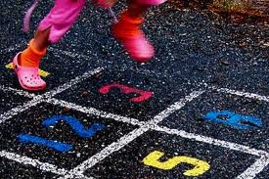
Thank You

