Slide 1
Social-Emotional Development
In a Transitional Kindergarten (TK) Classroom
Notes:
Approximate duration of the presentation: 3 hours
Target Audience: Primarily TK teachers

Slide 2

Acknowledgements
The following county offices of
education developed the TK
professional development modules:
With contributions from:
Fresno County Office of Education
Merced County Office of Education
CCSESA’s CISC School Readiness Subcommittee
Contra Costa County Office of Education
Humboldt County Office of Education
Orange County Department of Education
Sacramento County Office of Education
Santa Clara County Office of Education
Shasta County Office of Education
Coordinated by:
Sacramento County Office of Education
Funding provided by:
Notes:
2
Several county offices of education contributed to the development of the TK professional development modules… either by developing the content and/or by conducting a pilot session with school district teachers and administrators.
This project was coordinated by the Sacramento County Office of Education through funding from the David and Lucile Packard Foundation.

Slide 3

WELCOME
Notes:
The information in this presentation is based on:
The Alignment of the California Preschool Learning Foundations and Key Early Education Resources
California Preschool Learning Foundations, Volume 1
Social-Emotional Development Foundations
Current Research
California Collaborative for Social Emotional Foundations for Early Learning (CSEFEL)

Slide 4
Objectives
Understand the alignment between the Preschool Learning Foundations and the kindergarten Content Standards for California Public Schools
Become familiar with and understand the importance of the Preschool Learning Foundations in social-emotional development and the current research with an emphasis on self-regulation
Understand the importance of teaching social-emotional skills
and self-regulation in transitional kindergarten
Identify effective strategies that build positive relationships and environments to support social-emotional development

Slide 5
Norms
Start and end on time
Turn cell phones to vibrate
Listen to and contribute thoughts and ideas
Notes:
5

Slide 6
Ice Breaker…
Name
School District/Position
Share a relationship you remember from preschool or kindergarten
Notes:
Optional – revised as needed per audience – Ask participants to share about a significant relationship that had an impact in their early years.

Slide 7
Background on
Transitional Kindergarten
California was one of just four states (along with Connecticut, Michigan, and Vermont) with a cut-off date later than December 1. In most states, children must turn five by September 1 in order to start kindergarten
Research indicates that beginning kindergarten at an older age improves children’s social and academic development
Source: (Cannon, J.S. & Lipscomb, 2008)

Slide 8
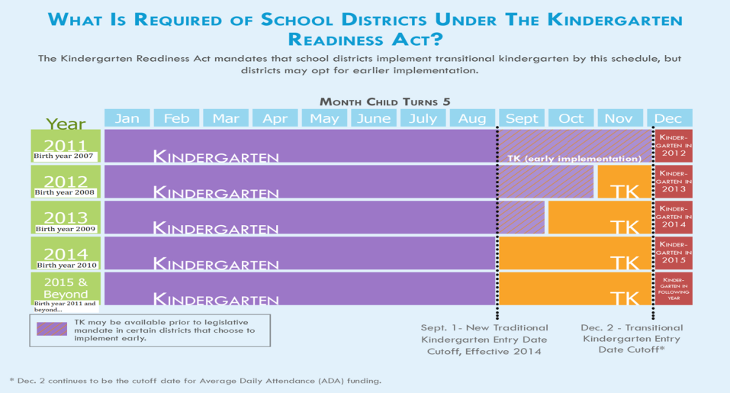
Senate Bill 1381 (Simitian)
The Kindergarten Readiness Act of 2010
Source: Early Edge California
Notes:
Senate Bill 1381 provides flexibility for districts in implementing TK that best meet the needs of students.
It is important to note, that all kindergarten regulations apply to TK. Children are not mandated to attend TK as the existing statute does not require parents to enroll children in kindergarten.
Children are not mandated to attend, but district must offer TK for birthdays between September 2 and December 2 ([Education Code Section 48000]; CCSESA, 2011).
In 2012-13, school districts began to offer a TK program for children whose fifth birthdates fall from November 2 through December 2.
The date will continue moving back one month over each subsequent year so that by 2014-15 and, each year thereafter, children who are five on or before September 1 are eligible for kindergarten.
The law also requires school districts to develop a transitional kindergarten program, for children who will no longer be age eligible for kindergarten.
Transitional kindergarten is the first year of a two-year program that provides a “modified kindergarten curriculum that is age and developmentally appropriate” (Education Code section 48000).

Slide 9
Principles of
Child Development and Learning-
Developmentally Appropriate Practice
All the domains of development and learning are interrelated
Learning follows a sequence and builds on previously acquired skills
Early experiences impact development
Social and cultural contexts influence learning
Secure, consistent relationships are critical to healthy development
Source: Copple, C., & S. Bredekamp. (Eds.). (2009). Developmentally Appropriate Practice in Early Childhood Programs Serving Children from Birth Through Age 8. 3d ed. Washington, DC: National Association for the Education of Young Children p. 10-15.
Notes:
Review the document “Developmentally Appropriate Practice in Early Childhood Programs Serving Children B-age 8”, pages 10-15. As you read, select one principle that resonates with you and why? What do you do currently in your program to ensure this principle is followed or what do you plan to do when you start teaching TK?

Slide 10
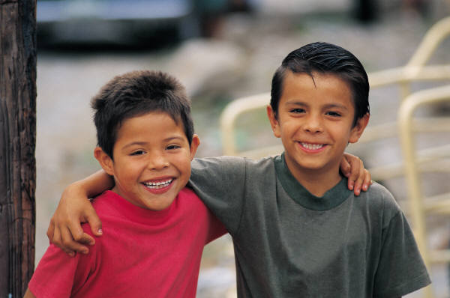
What is Social-Emotional Development?
Three strands of the social-emotional development domain include:
  Self
  Self awareness, self-regulation, social and emotional understanding, empathy and caring, and initiative in learning
  Social Interaction
  Interactions with familiar adults, interactions with peers, group participation, and cooperation and responsibility
  Relationships
  Attachment to parents, close relationships with
  teachers and caregivers, and friendships
Source: California Preschool Learning Foundations, 2008
Notes:
Source: California Preschool Learning Foundations, 2008
These competencies are predictive of children’s adaptation to school and their academic success (PLF, 2008, pg. 1).

Slide 11
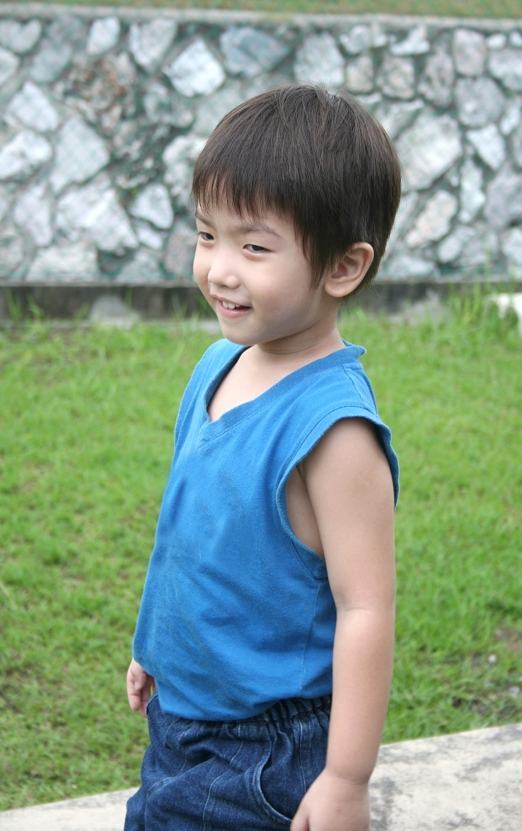
Picture a Child…
What social-emotional qualities, skills, or characteristics are necessary for success in kindergarten?
Discuss at your tables and come up with the five most important skills…

Slide 12
Brain Research Supports the Foundations of
Social-Emotional Development
This developing brain architecture is rooted in the context of experience and is the foundation for cognitive, social and emotional development
Brain development is dependent on experience
Brain development is rapid in the early years and continuous throughout adulthood
Child-adult relationships provide a foundation for many of the social-emotional qualities that underlie school readiness
Source: Neurons to Neighborhoods (2000)
Notes:
Content Information:
Source: Neurons to Neighborhoods
Bullet 1: Positive healthy experiences also have the potential to impact the neurological pathway development:
attachment bonds with caregivers
• healthy relationships with caregivers
• healthy parent-child and teacher-child interactions and conversations
• stimulating environment SUPPORT THE DEVELOPMENT OF A YOUNG CHILD
Bullet 2: Brain development is dependent on experience, both positive and negative. Unhealthy experiences such as:
chronic stress - absent or neglectful parent/caregiver
violence
impoverished environments impact neurological pathways
Bullet 3: Experiences in early childhood are integral to brain development. As you will see in the video clip, our brains develop and synapses increase at a rapid pace during infancy. Synapse growth has been correlated with learning. We continue to learn and develop synapses until the day we die. We are life-long learners.

Slide 13
Video: The Science of Early
Childhood Development
This video from the Center on the Developing Child at Harvard University (developingchild.harvard.edu) features center director Jack P. Shonkoff, M.D., professor at the Harvard Graduate School of Education, the Harvard School of Public Health, and Harvard Medical School.
http://www.youtube.com/watch?v=tLiP4b-TPCA
Notes:
http://www.tkcalifornia.org/teaching-tools/social-emotional/
Brain architecture has great plasticity and continues to change throughout life.
Emotional competencies that may not have been developed naturally can be taught through purposeful teaching and strategic planning.
Some children do not develop the emotional competencies such as self-regulation as quickly or naturally as other children. This does not mean they are incapable of developing these competencies. Teachers must observe and plan strategies to teach children these competencies. Intentional teaching of these skills are critical to the healthy development of each child.
As you have seen, we continue to develop synapses until the day we die. This demonstrates the plasticity of the brain and the ability to continue developing and learning throughout life.

Slide 14
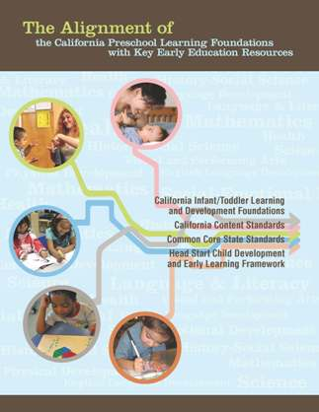
The Alignment of the California
Preschool Learning Foundations with Key Early Education Resources
All domains of the Preschool Learning Foundations correspond to the California Kindergarten Content Standards
Preschool Learning Foundations Language and Literacy domain aligns with the California Common Core State Standards (CCSS) for English Language Arts
Preschool Learning Foundations Mathematics
domain aligns with the California Common Core
State Standards for Mathematics
Notes:
Alignment Document includes key early education resources:
CA Infant/Toddler Learning and Development Foundations
• CA Content Standards
• Common Core State Standards
• Head Start Child Development Early Learning Framework
Optional:
Provide copies of the CA Preschool Learning Foundations, and the Common Core State Standards for each table; give each participant a copy of the Alignment Document.
Highlight (if needed, browse through the document with participants):
The Preschool Learning Foundations are a critical step in the California Department of Education’s efforts to strengthen preschool education and school readiness and to close the achievement gap in California. The Foundations cover the following domains:
Social-Emotional Development
Language and Literacy
English-Language Development (for English learners)
Mathematics
Visual and Performing Arts
Physical Development
History-Social Science
Science
Together, these domains represent crucial areas of learning and development for young children.
Competencies are included as foundations for children “at around 48 months of age” and “at around 60 months of age.”
Source: Expanding Access to High Quality Preschool Programs, 2003 California School Boards Association
14

Slide 15
Overview of Alignment
California Preschool Learning Foundations | California Kindergarten Content Standards | Common Core State Standards
Social-Emotional Development | Health, Education Mental, Emotional, and Social Health
Language and Literacy | English-Language Arts | English-Language Arts
English-Language Development | English-Language Development
Mathematics | Mathematics | Mathematics
Visual and Performing Arts | Visual and Performing Arts
Physical Development | Physical Education
Health | Health Education
History-Social Science | History-Social Science
Science | Science
Source: The Alignment of the California Preschool Learning Foundations with Key Early Education Resources, CDE, 2012.
Notes:
This table represents an overview of the alignment among the nine domains of the Preschool Learning Foundations with the content of the CA Kindergarten Content Standards and the Common Core State Standards (CCSS).
The alignment demonstrates that early learning is a significant part of the educational system and that the knowledge and skills of young children are foundational to future learning.
Understanding the links between the different ages and different early childhood services allows educators to build on children’s earlier learning and prepare them for the next educational challenge.
Visual and Performing Arts, Physical Development, Health, History-Social Science, and Science are all separate domains in the Preschool Learning Foundations. The Common Core includes English Language Arts & Literacy in History/Social Studies, Science, and Technical Subjects.
15

Slide 16

Overview of Social-Emotional Alignment
Source: The Alignment of the California Preschool Learning Foundations with Key Early Education Resources, CDE, 2012.
Notes:
Review page 25 in the Alignment Document or use the handout provided.
Give the participants a few minutes to look at the Alignment Document at their tables. Ask them, “What do you notice about the document?” Have a few participants share out loud, to begin the discussion.
Remind them that the table represents the developmental continuum of learning for children from three years old to kindergarten.
Explain the age break down from preschool to kindergarten:
Infant/Toddlers represent students who are 3-4 years of age
Preschool represents students who are 4-5 year of age
Kindergarten represents students from 5-6 years of age
Ask the participants to look at how Self-Regulation is represented in the California Infant/Toddler Learning and Development Foundations, the California Preschool Learning Foundations and in the California Content Standards Kindergarten. Have a few participants share out loud, to continue the discussion.

Slide 17
Overview of Social-Emotional
Source: The Alignment of the California Preschool Learning Foundations with Key Early Education Resources, CDE, 2012.
Notes:
Review page 26 in the Alignment Document or use the handout provided.
Give the participants a few minutes to look at the Alignment Document at their tables. Ask them, “What do you notice about the document?” Have a few participants share out loud, to begin the discussion.
Ask the participants to look at how Interactions with Peers is represented in the California Infant/Toddler Learning and Development Foundations, the California Preschool Learning Foundations and in the California Content Standards Kindergarten. Have a few participants share out loud, to continue the discussion.

Slide 18
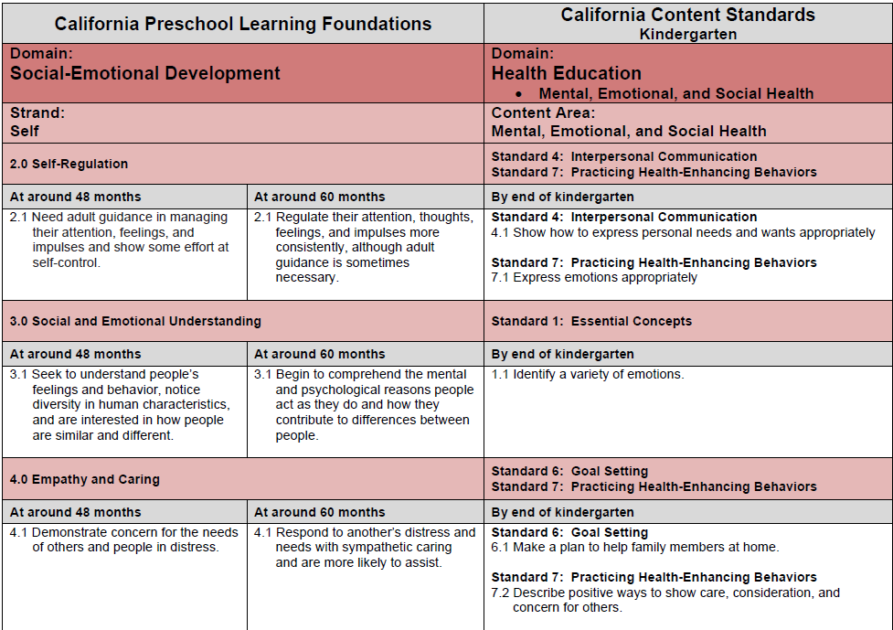
Overview of Social-Emotional
Source: The Alignment of the California Preschool Learning Foundations with Key Early Education Resources, CDE, 2012.
Notes:
Review page 28 in the Alignment Document or use the handout provided.
Give the participants a few minutes to look at the Self-Regulation column, in the Alignment Document. Ask them, “What do you notice in the continuum?” Have a few participants share out loud, to begin the discussion.
Let them know that the continuum displays what is expected of students at the end of school year.
For Example:
At the end of the 1st year of preschool (when students turn 4 years old) students will be expected to be able to do the following:
2.1 Need adult guidance in managing their attention, feelings, and impulses and show some effort at self-control.
Ask the participants, “Where do Transitional Kindergarten (TK) students fit in the continuum?” They should begin to understand that TK students overlap between the 2nd year of preschool and kindergarten.
Ask the participants to brainstorm activities that teach self-regulation skills. Have a few people share their ideas out loud.

Slide 19
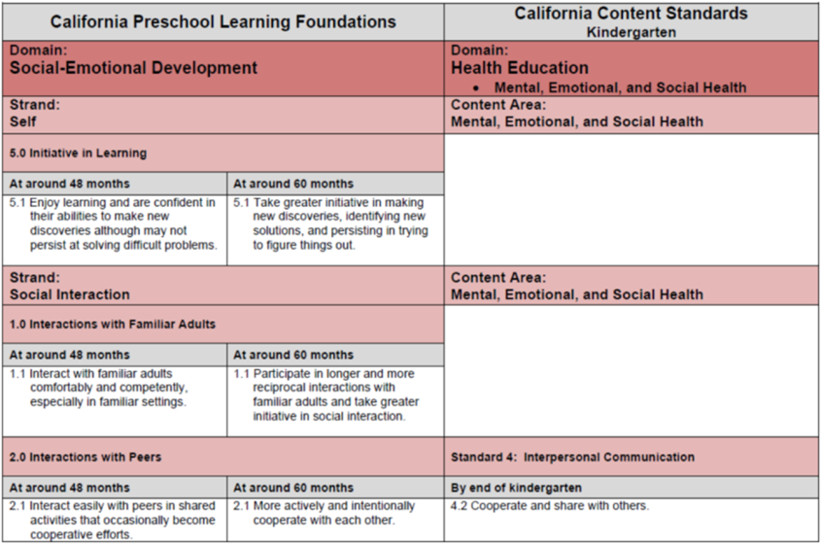
Overview of Social-Emotional
Source: The Alignment of the California Preschool Learning Foundations with Key Early Education Resources, CDE, 2012.
Notes:
Review page 29 in the Alignment Document or use the handout provided.
Give the participants a few minutes to look at the Interaction with Peers column, in the Alignment Document. Ask them, “What do you notice in the continuum?” Have a few participants share out loud, to begin the discussion.
Ask the participants, “Where do Transitional Kindergarten (TK) students fit in the continuum?” They should begin to understand that TK students overlap between the 2nd year of preschool and kindergarten.
Ask the participants to brainstorm activities that teach students how to interact with their peers in a pro-social manner. Have a few participants share their ideas out loud.

Slide 20
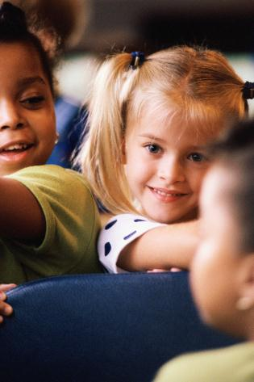
Self-Regulation
The growth of self-regulation is a cornerstone of early childhood development that cuts across all domains of behavior.
Source: Neurons to Neighborhoods (2000, pg. 3)
20
Notes:
20

Slide 21
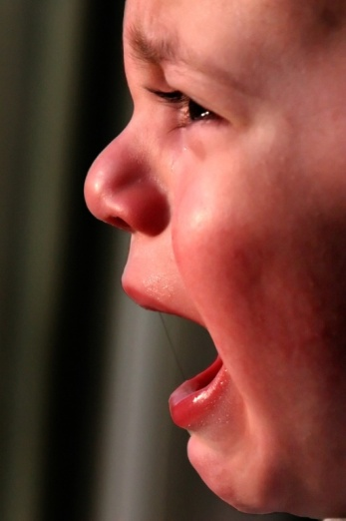
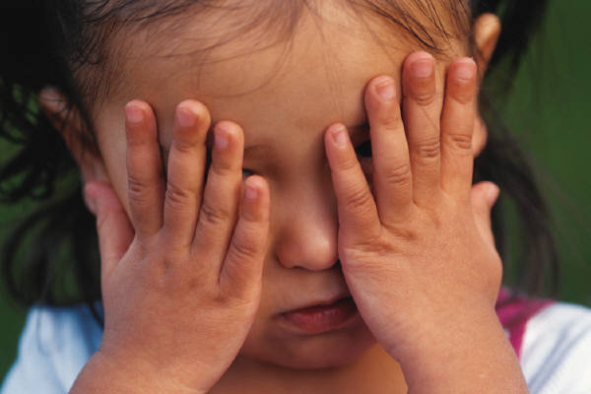
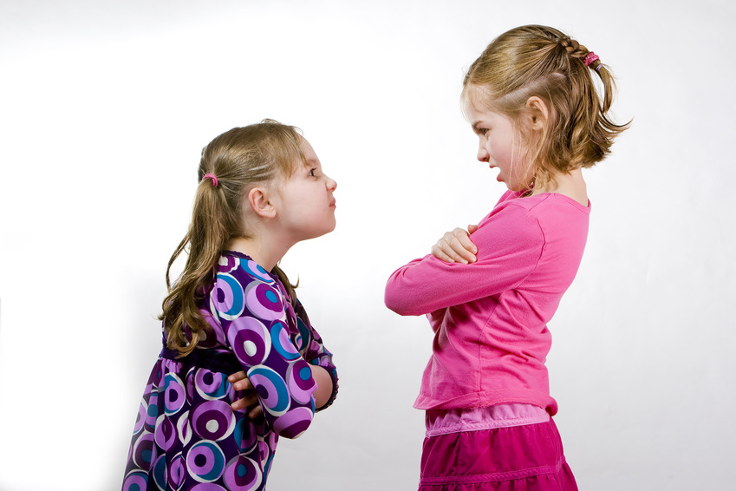
Self-Regulation
Includes the Skills to:
Anticipate routines
Cooperate
Focus attention on the task at hand
Manage transitions
Regulate feelings and impulses
Adapted from the California Preschool Learning Foundations, Volume 1, p. 7
Notes:
TK students are at the early phases of developing self-regulation and often need the support and guidance of adults.
TK teachers can incorporate a number of strategies to help young children develop the self-regulation skills they will need to succeed in traditional kindergarten.
Share things and space
Wait and take turns
21

Slide 22
Strategies for Supporting Healthy Social-Emotional
Development
Building Positive Relationships
Effective Classroom Environments
Predictable Daily Schedule
Expectations, Rituals, and Routines
Source: “Preventing Challenging Behavior in Young Children: Effective Practices” by P. Alter & M. Conroy, Center for Evidence-Based Practice: Young Children with Challenging Behavior. Retrieved from: http://www.challengingbehavior.org/do/resources/documents/rph_preventing_challenging_behavior.pdf
Notes:
Building positive relationships with children is an essential task and a foundational component of good teaching.
Children respond in the presence of sincere and caring adults….
Adults need to create a nurturing classroom environment to support healthy social-emotional development. There is no universal panacea for preventing challenging behavior. Researchers suggest using broad-based early intervention strategies as a way to prevent such behaviors. There are several social-emotional teaching strategies that are on the Early Edge California TK website (www.tkcalifornia.org).
TK teachers should establish a predictable daily schedule. This helps children predict what will happen next, gain a sense of order and time – a visual or physical happening (eating, sleeping, circle time, outdoor time etc. — important to have consistency and predictability).
Rituals and routines are social-emotional interactions that are unique to culture, family, and/or school. Examples would be: goodbyes, nap/bedtime stories, holidays, rites of passage, birthday parties, cultural celebrations.

Slide 23

Building Positive Relationships with Young Children
Building positive relationships with children is an essential task and foundational component of good teaching
Adults need to invest time and attention in children in order to effectively use behavior changing strategies
  Source: California Preschool Learning Foundations, 2008
Notes:
23

Slide 24
How Do We Help Young Children Develop
Their Relationships with Teachers?
Be part of the child’s daily experiences and activities
Talk with children about their experiences at home and in the classroom, showing interest and asking questions
Ensure that a special teacher greets the child at the beginning of the day, provides support as necessary, and says good-bye at the day’s end
Applaud the child’s accomplishments and provide specific feedback about the child’s efforts
Develop relationships with the child’s parents, and be friendly and respectful toward them in the child’s presence
Show respect for and interest in the child’s culture
Source: Ross A. Thompson (2008), CPIN Research Institute
Notes:
Websites
The Center on the Social and Emotional Foundations for Early Learning (CSEFEL) is focused on promoting the social-emotional development and school readiness of young children birth to age 5. CSEFEL is a national resource center funded by the Office of Head Start and Child Care Bureau for disseminating research and evidence-based practices to early childhood programs across the country. On this website, you will find user-friendly training materials, videos, and print resources available for download.
Technical Assistance Center on Social Emotional Intervention (TACSEI) The Technical Assistance Center on Social Emotional Intervention for Young Children, also known as TACSEI, is a five-year grant made possible by the U.S. Department of Education, Office of Special Education Programs. TACSEI takes the research that shows which practices improve the social-emotional outcomes for young children with, or at risk for, delays or disabilities and creates free products and resources to help decision-makers, caregivers, and service providers apply these best practices in the work they do every day. Most of these free products are on the website for download.
Other Resources
Alter, P. J. & Conroy, M. A. “Preventing Challenging Behavior in Young Children: Effective Practices” Center for Evidence-Based Practice: Young Children with Challenging Behavior
California’s Vision for Supporting Early Childhood Social-Emotional Competence
Cooperative Children’s Book Center 50 Multicultural Books Every Child Should Know
CSEFEL Children's Book List
CSEFEL Some Starters for Giving Positive Feedback
Fox, L. & Lentini, R. H. (2006) “Child-Friendly Ideas for Teaching Problem Solving” Beyond the Journal. November, 2006
Fox, L. & Lentini, R. H. (2006) “Teaching Children a Vocabulary for Emotions” Beyond the Journal. November, 2006
Greenspan, S. Six Stages to a Strong Self-Image
Joseph, G. E. & Strain, P. S. Building Positive Relationships with Young Children Center on Evidence Based Practices for Early Learning University of Colorado at Denver
Lamm, S.; Groulx, J. G.; Hansen, C.; Patton, M. M.; and Slaton, A. J. Creating Environments for Peaceful Problem Solving Young Children. November 2006
National Conference of State Legislators and Zero to Three (2005) Helping Young Children Succeed
NYSAEYC (2004) How Can You Create a Learning Environment That Respects Diversity
Ounce of Prevention Fund Toward the ABCs: Building a healthy social and emotional foundation for learning and living
Poole, C., Miller, S. A., & Church, E. B. (2003) Ages & Stages: How Children Build Friendships
Poole, C., Miller, S. A., & Church, E. B. (1999). “Ages & Stages: Physical Identity. How children become aware of their bodies and gain a positive sense of self,” Early Childhood Today

Slide 25
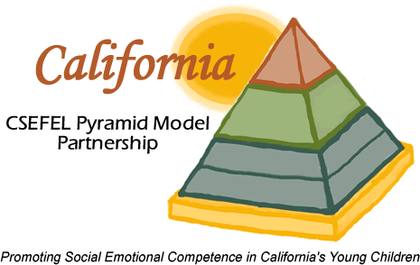
Teaching Pyramid
Children with persistent challenges
Intensive Individualized Interventions
Positive Behavior Support
Children at-risk
Targeted Social Emotional Supports
Targeted Social
Skills Curricula
High-Quality
Supportive Environments
High-quality
Early Education
All children
Nurturing and Responsive
Relationships
Effective Work Force
Source: http://cainclusion.org/camap/cacsefel.html
Notes:
Center on the Social and Emotional Foundations for Early Learning (CSEFEL)—California’s version is the Teaching Pyramid
Children often use challenging behavior when they don’t have the social or communication skills they need to engage in more appropriate interactions.
Behavior that persists over time is usually working for the child.
We need to focus on teaching children what to do in place of the challenging behavior.
The teaching pyramid is similar to the RtI model where most children will learn the concepts with a high-quality, supportive environment and responsive relationships.
Some children, about 15-18%, will need a more targeted support and teaching in smaller groups as in RtI. The top of the pyramid are those children who will need targeted individualized interventions – usually will be only 2-5% of the children in a class. Just as in RtI you must have the foundation of a quality environment, teaching and relationships in order for the strategy to be effective.
CSEFEL website: http://csefel.vanderbilt.edu/
www.cainclusion.org/teachingpyramid
http://www.challengingbehavior.org/
Technical Assistance Center on Social Emotional Intervention for Young Children
http://www.tkcalifornia.org/teaching-tools/social-emotional/
Show resources on TK web page for CSEFEL
This pyramid model emulates Response to Intervention (RtI) which is also a multi-tiered approach to help struggling learners. Students' progress is closely monitored at each stage of intervention to determine the need for further research-based instruction and/or intervention in general education, in special education, or both.

Slide 26
We Need to Teach!
“If a child doesn’t know how to read, we teach.
If a child doesn’t know how to swim, we teach.
If a child doesn’t know how to spell, we teach.
If a child doesn’t know how to write, we teach.
If a child doesn’t know how to behave, we…….....
…….teach? .……punish?
Why can’t we finish the last sentence as automatically as we do the others?”
Modified from Tom Herner (NASDE President) Counterpoint 1998, p.2
Notes:
Presenter reads each sentence out loud, ask participants to complete each sentence.
In small groups, may need a different way, reading one line at a time, reading to them.
This could also be useful for working with families.
Just like all of these skills, social-emotional skills and self-regulation need to be taught. One cannot assume that a child will know what is expected of them unless they are taught…..WE NEED TO TEACH THESE SKILLS!

Slide 27
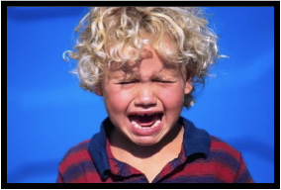
What Do Children Do When
They Don’t Develop These Skills?
When children do not have healthy social and emotional skills, they often exhibit
challenging behaviors
We must focus on TEACHING
the skills!
Notes:
If we teach these social skills, children will succeed in school… they will have self-regulation and the ability to get along with their peers and adults with positive relationships and engagement.

Slide 28
High-Quality Supportive Environments
Promote Learning Across Curricular Areas
Aspects to consider:
  Physical Environment
  Schedules & Routines
  Transitions
  Large/Small Group Activities
  Clear Expectations for Behavior
  Positive Feedback and Interactions
“
Notes:
“The TK classroom environment sets the stage for learning and interactions between students and adults. It also establishes the expectations for behavior in the classroom (Thompson & Twibell, 2009). An attractive, well organized classroom environment invites students to actively explore and engage with the materials and access classroom instruction.” (Transitional Kindergarten Implementation Guide, 2013, p. 62)
“Young students thrive in settings that are predictable and consistent. A student’s ability to engage, focus, and successfully complete tasks is especially contingent on routines and transitions that are consistent and balanced.” (Transitional Kindergarten Implementation Guide, 2013, p. 42)
“Expectations for each routine and transition need to be thoughtfully planned and then taught, modeled, practiced, and reviewed as necessary. Instruction should be clear and concise and make use of auditory and visual cues to reinforce verbal prompts” (Transitional Kindergarten Implementation Guide, 2013, p. 43).
“ The TK classroom needs designated spaces for large-group instruction as well as areas for small-group learning and exploration.” (Transitional Kindergarten Implementation Guide, 2013, p. 63)

Slide 29
Effective Classroom Environments for
Social Emotional Development
Strategies to structure the classroom environment include arranging:
  The classroom to ensure visual monitoring of children
  Activity centers to support children’s appropriate behaviors
  Materials in the classroom to promote engagement, independence, and smooth transitions
Source: “Preventing Challenging Behavior in Young Children: Effective Practices” by P. Alter & M. Conroy, Center for
Evidence-Based Practice: Young Children with Challenging Behavior
Notes:
Content Information:
“Effective classroom environments begin with a well-organized and engaging classroom that includes developmentally appropriate practices (DAP) activities and materials.”
Recommended Practices; Preventing Challenging Behavior in Young Children: Effective Practices,” by P. Alter & M. Conroy, from the Center for Evidence-Based Practice: Young Children with Challenging Behavior.
“Designing effective classroom environments includes structuring the physical arrangement of the classroom to increase appropriate behaviors, such as engagement, and decrease the probability of challenging behaviors. Several strategies for structuring the physical classroom include: arranging the classroom to ensure visual monitoring of children, arranging activity centers to support children’s appropriate behaviors (e.g., limiting the number of children in a center) and facilitating smooth transitions among activities (e.g., organizing the location of materials on shelves), and arranging materials in the classroom to promote engagement, mastery, and independence. Increasing the accessibility, appropriateness, and availability of toys and materials can facilitate children’s independence, thus, decreasing the likelihood of challenging behaviors. In addition, attending to details, such as the lighting, temperature, and noise levels, can reduce the probability of children who engage in problem behaviors due to sensitivity to these environmental factors (e.g., children with autism).”
“Designing effective classroom environments also includes structuring the interpersonal climate of the classroom. When teachers attend to children’s appropriate behaviors and provide assistance as they need help, children are less likely to engage in challenging behaviors. Developing a positive interpersonal climate begins with implementing engaging activities that are developmentally and individually appropriate for all children. In addition, the use of positive attention and positive feedback with children who are engaging appropriately in activities and playing with their peers will increase appropriate behaviors. Remember, “catch them being good” and acknowledge them for it!”
The environment conveys the message that this is a place where adults have thought about the quality and the instructive power of space. The layout of the physical space is welcoming and fosters encounters, communication, and relationships. The arrangement of structures, objects, and activities encourages choices, problem solving, and discoveries in the process of learning.
(L. Gandini Curtis & Carter, 2003) (adapted from EISS©: Early Intervention for School Success Handbook, 2012)

Slide 30
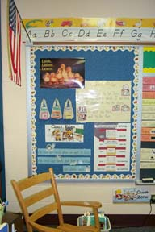
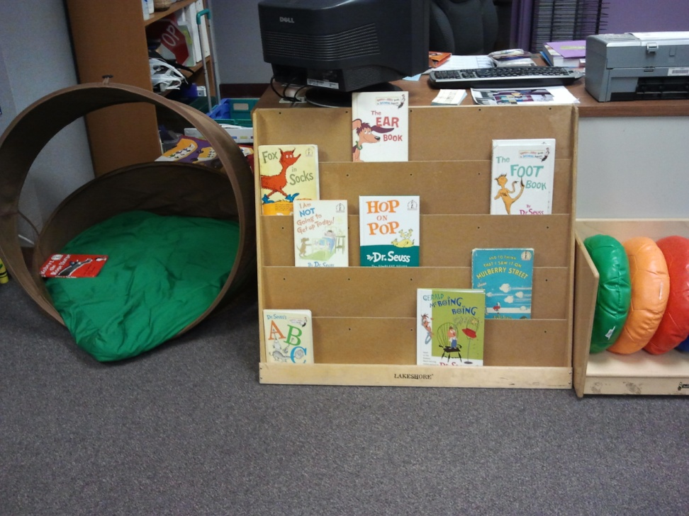
TK Supportive Environments
Clear Expectations
Quiet Area
Notes:
Make sure the environment works for you and the children. You can use the environment as a teaching strategy, as well, making sure there are spaces that support all children learning and accessing the curriculum.
Here is a place where the teacher has listed the classroom expectations.
Having a quiet area where a child can go when they are over-stimulated and need to be by themselves is really important. The TK teacher placed a quiet area next to the book area, that includes a clear view of the child. A child can access this area from either side.

Slide 31
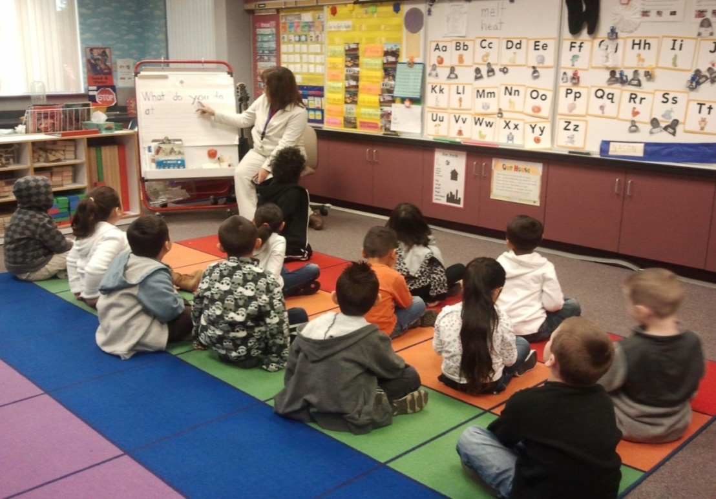
TK Supportive Environments
Large Group Area
Notes:
These are photos from a TK class. The children have a defined space to sit on with the squares allowing them to know where they should sit, keeping a distance from their classmates.

Slide 32
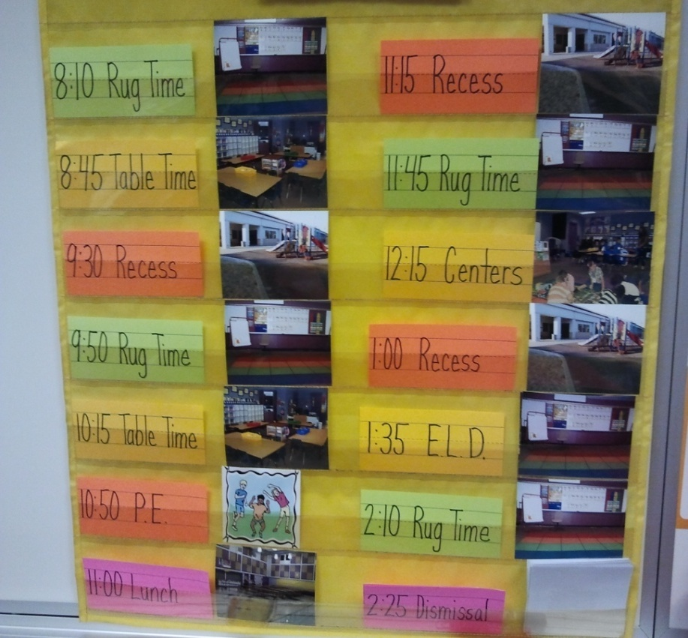
TK Supportive Environments
Clear Class Schedule
Notes:
This photo is also from a TK class.
The schedule has actual pictures of the children in the class engaged in the various activities throughout the class schedule. It was created in a pocket holder so that the pictures/schedule can be changed as needed. The pictures are turned around when the activity is completed so that the children know what activity is next. This can also be done with icons or drawings if pictures are not available at the beginning of the year as seen in the next picture.

Slide 33
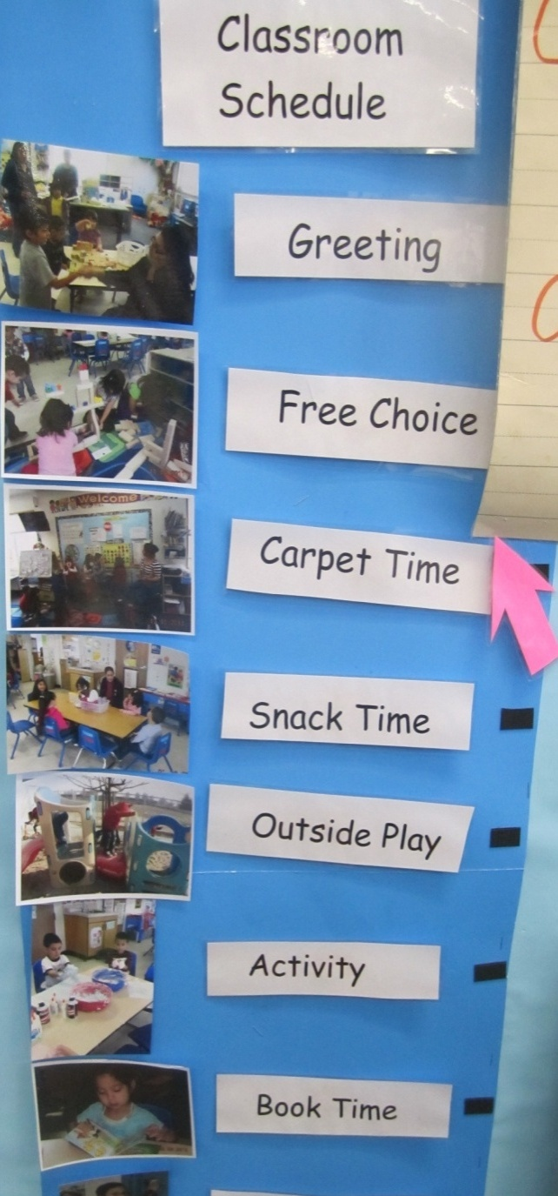
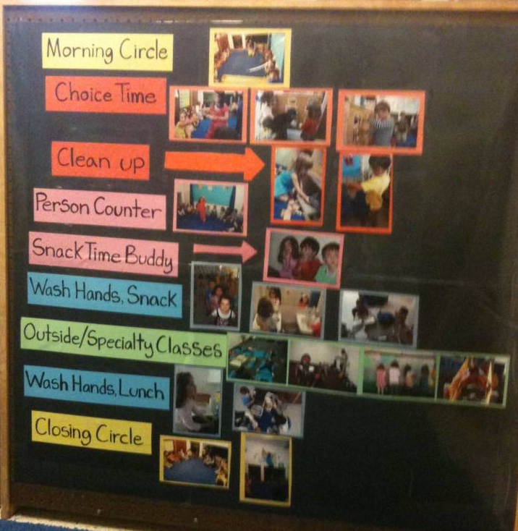
Teach Through Use of Visual Schedules
Notes:
The pink arrow indicates what activity is happening. Here are some additional examples of schedules that can be used in the classroom. As you can see, all of these schedules can be changed depending on the students needs.

Slide 34
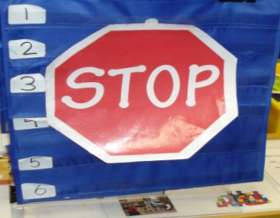
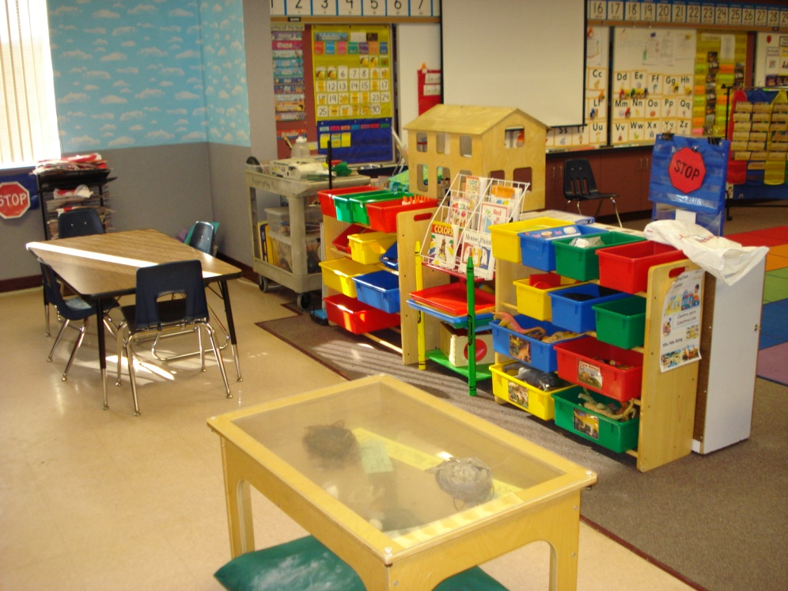
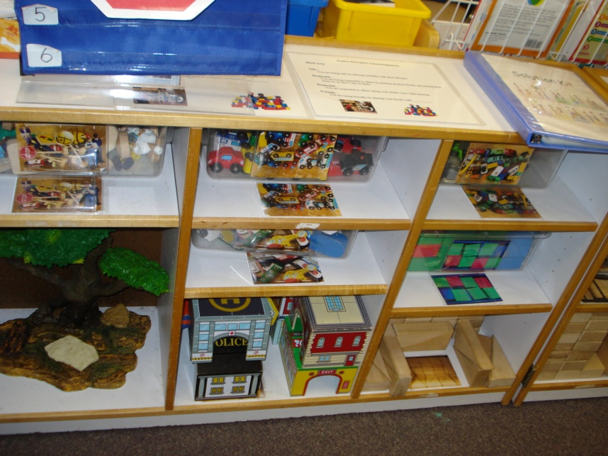
TK Supportive Environments
Block Area
Art and Sensory Area
Notes:
Teachers can develop a management system for students to select centers by providing visual systems to communicate appropriate group size.
The block area photo above, is an example of how one teacher communicates when a center is “closed”. The stop sign is displayed as a visual cue.
As exemplified in the art and sensory photo above, providing sufficient space for TK students helps to ensure maximum engagement in each area.

Slide 35

Building Positive Relationships with Children
Home
visits
Play
Happy
Grams
Empathy
Notes
home
Time &
Attention
Share
Source: Carolyn Webster-Stratton (1999)
Notes:
This metaphor, adopted from the work of Carolyn Webster-Stratton, uses a piggy bank to illustrate making deposits as a way of building positive relationships. This can be used, as seen in the next slide, to support children when they make positive deposits with their peers.
(Webster-Stratton, 1999)

Slide 36
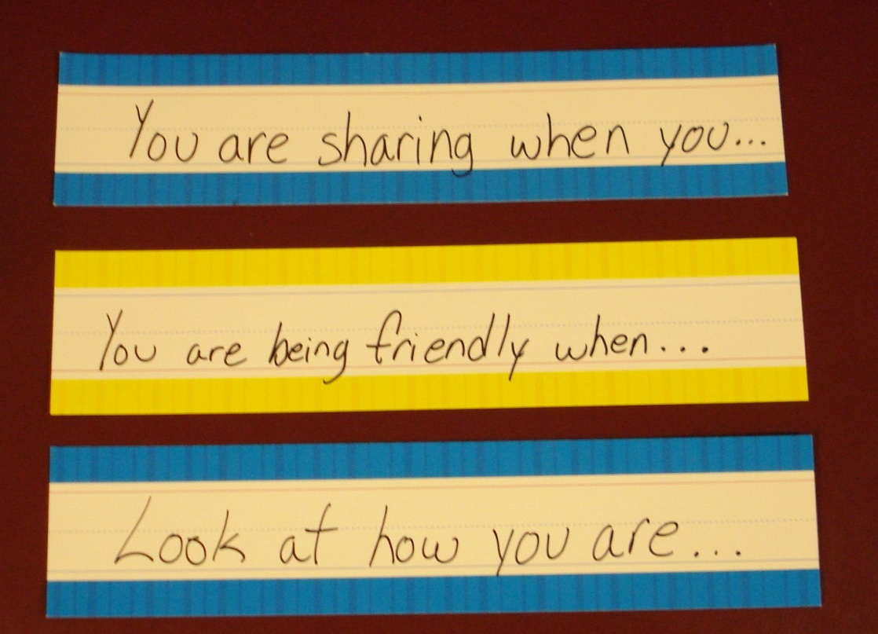
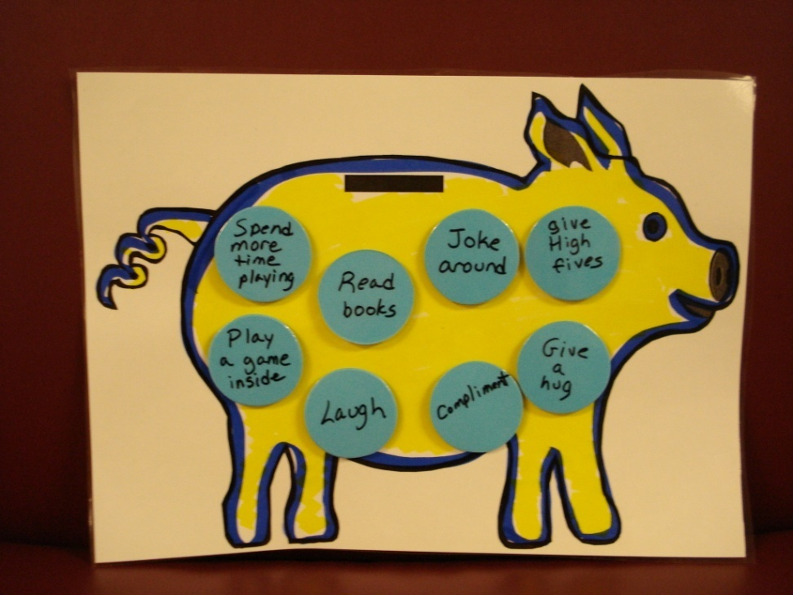
Give Positive Descriptive
Acknowledgments….
Notes:
Visual supports and reminders for both the staff and the children. Children often begin to give positive acknowledgments to each other, as well.
It is important to link the positive descriptive acknowledgments to the classroom expectations. This is how you can begin to ‘teach’ the expectations at the beginning of the year and reinforce throughout the year.

Slide 37
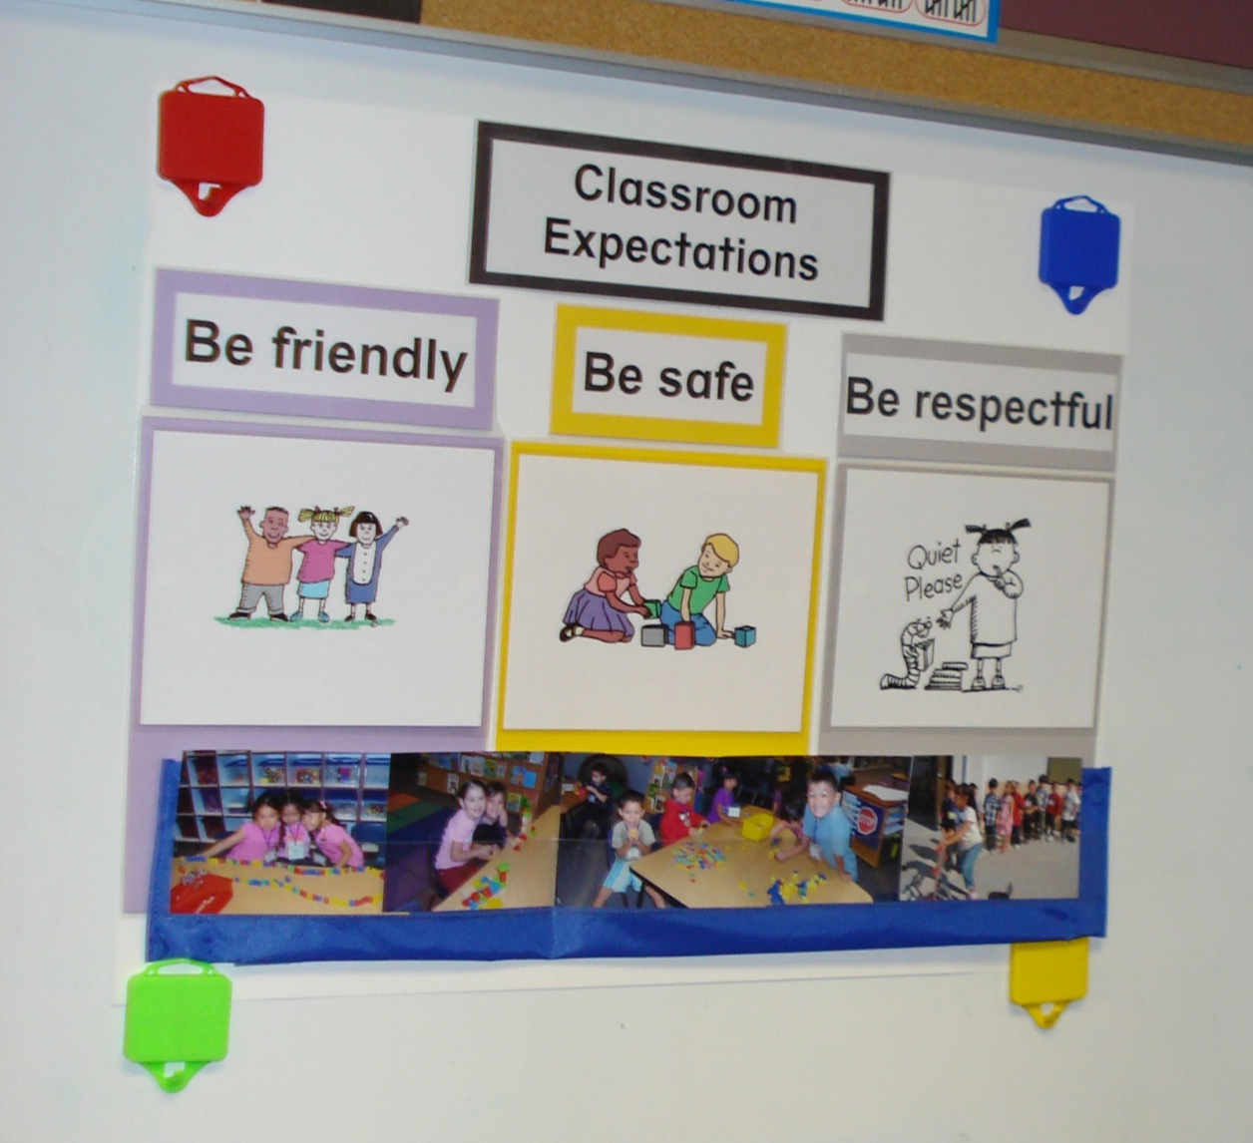
Teach Clear and Consistent Expectations

Slide 38
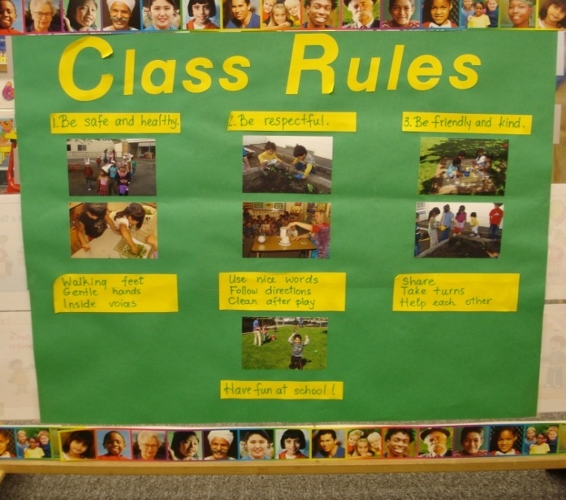
Teach Clear and Consistent Expectations
Classroom Expectations
Notes:
Make sure you have clear expectations that are posted clearly. Children love to see their own pictures. Many teachers have the children come up with what are examples of the expectations and then take pictures of the children who exhibit these expectations.
These expectations need to be taught throughout the year. Ways to teach are to model the appropriate behavior, use puppets to role play, read stories that promote social development. Frequently, throughout the day, ‘catch’ children doing an expectation and give a positive, descriptive acknowledgement.

Slide 39
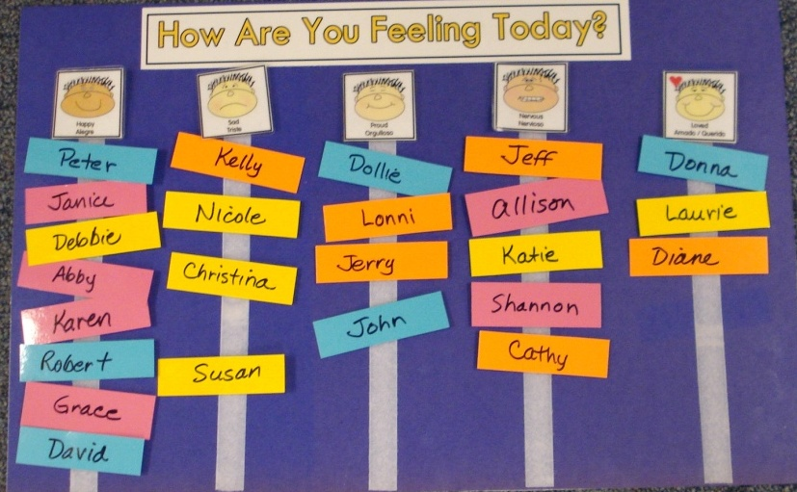
Teach About Feelings
  Source: http://csefel.vanderbilt.edu/modules/2006/feelingchart-sp.pdf
Notes:
Have children share their feelings at the beginning of the day, as they come in or transition from one activity to another. Children need to learn how to express and talk about their feelings so that they can manage their intense feelings when they are angry or hurt. Talking about feelings when it is not intense is important practice for everyone. You can use the pictures from the CSEFEL website http://csefel.vanderbilt.edu/modules/2006/feelingchart-sp.pdf

Slide 40
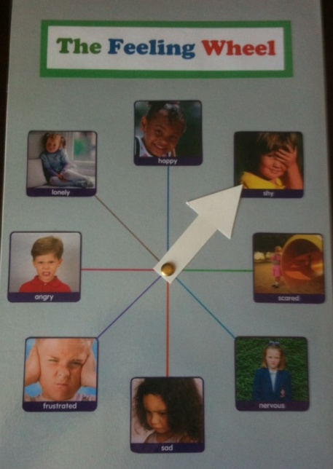
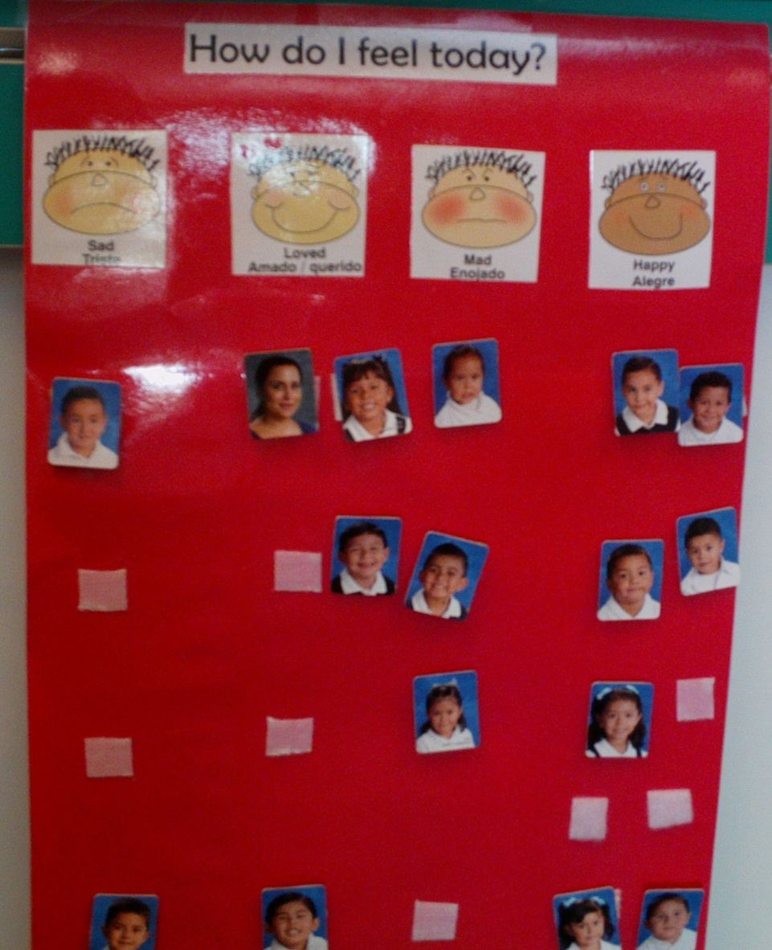
Teach About Feelings
Notes:
Here are a couple more examples of feeling charts. Children love to see their pictures so you can incorporate that into your charts, as well as, when you have time….
Incorporate a song about feelings… if your happy and you know it… add more creative feelings as well… if you are confused… if you are silly… if you are frustrated… etc.
http://www.jimgill.com/videos/silly_dance.html silly dance contest--fast forward to the song

Slide 41
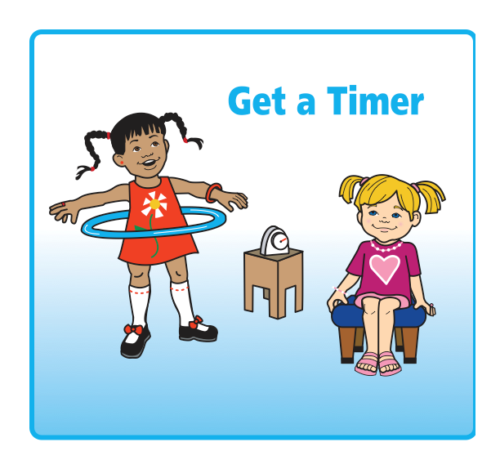
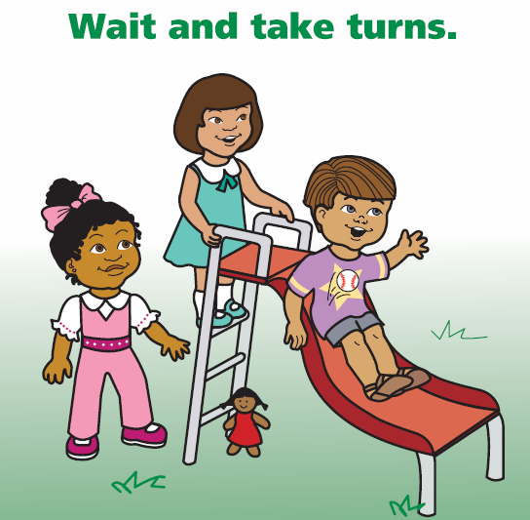
Teach How to Problem Solve
Source: http://csefel.vanderbilt.edu/resources/strategies.html
Notes:
CSEFEL has developed a Solution Kit that can be used as a tool in a TK classroom. This problem solving kit provides resources for children to learn how to solve their own problems independently with their peers. The Solution Kit, cue cards, and other resources can be found on the Vanderbilt/CSEFEL website.
http://csefel.vanderbilt.edu/resources/strategies.html
Children do not know how to problem solve on their own. This problem solving kit has been a great success in many TK classrooms. It gives the children a way to solve their own problems without always involving an adult. You can find these pictures on the CSEFEL website at the link on the slide.

Slide 42
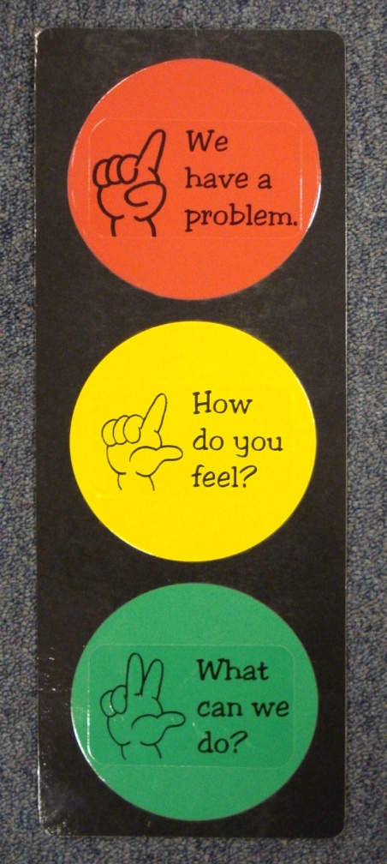
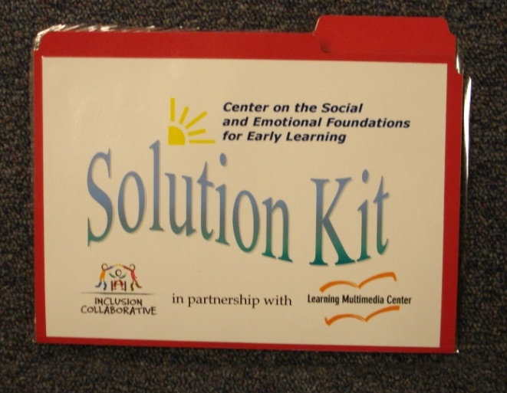
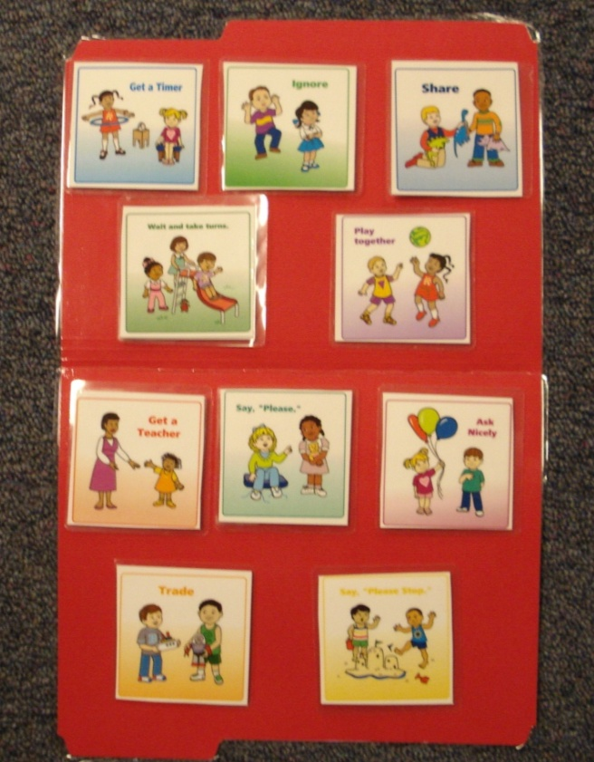
Solution Kit Choice Board
(problem solving strategies)
Source: http://csefel.vanderbilt.edu/resources/strategies.html
Notes:
While there are many examples of problem-solving tools developed by county offices of education and school districts, here is an example of how the Solution Kit was adapted to make it useable in many of the preschool and TK classrooms in Santa Clara County. The Inclusion Collaborative at the Santa Clara County Office of Education has created several different make and take materials to support teachers using these strategies easily in the classrooms. This has made a difference for the teacher to use these in the classroom immediately following a professional development opportunity. All of the visual strategies that we have shared today will assist all children in learning about self-regulation and effective social-emotional skills. These strategies are also effective for children who are English learners and for children who may have a disability.
Take a few minutes to think about how you may incorporate two or more of these strategies into your daily routine.

Slide 43
Resources
TK Online Resources
The Alignment of the California Preschool Learning Foundations with Key Early Education Resources | http://www.cde.ca.gov/sp/cd/re/documents/psalignment.pdf
California County Superintendents Educational Service Association (CCSESA) Information and resources for early education are posted on the CCSESA website under School Readiness Transitional Kindergarten (TK) Planning Guide – A Resource for Administrators of California Public School Districts | http://www.ccsesa.org/index/sp_prek.cfm http://www.ccsesa.org/index/documents/TransitionalKindergartenGuide-webversion.pdf
California Department of Education Kindergarten in California Transitional Kindergarten FAQs Transitional Kindergarten Implementation Guide | http://www.cde.ca.gov/ci/gs/em/
California Kindergarten Association An association to support kindergarten teachers | http://www.californiakindergartenassociation.org/transitional-kindergarten/
California Preschool Instructional Network (CPIN) CPIN, funded by CDE, conducts professional development on CDE publications such as the Preschool Learning Foundations, Preschool Curriculum Framework and Preschool English Learners Guide | http://www.cpin.us
Changing the Kindergarten Cutoff Date: Effects on California Students and Schools Cannon, J. S. and Lipscomb, S. | www.ppic.org/content/pubs/op/OP_508JCOP.pdf

Slide 44
Resources
TK Online Resources
National Association for the Education of Young Children Resources to promote Developmentally Appropriate Practice (DAP) | www.naeyc.org/DAP
Preschool Curriculum Framework, Volume 1, 2, and 3 Aligned with the foundations, the curriculum framework provides guidance on planning learning environments and experiences for young children | http://www.cde.ca.gov/sp/cd/re/documents/psframeworkkvol1.pdf http://www.cde.ca.gov/sp/cd/re/documents/psframeworkvol2.pdf http://www.cde.ca.gov/sp/cd/re/documents/preschoolframeworkvol3.pdf
Preschool English Learners: Principles and Practices to Promote Language, Literacy, and Learning A resource guide to educate preschool English learners | http://www.cde.ca.gov/sp/cd/re/documents/psenglearnersed2.pdf
Preschool Learning Foundations, Volume 1, 2, and 3 The foundations for preschool-age children identify key domains of learning and guide instructional practice | http://www.cde.ca.gov/sp/cd/re/documents/preschoollf.pdf http://www.cde.ca.gov/sp/cd/re/documents/psfoundationsvol2.pdf http://www.cde.ca.gov/sp/cd/re/documents/preschoolfoundationsvol3.pdf
Transitional Kindergarten (TK) California Online resources to support the successful implementation of transitional kindergarten | http://www.tkcalifornia.org/

Slide 45
Resources
TK Online Resources for Social-Emotional Development
California Collaborative on the Social & Emotional Foundations for Early Learning | http://www.cainclusion.org/teachingpyramid/index.html or http://www.cainclusion.org/
California Preschool Instructional Network (CPIN) | www.cpin.us
Center on the Social and Emotional Foundations for Early Learning | http://csefel.vanderbilt.edu or http://csefel.vanderbilt.edu/resources/strategies.html
Inclusion Collaborative | www.inclusioncollaborative.org
Technical Assistance Center on Social Emotional Intervention for Young Children (TACSEI) | www.challengingbehavior.org
TK California-Teaching Tools | http://www.tkcalifornia.org/teaching-tools/social-emotional/teaching-strategies/#socialemotionalsegies

Slide 46
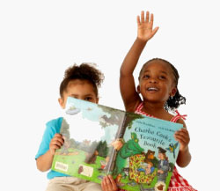
Questions?
Notes:
Optional Closing Activity:
Some simple strategies---Pick one to have the teachers create
Positive descriptive acknowledgment
Expectations chart
Feelings chart
Literature around feelings
Environment
Building relationships—when procedure is not DAP—children do not understand the concepts—teaching them what to do rather than giving abstract directions or concepts that they do not understand
Solution Kit
Schedule
DAP—modeling combination of DAP and teaching SED—won’t have discipline challenges—engagement
Administration—needs to understand how SE impacts discipline and overall development

Slide 47
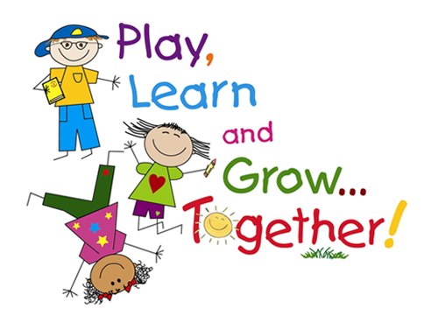
Thank You
Notes:
47

