Slide 1
Education’s Role in Emergency Management

Slide 2
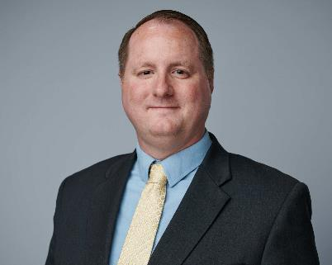
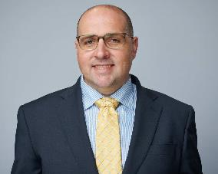
CDE’s Emergency Services Team
Joe Anderson – Manager
Recovery
Mitigation
Grants
Jake Wolf – Specialist
Planning
Response

Slide 3
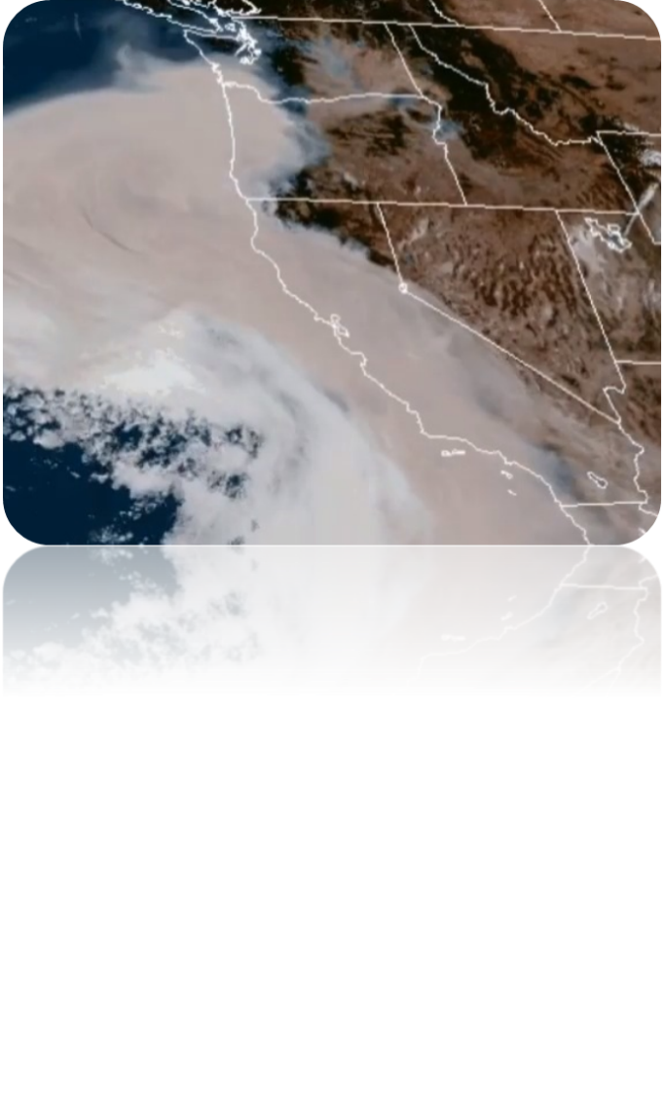
School Impacts
37 school facilities have been damaged or destroyed over the past 5 fire seasons
8 different counties
9 different fires
Many more schools have been impacted by smoke and evacuations

Slide 4
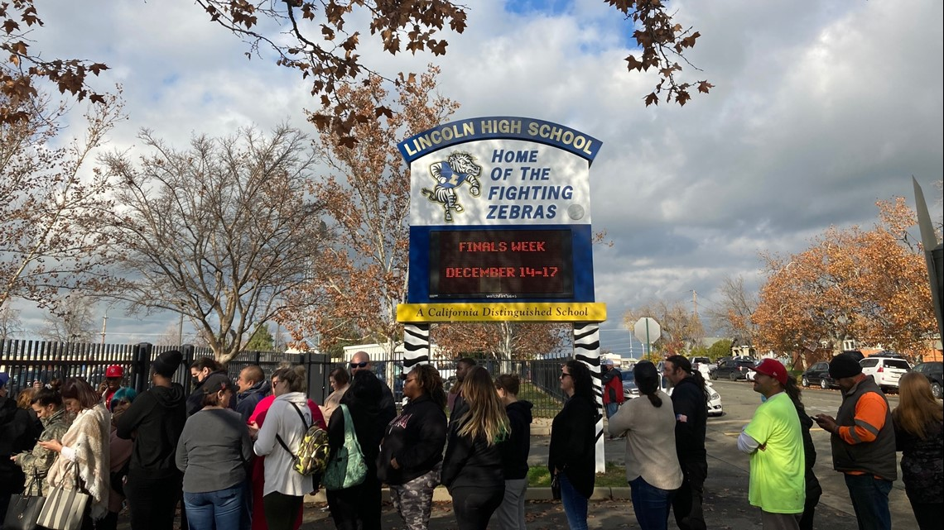
Data Needs
Status of school sites
Open or Closed
Damaged or Destroyed
Status of program sites
Early Learning
Expanded Learning
Status of students
Displaced and/or homeless

Slide 5
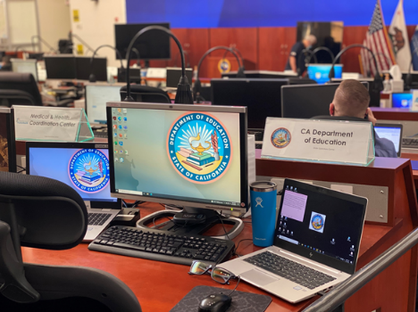
School Emergency Reporting System
The School Emergency Reporting System (SERS) was developed to:
Increase situational awareness
Track school closures
Discover unmet needs to coordinate resources
Act as a record of school impacts in disasters

Slide 6
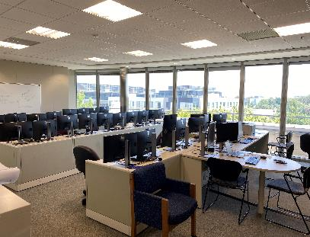
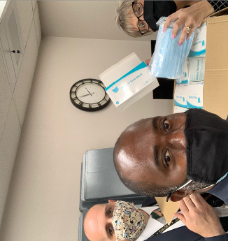
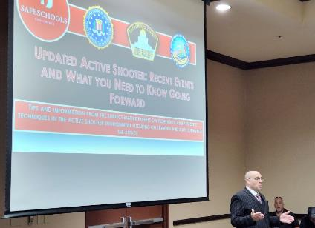
Emergency Services Team Developments
Track impacts from fires and support LEA’s
Developed the K-12 Education DOC
Coordinate personal protective equipment for COVID
Distributed over 90 million pieces of personal protective equipment
Quarterly meetings with counties
Active Shooter Training in Sacramento on 09/16
Wildfire Webinar for schools

Slide 7
COE Roles and Activities
Convener and coordinator
Establish Schools Liaison at the local Emergency Operations Center (EOC)
Identify roles and responsibilities
Provide consistent structure
Liaison between the state and LEAs
Share data, resources, needs, etc.
Avoid duplication of effort

Slide 8
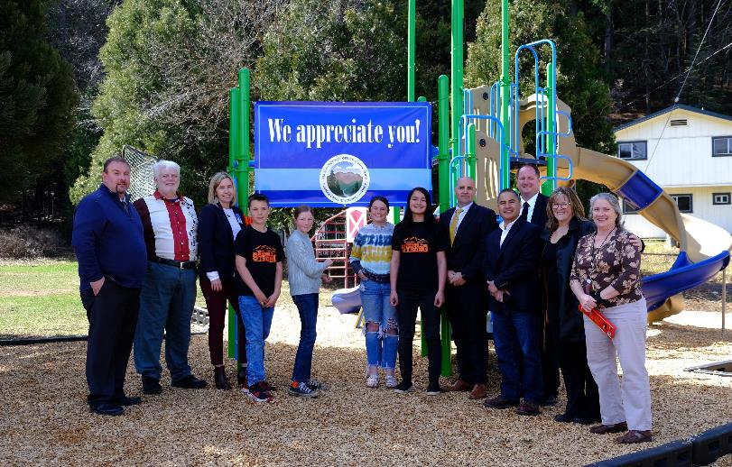
What Can You Do
Partner with emergency management in your jurisdiction
Emergency operations planning
Exercises and other preparedness activities
Funding and positions
Hazard mitigation
Urge LEAs to report on SERS
Participate in you county EOC
Advocate for “schools first”

Slide 9
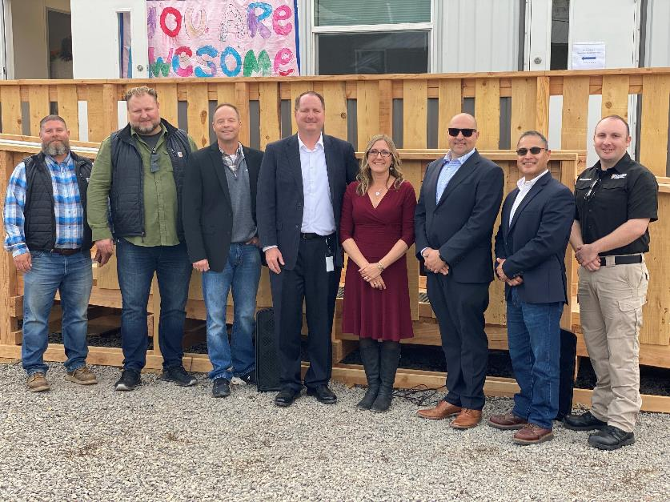
Schools Capabilities
Schools have assets
Transportation
Feeding Capability
Structures
Administration and teachers
Subject matter expertise
Community trust

Slide 10
Joe Anderson joanderson@cde.ca.gov (916) 204-4480 Jake Wolf jwolf@cde.ca.gov (916) 622-4269 General inbox EmergencyServices@cde.ca.gov

