Slide 1
2021-22 budget investments in School-based Health & mental health

Slide 2
ORGANIZING
FRAMEWORKS
COMMUNITY SCHOOLS
WHOLE CHILD APPROACH
COLLECTIVE
IMPACT
INTERCONNECTED
SYSTEMS
MULTI-TIERED SYSTEMS OF SUPPORT
INTEGRATED SYSTEM OF SUPPORT/CARE
CULTURE &
PRINCIPLES
PBIS
SEL
RTI2
PROGRAMS
& SERVICES
WELLNESS CENTERS
SCHOOL-BASED HEALTH CENTERS
MENTAL HEALTH RESOURCE CENTERS
MEDI-CAL ENROLLMENT & CLAIMING
ACADEMIC & CAREER COUNSELING
BEFORE & AFTER SCHOOL
MENTORING & TUTORING
EARLY LEARNING & CHILDCARE
FOOD & NUTRITION
TRANSPORTA-TION
HOUSING ASSISTANCE
DEVICES, BROADBAND & IT SUPPORT

Slide 3
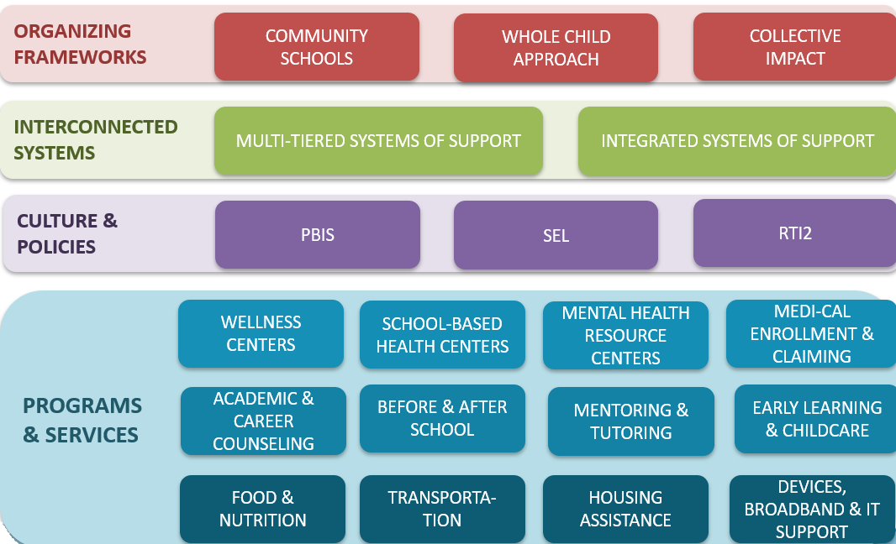
CHILDREN & YOUTH BEHAVIORAL HEALTH INITIATIVE
(AB 133, SEC 13, 116, 342, 355)

Slide 4
Children and Youth Behavioral Health Initiative
School-Linked Behavioral Health Partnerships & Capacity - $100M in 21/22, $450M in 22/23 ($550M total), W&I 5961.2
$400M earmarked for preschool through 12th grade; $150M for higher education
DHCS will determine the eligibility criteria, grant application process, and methodology for distribution of funds
Notes:
Your cooperation in the event of an emergency is appreciated

Slide 5
Children and Youth Behavioral Health Initiative
School-Linked Behavioral Health Partnerships & Capacity - $100M in 21/22, $450M in 22/23 ($550M total), W&I 5961.2
Purpose:
“To build partnerships, capacity and infrastructure supporting ongoing school-linked behavioral health services for children and youth”
“To expand access to licensed medical and behavioral health professionals, counselors, peer support specialists, community health workers, and behavioral health coaches”
“To build a statewide, community-based organization provider network for behavioral health prevention and treatment services”
“To enhance coordination and partnerships with respect to behavioral health prevention and treatment services…via appropriate data sharing systems.”
Notes:
Your cooperation in the event of an emergency is appreciated

Slide 6
Children and Youth Behavioral Health Initiative
School-Linked Behavioral Health Partnerships & Capacity - $100M in 21/22, $450M in 22/23 ($550M total), W&I 5961.2
Allowable activities include, but are not limited to:
Addressing behavioral health disparities while providing linguistically and culturally competent services
Supporting administrative costs including planning, project management, training, and technical assistance
Linking plans, counties, and school districts with local social services and community-based organizations
Implementing telehealth equipment and virtual systems in or near schools
Implementing data-sharing tools, information technology interfaces, or other technology investments designed to connect to behavioral health services
Notes:
Your cooperation in the event of an emergency is appreciated

Slide 7
Children and Youth Behavioral Health Initiative
Medi-Cal & Commercial Health Plans Shall Reimburse for School-Based Services, H&S 1374.722, Insurance 10144.53, W&I 5961.4
Starting on January 1, 2024, all Medi-Cal managed care, commercial health, and disability insurance plans shall reimburse LEAs for:
All mental health or substance abuse treatment services the plan is responsible for covering (i.e. EPSDT/non-intensive services)
Provided to an individual aged 0 to 25 who is an enrollee of the Medi-Cal, commercial health, or disability insurance plan
Provided by a licensed or authorized mental health provider
Provided at a school a school site (a facility or location used for K-16 purposes and locations not owned or operated by a an LEA if the LEA provides or arranges for the provision of the treatment)
Regardless of LEA network status (ie cannot deny because an LEA is “out of network”)
Notes:
Your cooperation in the event of an emergency is appreciated

Slide 8
Children and Youth Behavioral Health Initiative
Medi-Cal & Commercial Health Plans Shall Reimburse for School-Based Services, H&S 1374.722, Insurance 10144.53, W&I 5961.4
There are only three reasons the plan may deny a claim:
The individual receiving the services was not actually an enrollee of the Medi-Cal, commercial health, or disability insurance plan
The services were not provided by a licensed or authorized mental health provider
The services were not actually provided
The health plan shall reimburse the greater of either the state-established school-linked fee or the health plan/LEA negotiated rate.
DHCS will establish a school-linked fee schedule
Notes:
Your cooperation in the event of an emergency is appreciated

Slide 9
Children and Youth Behavioral Health Initiative
Medi-Cal & Commercial Health Plans Shall Reimburse for School-Based Services, H&S 1374.722, Insurance 10144.53, W&I 5961.4
The health plan cannot require preauthorization. (Caveat- DHCS stakeholder group will decide if there are an exceptions to this rule.)
The health plan must pay claims in a timely manner (generally, 30 days).
Neither the plan nor the LEA may charge a copayment, deductible, or any other form of cost sharing.
*Caveat: This law does not relieve an LEA from the requirement to “accommodate or provide services” to a student with an IEP.
Notes:
Your cooperation in the event of an emergency is appreciated

Slide 10
Children and Youth Behavioral Health Initiative
Medi-Cal Managed Care Incentives – Approx. $400M for Managed Care Plans ($227M State Funds, plus federal matching), W&I 5961.3
Incentive payments for Medi-Cal managed care plans that “increase access to preventative, early intervention and behavioral health services by school-affiliated behavioral health providers for K-12 children in schools.”
Incentive payments shall be used to develop “new collaborative initiatives” and “build on existing school-based partnerships”
Incentives must supplement, not supplant existing funding
(Legislative summary states that eligibility is conditioned on Medi-Cal managed care plan entering into a three-party partnership with an LEA and county mental health agency)
Notes:
Your cooperation in the event of an emergency is appreciated

Slide 11
Children and Youth Behavioral Health Initiative
Medi-Cal Managed Care Incentives – Approx. $400M for Managed Care Plans ($227M State Funds, plus federal matching), W&I 5961.3
Medi-Cal managed care plans will only receive payments if they meet metrics, interventions, and goals, as defined by a DHCS stakeholder group, in alignment with the following:
Technical assistance to increase coordination and partnerships between schools and health plans (e.g. contracts, MOUs, agreements)
Planning efforts to use data to identify needs, gaps, disparities, inequities, and resources and develop a framework for a robust and coordinated system of social, emotional and behavioral health
Developing or piloting behavioral health wellness programs in school settings (e.g. Mental Health First Aid, SEL)
Expanding the workforce by using community health workers or peers
Increasing telehealth services in schools
Implementing suicide prevention strategies
Improving performance and outcomes-based accountability for behavioral health access
Increasing access to substance abuse prevention, early intervention, and treatment
Notes:
Your cooperation in the event of an emergency is appreciated

Slide 12
Children and Youth Behavioral Health Initiative
Behavioral Health Services & Supports Virtual Platform- $680M
Establish a virtual platform targeted at ages 0 to 26 that offers Tier 1 and some Tier 2 services, with streamlined referrals to health plans for more intensive services.
Services provided virtually, regardless of insurance or health plan. Includes links to other social services like housing and food assistance.
Includes screening tools and activities.
Notes:
Your cooperation in the event of an emergency is appreciated

Slide 13
Children and Youth Behavioral Health Initiative
Behavioral Health Workforce Capacity - $427M & $428M
Recruit and train 10,000 culturally and linguistically proficient counselors and coaches to serve K-12 and college age youth.
Increase the number of licensed and unlicensed mental health professionals, including creation of new “behavioral health coaches”
Funds could pay for training programs, tuition, and mentorship or coaching.
Notes:
Your cooperation in the event of an emergency is appreciated

Slide 14
Children and Youth Behavioral Health Initiative
Public Education Campaign - $125M
Enhance Medi-Cal Benefits (ACEs & dyadic care) - $800M
Behavioral Health Infrastructure (mobile crisis teams) - $150M
Evidence-Based Behavioral Health Programs - $429M
CalHOPE - $45M
E-Consult Services & Training - $165M
Notes:
Your cooperation in the event of an emergency is appreciated

Slide 15
COMMUNITY SCHOOLS PARTNERSHIP PROGRAM (AB 130, SEC 8)

Slide 16
COMMUNITY SCHOOLS PARTNERSHIP PROGRAM
Provides $2.8B for a second round of funding (grant was created in 20/21 budget)
Governor’s proposal estimates that this would fund more than half of all schools in CA
Competitive grant process
Funds
10% available for 2 year planning grants (up to $200,000 each)
70% for implementation grants (up to $500,000 each annually for up to 5 years)
20% for coordination grants (up to $100,000 annually) from 2024/25 to 2027/28
Funds available for encumbrance until 6/30/2028
RFA will be updated by 11/15/2021 (and presumably go out then)
Grant decisions made by the SPI subject to approval by the SBE
Notes:
Your cooperation in the event of an emergency is appreciated

Slide 17
COMMUNITY SCHOOLS PARTNERSHIP PROGRAM
Eligibility
An LEA that meets at least one of the following: 50%+ unduplicated; higher than average dropout rate; higher than average suspension/expulsion rate; higher than average rates of homelessness, foster, or justice involved youth; or can demonstrate an exceptional need or service to a particular population
Consortiums are allowed, including those lead by COEs
Behavioral health agencies, Head Start grantees, and ELC contractors can apply in partnership with an LEA
Prioritizes creation of new community schools and applicants with high FRPM rates
Prioritization: applicants with 80%+ unduplicated pupils, plans that are sustainable, plans that include early learning and childcare, collaborations with other agencies, plans that demonstrate need, plans to provide health and mental health at the school site, new community schools
Notes:
Your cooperation in the event of an emergency is appreciated

Slide 18
COMMUNITY SCHOOLS PARTNERSHIP PROGRAM
Establishes 5 (or more) new TA leads for a term of 7 years (through 2028/28). Leads would provide:
School and community needs and asset assessments
Help improving community engagement, creating community partnerships
Assist schools to develop and combine funding to create sustainability
Coordination of services across agencies and schools
Outreach and TA to applicants before and after application awards
Development of community school resources, sharing of best practices, and data collection
Notes:
Your cooperation in the event of an emergency is appreciated

Slide 19
MENTAL HEALTH STUDENT SERVICES ACT
(AB 133, SEC 353)

Slide 20
MENTAL HEALTH STUDENT SERVICES ACT
Provides MHSOAC with a second round of funding ($205M) for MHSSA grants that would allow them to fund all additional applicants
New language:
“the commission shall award a grant under this section to a county mental health or behavioral health department or another lead agency, as identified by the partnership within each county that meets the requirements of this section.”
Plans must include a description of how the “partnership will collaborate with preschool and childcare providers or other early childhood service organizations to ensure the mental health needs of children are met before they transition to a school setting.”
MHSOAC ED Toby Ewing estimates that it would cost only $30 million to fund the remaining applicants from the first round that were not funded
Toby will be joining us to discuss plans for these funds
Notes:
Your cooperation in the event of an emergency is appreciated

Slide 21
SCHOOL HEALTH DEMONSTRATION PROJECTS
(AB 130,
SEC 61)

Slide 22
MEDI-CAL BILLING LEAD
(AB 130,
SEC 61)

Slide 23
Student Health, Mental Health, and Medi-Cal
SCHOOL HEALTH DEMONSTRATION PROJECTS
$2.5 million to fund 25 LEAs to participate in a pilot for the purpose of assessing and maximizing Medi-Cal reimbursement (LEA BOP, SMAA, managed care, EPSDT, county mental health)
$2.5 million for 3 LEA technical assistance leads to provide TA to the 25 LEA grantees.
MEDI-CAL BILLING LEAD
$250,000 ongoing annually for an LEA to provide TA on school-based Medi-Cal programs in coordination with CDE, DHCS, and the state system of support leads.

Slide 24
EXPANDED LEARNING OPPORTUNITIES GRANT
(AB 130,
SEC 52)

Slide 25
EXPANDED LEARNING GRANT ab 130, Section 52
Starts in 2021/22
Ongoing (presumably)
Noncompetitive, for all LEAs serving grades TK to 6 with unduplicated pupils (except non-classroom based charter schools)
Generally aligns with ASES requirements/standards (ie credentialed teacher not required, can contract out)
Requires that all LEAs receiving the grant provide:
175 school days, 9 hours of combined instructional time and expanded learning (“opportunities to engage pupils in enrichment, play, nutrition, and other developmentally appropriate activities”).
Plus 30 additional non-school days of expanded learning
2021-2022 | Must serve 50% of unduplicated pupils
2022-2023 | Must serve 100% of unduplicated pupils

Slide 26
MTSS SUBGRANTS
(AB 130,
SEC 23)

Slide 27
Student Health, Mental Health, and Medi-Cal
OTHER INVESTMENTS
Established an Office of School Based Health at CDE.
Requires CDE to hire a nurse consultant.
Provides CDE with funding to train LEAs on use of school climate surveys and standardize surveys.
$30 million for COEs to provide tutoring, mentoring, counseling, and direct interventions to foster youth.

