Slide 1
Notes:
1 minute Running time = 1 minute
Introduction
Slide intent: The purpose of this slide is to introduce the session and presenters.
Presenter says:
(Introduce presenters)
We are pleased to present an overview of the CCSESA publication “Improving Performance of Students with Disabilities: A Handbook for Providing Technical Assistance to Local Education Agencies.”
This Handbook was developed collaboratively by staff from the El Dorado and Sacramento County Offices of Education (COE) in 2017 through a grant received from CCSESA. The team included members with expertise in Special Education, school improvement processes, data use, and accountability systems. A graphic design team produced the final document and training materials.
CCSESA anticipated that when the California School Dashboard (Dashboard) was released, COE staff might benefit from guidance that would assist them in providing “Differentiated Assistance” and supporting local districts to improve the performance of Students With Disabilities.
CCSESA disseminated the draft document for review to various groups (such as CISC and SEACO).
The feedback was incorporated into the final version that was approved by CCSESA.
Materials required:
Four Interactive Posters (posted in different locations throughout the room), 4 sticky dots per person
Guidance Document: printed document or retrieve online from CCSESA.org
Supplies (sticky notes, highlighters, pens, chart paper, tape, etc…)
Handouts:
PPT (recommend PDF with 2 slides per page, portrait orientation, staple on upper-left corner)

Slide 2
Handbook Contents
The Handbook has four sections:
Section 1: California’s Accountability System, pp. 1 – 4
Section 2: Support for Students with Disabilities, pp. 5 – 8
Section 3: Continuous Improvement Cycle, pp. 9 – 22
Section 4: Toolkit, pp. 23 – 62
Notes:
2 minutes Running time = 4 minutes
Introduction
Slide intent: The purpose of this slide is provide an overview of the sections of the Handbook.
Presenter says:
Let’s take a minute to look at the organization of the Handbook. It is divided into the four sections that you saw on the Agenda. Each section is labeled with a band at the bottom of the page so that the reader can quickly locate the section they want to see.
We will highlight the key information included in each section on the following slides.
(Tip: If participants have a copy of the Handbook, ask them to tab each section with a sticky note)
Section 1 (pages 1–4): Provides an overview of the key components of California’s new accountability system with a focus on the California School Dashboard and points out implications for Students with Disabilities (SWD).
Section 2 (pages 5–8):
Includes background information about California’s SWDs and how they are included in the Local Control and Accountability Plan (LCAP). Models and processes for supporting SWDs are outlined including: Multi-Tiered System of Supports (MTSS), Universal Design for Learning (UDL), and Evidence-Based Practices. Links to in-depth information about these models are included.
Section 3 (pages 9–22):
Describes practices for LEAs to use to implement elements of a continuous improvement process using a “plan, do, study, act” cycle.
This section provides an overview of the planning process and highlights of the types of plans that are typically developed for SWDs (e.g., Individual Education Program (IEP), Single Plan for Student Achievement (SPSA), and LCAP). This section is full of guiding questions, tips, tools, and links to in-depth resources for each component of the continuous improvement cycle.
Section 4 (pages 23–62):
Provides a resource toolkit that includes rubrics, Dashboard analysis templates, tools, and links to a variety of resources that support the technical assistance and guidance strategies presented in the Handbook.

Slide 3
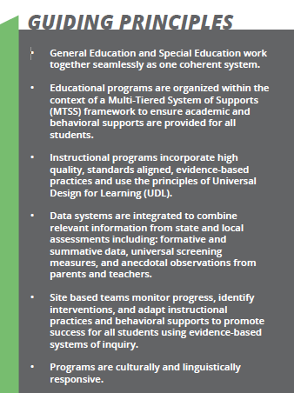
Guiding Principles
The Handbook is based on six guiding principles derived from:
Effective program elements necessary for SWDs, and
Recommendations from the 2015 Statewide Task Force Report on Special Education “One System: Reforming Education to Serve ALL Students.”
Notes:
1 minute Running time = 11 minutes
Introduction
Slide intent: The purpose of this slide is for participants to become familiar with the six guiding principles.
Presenter says:
The guidance in the Handbook was based on six guiding principles taken from known effective program elements necessary for Students With Disabilities and a recent (2015) Statewide Task Force Report on Special Education “One System: Reforming Education to Serve ALL Students.”
The Task Force report can be found on the San Mateo County Office of Education website at: http://www.smcoe.org/about-smcoe/statewide-special-education-task-force/

Slide 4
Guiding Principles
General Education and Special Education work together seamlessly as one coherent system.
Educational programs are organized within the context of a Multi-Tiered System of Supports (MTSS) framework to ensure academic and behavioral supports are provided for all students.
Instructional programs incorporate high quality, standards aligned, evidence-based practices and use of principles of Universal Design for Learning (UDL).
Notes:
5 minutes (Slides 6-8) Running time = 16 minutes
Introduction
Slide intent: The purpose of this slide is for participants to become familiar with the six guiding principles.
Presenter says:
Here are the first 3 principles.
General Education and Special Education work together seamlessly as one coherent system.
Educational programs are organized within the context of a Multi-Tiered System of Supports (MTSS) framework to ensure academic and behavioral supports are provided for all students.
Instructional programs incorporate high quality, standards aligned, evidence-based practices and use of principles of Universal Design for Learning (UDL).

Slide 5
Guiding Principles, continued
Data systems are integrated to combine relevant information from state and local assessments including: formative and summative data, universal screening measures, and anecdotal observations from parents and teachers.
Site based teams monitor progress, identify interventions, and adapt instructional practices and behavioral supports to promote success for all student using evidence-based systems of inquiry.
Programs are culturally and linguistically responsive.
Notes:
5 minutes (Slides 6-8) Running time = 17 minutes
Introduction
Slide intent: The purpose of this slide is for participants to become familiar with the six guiding principles.
Presenter says: This slide show principles 4-6.
Data systems are integrated to combine relevant information from state and local assessments including: formative and summative data, universal screening measures, and anecdotal observations from parents and teachers.
Site based teams monitor progress, identify interventions, and adapt instructional practices and behavioral supports to promote success for all student using evidence-based systems of inquiry.
Programs are culturally and linguistically responsive.
The ideas from these principles formed the foundation of the Handbook.
Note: As time allows: Invite participants to share with the whole group why the principle they selected resonates with them.
Thank the participants for sharing their thoughts.

Slide 6
Notes:
1 minute Running time = 18 minutes
Slide intent: Introduce the session’s information about California’s Accountability System.
Section 1
Presenter says: Now we’ll turn our attention to Section 1 of the Handbook: California’s Accountability System.
This section of today’s training will provide you a brief overview, and in some cases a review, of California’s accountability system including the California School Dashboard.
Understanding the how the Dashboard is organized is important to us because it is used to report the performance of student groups on the LCFF state indicators. If SWDs are not performing well in two or more priority areas, the district will be identified for “Differentiated Assistance.”
Additionally, in Fall of 2018, the Every Student Succeeds Act (ESSA) will require California to identify schools for improvement based on the performance of students in schools. This will have implications for SWDs. The Fall 2017 California School Dashboard results indicate that half of the schools in the state received the lowest ranking for English-language arts (50.8%) and nearly half received the lowest ranking for mathematics (44%) for the SWD group.
Materials required:
None.

Slide 7
Handbook Contents
Section 1: California’s Accountability System (pp. 1 – 4)
Overview of the key components of the California School Dashboard and key information about implications for Students with Disabilities
State and local indicators of school success
Getting to know the reports in the Dashboard
Disaggregated data: A closer look at the SWDs
Accessibility supports
Participation of SWDs in California’s assessment system
Notes:
1 minute Running time = 3 minutes
Slide intent: To introduce the topics covered in Section 1 – California’s Accountability System.
Presenter says:
Section 1 is on pages 1–4 of the Handbook. This section provides an overview of the key components of California’s accountability system, particularly the California School Dashboard and points out implications for Students with Disabilities.
The topics addressed in this section are listed on the slide.
Let’s go into further detail on some of these topics.
Materials required:
None.

Slide 8
California’s Accountability System
Single, coherent system that includes multiple indicators of success
Tied to the Local Control Funding Formula (LCFF)
Focused on:
Transparency
Equity
Continuous improvement
Includes:
School districts
Schools, including charter schools
Student groups (ethnic/racial groups, English learners, low income, students with disabilities, homeless, and foster)
Notes:
1 minute Running time = 1 minute
Slide intent: To introduce the features of California’s accountability system.
Section 1
Presenter says:
California now has a single, coherent accountability system that meets requirements of both federal and state law.
This system includes multiple measures of success.
The accountability system is part of the 2013 Local Control Funding Formula and is focused on three key factors:
Transparency
Equity, and
Supporting local continuous improvement efforts.
As the single, coherent system it provides information about all school districts (and county offices of education), schools, including charter schools, and student groups.
Of particular focus today is the students with disabilities group, but the information that I’m sharing with you and the process that you’ll go through to learn more about the performance of your students with disabilities group can be applied to any student group.
Materials required:
None.

Slide 9
Notes:
1 minute Running time = 1 minute
Slide intent: To introduce the features of California’s accountability system.
Section 1
Presenter says:
California now has a single, coherent accountability system that meets requirements of both federal and state law.
This system includes multiple measures of success.
The accountability system is part of the 2013 Local Control Funding Formula and is focused on three key factors:
Transparency
Equity, and
Supporting local continuous improvement efforts.
As the single, coherent system it provides information about all school districts (and county offices of education), schools, including charter schools, and student groups.
Of particular focus today is the students with disabilities group, but the information that I’m sharing with you and the process that you’ll go through to learn more about the performance of your students with disabilities group can be applied to any student group.
Materials required:
None.

Slide 10
California School Dashboard
One key component to California’s accountability and continuous improvement system
Series of reports that displays performance on multiple measures (“indicators”) of school success
Indicators include:
State – as measured by the State of California (six)
Local – as measured by local school districts (five)
The Dashboard assists in identifying strengths and areas of improvement for districts, schools, and student groups.
Notes:
1 minute Running time = 5 minutes
Slide intent: To introduce the California School Dashboard.
Presenter says:
One of the key components to California’s accountability system is the California School Dashboard.
Launched in the spring of 2017, the Dashboard is the mechanism by which performance of school districts, schools, and student group is measured.
The California School Dashboard, or Dashboard, consists of a series of reports that displays information on multiple measures, called indicators.
There are eleven indicators of performance, six that are state indicators meaning they are measured by data collected and reported by the California Department of Education (CDE) and five that are local indicators meaning that they are collected and reported locally by the school or school district.
Materials required:
None.

Slide 11
State and Local Indicators of Success
State Indicators
Chronic Absenteeism
Suspension Rate
English Learner Progress
High School Graduation Rate
College/Career Readiness
Academic Performance
English-Language Arts
Mathematics
Local Indicators
Basic Conditions
Teacher Qualifications
Safe and Clean Buildings
Textbooks for All Students
Implementation of Academic Standards
School Climate Surveys
Safety
Connection to School
Parent Engagement
Access to Courses
Notes:
2 minutes Running time = 7 minutes
Slide intent: To introduce the eleven indictors included in the California School Dashboard.
Presenter says:
The left hand side of this slide shows the six state indicators. As you can see there is a range of indicators covering several different aspects of school performance.
Remember that the state indicators are common for all schools and school districts and are reported by the CDE.
On the right hand side of this slide you see the five local indicators.
Local indicators include things like teacher qualifications, clean facilities, and adequate textbooks – items that are also reported in the School Accountability Report Card.
Other key local indicators include school climate surveys and measures of parent engagement.
Materials required:
None.

Slide 12
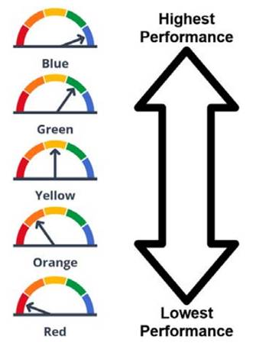
Performance Ratings
Performance on state indicators is displayed in easy to understand color ratings
Performance on local indicators is displayed as:
Met
Not Met
Not Met for 2+ Years
Notes:
2 minutes Running time = 9 minutes
Slide intent: To introduce the performance ratings.
Presenter says:
Performance on the indicators shown on the last slide is rating in two different ways.
For state indicators, a colored rating is provided. There are five colors as shown on this slide.
The state goal is that schools and school districts are performing at the Green or Blue level.
Colors aren’t provided for local indicators. Instead, each local indicator is measured on a Met or Not Met scale. In some cases, a school or school district may receive a rating of “Not Met for 2 or more Years” for indicators that have shown little or no progress over time.
Materials required:
None.

Slide 13
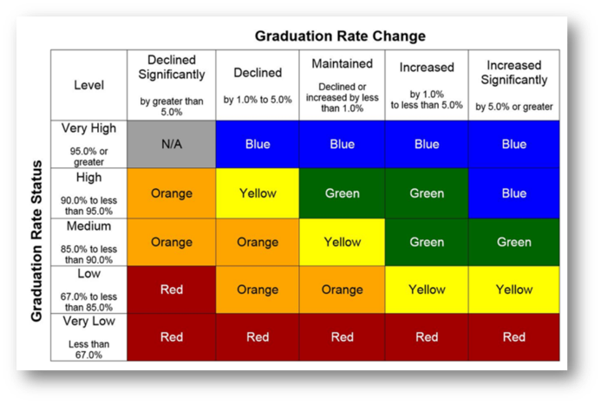
Performance on State Indicators Combines “Status” and “Change”
The color-coded ratings for each state indicator are based on a combination of “status” and “change.”
Status = most recent performance
Change = difference from prior year to current year
Notes:
2 minutes Running time = 11 minutes
Slide intent: To introduce the way that schools are measured on the indicators
Presenter says:
The color coded ratings for each state indicator are based on a combination of two measures:
First, the school or school district’s most recent performance. This is referred to as the “status”.
The second measure is the difference between the most recent performance and the prior year. This is referred to as the “change”.
As you can see in the bottom right hand side of this slide, there are colored 5x5 tables for each indicator showing how the color ratings are assigned.
Both status and change are divided into five categories.
Status is shown on the vertical axis and change is shown on the horizontal axis.
Materials required:
None.

Slide 14
Who Receives a Dashboard?
All Local Educational Agencies
All schools, including charter schools
The Dashboard reports on specific student groups
Major racial/ethnic groups
Low income students
English learner students
Students with disabilities (SWD)
Foster youth
Homeless
Notes:
1 minute Running time = 12 minutes
Slide intent: To introduce the type of entities that receive a California School Dashboard.
Presenter says:
Dashboard reports are produced at the LEA level (districts, COEs) and the school level. Reports include specific student groups.
Materials required:
None.

Slide 15
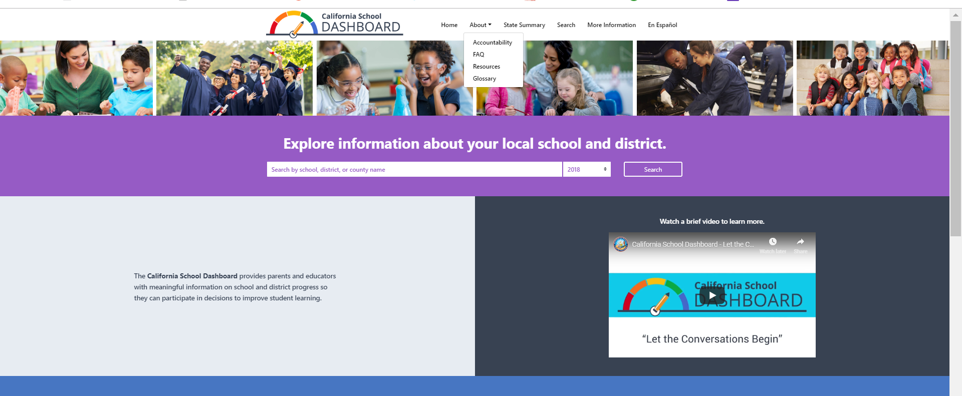
Accessing the Dashboard
Online access at https://www.caschooldashboard.org/
Notes:
1 minute Running time = 13 minutes
Slide intent: To show how the Dashboard reports are accessed on the CDE Web site.
Presenter says:
This slide shows a screenshot of the Dashboard landing page.
You can see that it’s very easy to type in the name of a school or school district into the search bar to find the Dashboard report.
You can also see on this landing page has an intro video. The “About” tab at the top of screen includes links to additional resources such as a dashboard FAQ, info on accountability, and additional resources such as a communications toolkit
Presenter Note: communication toolkit now links to CDE’s accountability page, with many dashboard resources. Under the “translations” tab, the Getting To Know Dashboard flyer is now available in multiple languages.
Materials required:
None.

Slide 16
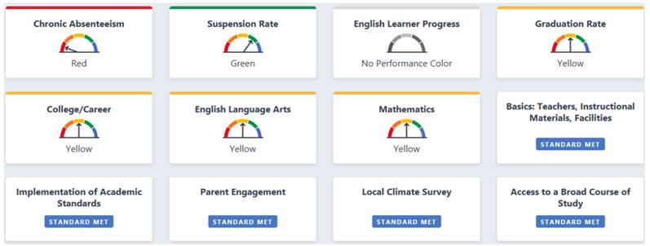
Navigating the Dashboard
At-a-glance: State & Local Indicators
Student Population
Notes:
1 minute Running time = 14 minutes
Slide intent: To introduce the Dashboard components
Presenter says:
Once you type in the name of a school or school district into the search box and select it from the resulting menu, you will see the school’s landing page.
The landing page has three primary sections. I will show you each one and highlight the kind of information each section gives you.
Here, you see the first two sections of the dashboard. The first section is an At-A-Glance of each of the Indicators. The second section is an overview of the student population.
Materials required:
None.

Slide 17
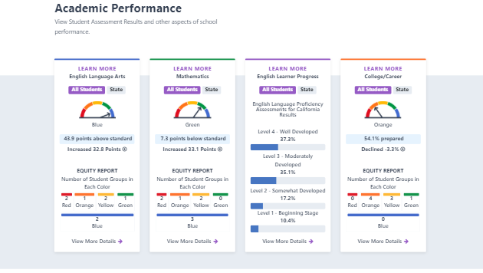
Navigating the Dashboard
Indicator Cards
Notes:
1 minute Running time = 14 minutes
Slide intent: To introduce the Dashboard components
Presenter says:
Once you type in the name of a school or school district into the search box and select it from the resulting menu, you will see the school’s landing page.
The landing page has three primary sections. I will show you each one and highlight the kind of information each section gives you.
Here, you see the first two sections of the dashboard. The first section is an At-A-Glance of each of the Indicators. The second section is an overview of the student population.
Materials required:
None.

Slide 18
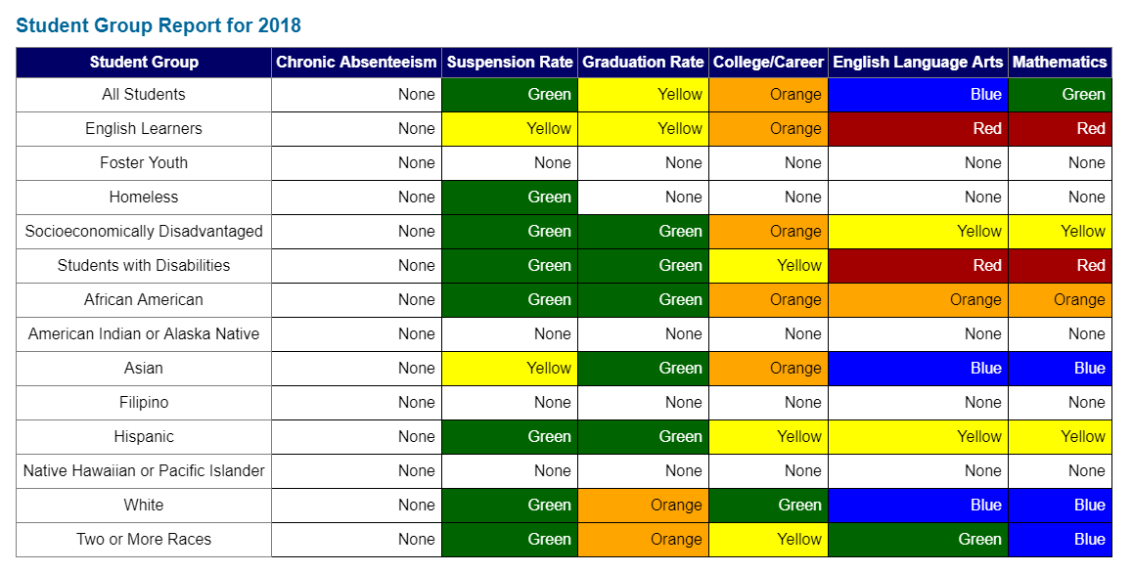
Student Group Report
Shows:
Performance levels for all students on the state indicators,
The total number of student groups that received a performance level for each indicator, and
The total number of student groups that received a performance level of Orange or Red.
Notes:
1 minute Running time = 15 minutes
Slide intent: To introduce the Equity Report.
Presenter says:
The Equity Report is the default report.
It’s purpose is to focus on the performance of student groups.
This report shows for each state indicator how many student groups received a colored rating and how many of those student groups are in orange/red indicating low performance.
Materials required:
None.

Slide 19
Inclusion of SWDs in the Dashboard
Districts and schools are accountable for the performance of their students with disabilities.
Color-coded performance on state indicators are displayed for districts or schools with 30 or more students in the group.
Notes:
1 minute Running time = 23 minutes
Slide intent: To describe how students with disabilities are included in the School Dashboard.
Presenter says:
Inclusion of students with disabilities in the Dashboard report is no different than any other student group.
If there are more than 30 students with disabilities at a school or school district, color coded performance for that group of students will be displayed.
Materials required:
None.

Slide 20
Special Notes About Participation of SWDs in California’s Assessment System
All SWDs participate in the California Assessment of Student Performance and Progress (CAASPP) System.
Some, with the most significant cognitive disabilities, participate in the California Alternate Assessment (CAA) in English-language arts/literacy (ELA), mathematics, and science. The Fall 2018 Dashboard includes results from the CAA in participation rates.
Most SWDs participate in:
The Smarter Balanced Summative Assessments in ELA and mathematics
The California Science Test (CAST)
Accessibility resources support students in showing what they know and are able to do
Notes:
2 minutes Running time = 25 minutes
Slide intent: To provide some reminders about students with disabilities and the state’s assessment system.
Presenter says:
As we begin to talk specifically about the students with disabilities group, I want to spend just a minute providing some reminders about how these students participate in the CAASPP system.
The most severely cognitively disabled students participate in the CAASPP system by taking the California Alternate Assessment. This is usually 1 percent or fewer of students with disabilities at a school or school district. The CAA provides results in one of three performance levels. To date, results from the CAA in language arts or mathematics are not included in the Dashboard status/change reports, but detailed reports provide a percentage of students scoring at each level on the CAA are included on the Dashboard.
Because the CAA is for only about 1 percent of the population of students with disabilities, what do the other students take in terms of a state assessment?
Answer: Yes, the Smarter Balanced assessments.
Currently the Dashboard includes results from the Smarter Balanced assessments in both English-language arts and mathematics.
As the science test – both the CAA for science and the CAST – becomes operational it too will be added to the Dashboard. Participation rates are not included in the 2018 Dashboard.
Materials required:
None.

Slide 21
Accessibility Resources
Three types:
Universal Tools are available to all students and do not require any specific settings to be applied in the testing interface.
Designated Supports are available to any student who could benefit from its use as determined by a team of educators familiar with the student.
Accommodations are only available for students with an Individualized Education Plan (IEP) or Section 504 Plan.
Districts and schools should employ a standard process for:
Identifying which students would benefit from using one or more accessibility resources
Evaluating available accessibility resources for appropriateness
Allowing students practice time with the accessibility resources prior to the summative assessment each spring
Notes:
4 minutes Running time = 29 minutes
Slide intent: To discuss the importance of accessibility resources for students.
Presenter says:
One of the key components of the Smarter Balanced system of assessment, and really all assessments included in the CAASPP system, are the available accessibility resources.
Accessibility resources are ways that allow students to better access the test content and show what they know and are able to do.
I think when most people think about accessibility supports they may think first of students with disabilities. While accessibility supports definitely help our students with disabilities, they can also help every other student.
There are three types of accessibility supports provided through the CAASPP system.
Take a moment to read about them on the screen.
Let’s review.
Which students can use Universal Tools? [Answer: All students}
Which students can use Accommodations? {Answer: Only students with an IEP or 504 Plan]
Great!
While knowing which students are eligible for which support is key to appropriate use, there are many other issues to consider when talking about accessibility supports.
Schools and school districts should be carefully and consistently evaluating all of their students for potential use of accessibility supports.
Once students are identifying as benefitting from an accessibility support, provide the student with practice before the springtime summative assessment. Accessibility supports can be practiced on the Smarter Balanced Interim Assessments or on the Practice Tests. I can’t emphasize enough how important providing students practice is.
Materials required:
None.

Slide 22
Use of Accessibility Resources: Questions to Consider
Who in your school district or school is responsible for implementing a systematic process for the effective and equitable use of accessibility resources?
Who is responsible for training teachers and others on the available accessibility resources?
NOTE: Accessibility resources are for all students, not just students with an IEP or Section 504 Plan.
Notes:
1 minute Running time = 30 minutes
Slide intent: To discuss who is responsible for accessibility supports.
Presenter says:
Employing a standard process for identifying students for accessibility supports, assigning supports that meet their individual needs, and allowing them time to practice with those supports is critically important.
Knowing who at your school or district is responsible for this work is also critically important.
Take 30 seconds to read the two questions on this slide and think about who this person is at your school or school district.
Materials required:
None.

Slide 23
Questions to Ask About SWD
Step 1: Learn more about the students who are part of the SWD group
What is the racial/ethnic breakdown?
What is the socioeconomic breakdown?
What are the English proficiency levels?
What kind of disabilities exist?
Step 2: Dig into performance to identify trends/anomalies
Does performance differ by identified disability?
Does performance differ by grade?
Does performance differ for elementary schools compared to middle or high?
Are there performance differences for SWD who are also English learners?
Are there performance differences for SWD who are also low income?
Notes:
2 minutes Running time =33 minutes
Slide intent: To encourage use of additional data or questions in determining next steps for the students with disabilities student group.
Presenter says:
Here are some specific suggestions for steps you and your team might take to learn more about the performance of the students with disabilities group.
Take a few moments to digest these questions and how they might apply to your school or LEA.
Materials required:
None.

Slide 24
Fall 2018 Dashboard Results
Last year, 228 districts were eligible for differentiated assistance. This year, with the Dashboard’s added metrics and other changes, 374 districts qualify for specialized assistance.
244 of the districts identified for differentiated assistance were eligible based on the performance of students with disabilities.
Notes:
1 minute Running time = 34 minutes
Presenter says: Let’s talk about how SWDs performed across the state on the fall 2018 Dashboard.
Last year 72% (164 out of the 228) of the districts that became eligible for differentiated Assistance were identified based on the performance of Students with Disabilities. This year, 65% (244 out of 374) of the districts that became eligible for differentiated assistance were identified based on the performance of SWDs.
To be eligible for differentiated assistance, districts had to have a group of students identified in two or more LCFF priorities. This slide shows the number of districts that became eligible for differentiated assistance for SWDs for each combination of LCFF priorities.

Slide 25
Fall 2018 Dashboard Results
37 districts were eligible based on LCFF priorities 4 & 5 (up from 21)
83 districts were eligible based on LCFF priorities 4 & 6 (down from 120)
17 districts were eligible based on LCFF priorities 5 & 6 (up from 11)
22 districts were eligible based on LCFF priorities 4, 5 & 6 (up from 11)
42 districts were eligible based on LCFF priorities 4 & 8 (down from 86)
13 districts were eligible based on LCFF priorities 5 & 8
4 districts were eligible based on LCFF priorities 6 & 8
23 districts were eligible based on LCFF priorities 4, 5, & 8
13 districts were eligible based on LCFF priorities 4, 6, & 8
11 districts were eligible based on LCFF priorities 5, 6, & 8
14 districts were eligible based on LCFF priorities 4, 5, 6, & 8
Notes:
1 minute Running time = 34 minutes
Presenter says: Let’s talk about how SWDs performed across the state on the fall 2018 Dashboard.
164 out of the 228 districts that became eligible for differentiated Assistance were identified based on the performance of Students with Disabilities.
To be eligible for differentiated assistance, districts had to have a group of students identified in two or more LCFF priorities. This slide shows the number of districts that became eligible for differentiated assistance for SWDs for each combination of LCFF priorities.

Slide 26
Notes:
1 minute Running time = 1 minute Total time for Section 2= 40 minutes
Section 2
Slide intent: To introduce the section that describes support for students with disabilities.
Presenter says: Now let’s turn our attention to Section 2 of the document which provides relevant background information about students with disabilities SWDs). In addition to providing the context, it emphasizes the focus on one coherent system of supporting all students, including the individualized needs of students with disabilities.

Slide 27
Handbook Contents
Section 2: Support for Students with Disabilities (pp. 5–8)
Background information about California’s Students with Disabilities
One system for all students
Who are California’s students with disabilities?
Categories of disabilities and inclusion in LCAP – unduplicated student groups
Aligning support for students with disabilities
Multi-Tiered Systems of Supports (MTSS)
Universal Design for Learning (UDL)
Evidence-Based Practices (EBP)
Notes:
1 minute Running time = 2 minutes
Section 2
Slide intent: The purpose of this slide is to introduce the topics covered in Section 2.
Presenter says:
You will find Section 2 on pages 5–8 of the Handbook. It begins by addressing background information about California’s SWDs and shows how they are included in the unduplicated students groups in Local Control and Accountability Plans (LCAP).
The topics addressed in this Section 2 are shown on the slide.
This section also describes models and processes for supporting SWDs: Multi-Tiered System of Supports (MTSS), Universal Design for Learning (UDL), and Evidence-Based Practices.
Similar to Section 1, links to in-depth information about these models are included.
There are also related resources in the Section 4 Toolkit.

Slide 28
One Coherent System
“In a coherent system of education, all children are considered general education students first;
all educators, regardless of which students they are assigned to serve, have a collective responsibility to see that all children receive the education and the supports they need to maximize their development and potential so that they can participate meaningfully in the nation’s economy and democracy.”
CA Special Education Task Force Report (March 2015)
Notes:
3 minutes Running time = 5 minutes
Section 2
Slide intent: To introduce the concept of “One Coherent System”
Presenter says: As noted in California’s Special Education Task Force Report, One System: Reforming Education to Serve All Students (March 2015), starting in preschool it is critical to note the quote on the slide above.
Please take a minute to read the quote, paying special attention to the words in bold. Think about what this quote means for you in a school or LEA that you are working with. Use a highlighter to note phrases that are significant to you.
Materials: Highlighters
Relevant Links:
CA Special Education Task Force Report (March 2015)
http://www.smcoe.org/assets/files/about-smcoe/superintendents-office/statewide-special-education-task-force/Special_Ed_Task_Force_Report-reduced.pdf

Slide 29
Equality vs. Equity
EQUALITY EQUITY
Handbook, p. 5
Notes:
3 minutes Running time = 8 minutes
Section 2
Slide intent: To reflect on the ideas of equity versus equality.
Presenter says: Please take a minute to think, then talk, with a partner about how this idea and the quote on the previous slide relate to your work and how we work to make a more equitable system for all students.
Solicit volunteers to share thoughts with the whole group based on their discussion.
Key ideas: Different students may need different types of supports to fully access their educational program. Providing the same supports to all students does not meet the needs of individual students.

Slide 30
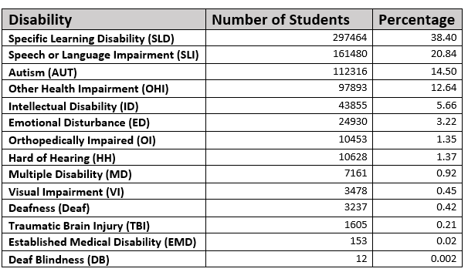
California Children with Disabilities:
Ages 0-22 by Primary Disability Category
Students with Disabilities Population for Ages 0-22: 774,665 Source: CASEMIS December 2017
Notes:
1 minute Running time = 11 minutes
Section 2
Slide intent: To share the most recent data (CASEMIS, 2017) regarding the number of children with disabilities within each disability categories for individuals in preschool through 22 years of age.
Presenter says: Students who qualify for special education are designated through a primary disability category in IDEA. This slide has the information shared by CDE showing the 2017 CASEMIS data that notes the number and percentage of students with disabilities in each category. Each category includes a range of student needs. Within each category, students may need a mild to significant support.

Slide 31
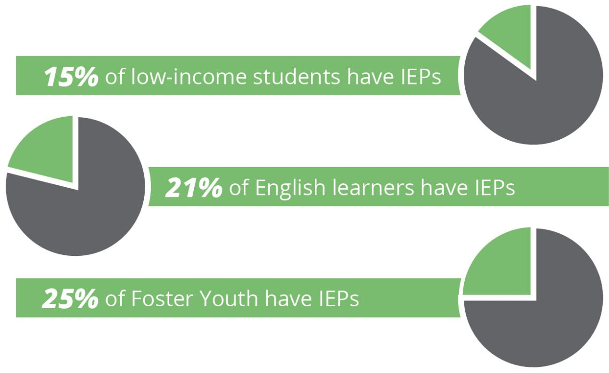
LCAP Unduplicated Student Groups
13%
17%
27%
71% of Students with Disabilities are in One or More LCFF Student Groups (unduplicated)
Source: December 2017 CASEMIS and DataQuest
Notes:
1 minute Running time = 12 minutes
Section 2
Slide intent: To introduce the connection between students with disabilities and their inclusion in other unduplicated student groups that are reviewed as part of the Local Control Accountability Plan or LCAP.
Presenter says: The charts on the slide are on page 6 of the Handbook. They show that in 2016-17, a majority of students with disabilities were also represented in at least one unduplicated student group that is part of the Local Control Accountability Plan or LCAP.

Slide 32
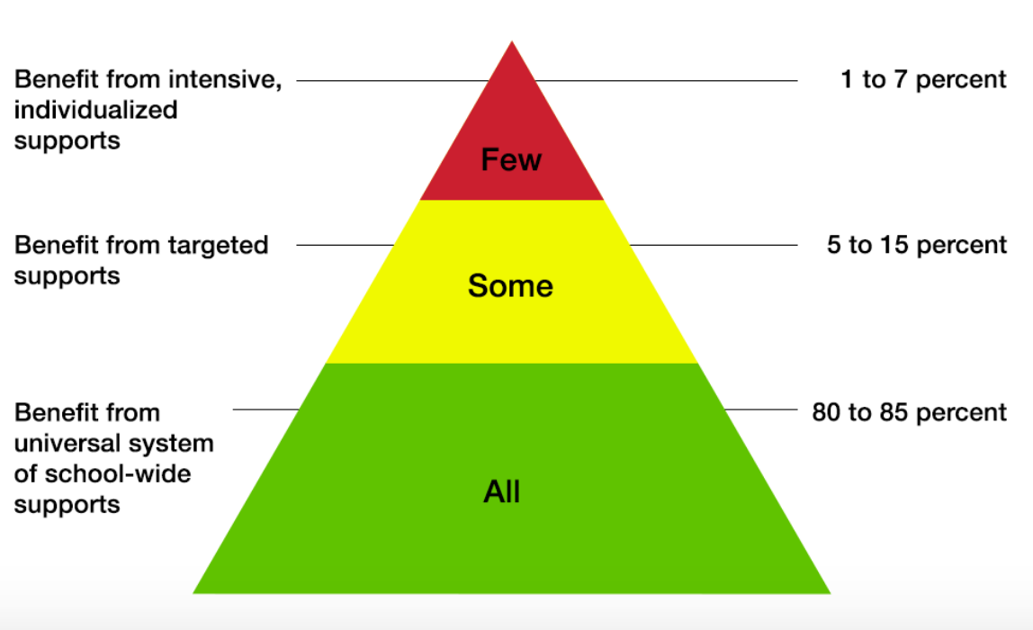
Layers of Support
Notes:
1 minute Running time = 13 minutes
Section 2
Slide intent: To introduce that idea of a Multi-Tiered System of Supports and the importance of aligning resources within an LEA and/or district to support student needs.
Presenter says: Whether addressing academics, behavior, or social-emotional learning and support, it is important to consider what is being done to support high quality first instruction, what systematic processes are in place to identify need and layer additional support for some students who need targeted supports in these areas, and what is in place to identify needs and layer additional support for those student who need more intensive academic, behavioral, or social-emotional supports.
The green tier at the bottom of the pyramid shows that all students need the general program and school-wide supports that are available.
Some students benefit from targeted, additional supports as is shown by the yellow tier in the middle of the pyramid. About 5-15% of the students may need these supports at any given time.
A few students will need intensive, individualized supports – about 1-7% of the students. This is shown in the red section at the top of the pyramid.
Taken together, these layers are known as the “multi-tiered system of supports.”

Slide 33
Key Elements of a Multi-Tiered System of Supports (MTSS)
System-wide alignment of resources and initiatives
District, site, and grade-level participation in alignment of resources and programs
Support for all students including gifted and high achievers
Use of the Universal Design for Learning (UDL) proactive lesson planning framework
A focus on sustainable interventions that reflect best practice aligned to Common Core State Standards
Notes:
1 minute Running time = 14 minutes
Section 2
Slide intent: To highlight the key elements of a Multi-Tiered System of Supports.
Presenter says: Let’s review some key elements of a high-quality Multi-Tiered System of Supports found on page 7 of the Handbook.
System-wide alignment of resources and initiatives and systematic processes for identifying resources and who may benefit from universal, targeted and intensive supports.
District, site and grade level participation in alignment of resources and programs
Support for all students including gifted and high achievers
Use of Universal Design for Learning (UDL) proactive lesson planning framwork, which will be discussed in greater detail later in this presentation. AND
A focus on sustainable interventions that reflect best practice aligned to Common Core State Standards

Slide 34
Universal Design for Learning (UDL)
Source: Udlcenter.org
Notes:
2 minutes Running time = 16 minutes
Section 2
Slide intent: To provide an overview of the Evidence-Based Practice, Universal Design for Learning.
Presenter says: The Universal Design for Learning principles or UDL are a critical element of MTSS. UDL is an evidence-based practice that takes into account the multitude of needs of all learners in the classroom and proactively assists educators in addressing the why, what, and how of learning in their classrooms.
In a nutshell, UDL is a set of principles for curriculum development that give all individuals equal opportunities to learn.
UDL provides a blueprint for creating instructional goals, methods, materials, and assessments that work for everyone--not a single, one-size-fits-all solution but rather flexible approaches that can be customized and adjusted for individual needs.
UDL is necessary because each student brings a variety of skills, needs, and interests to learning. Neuroscience reveals that these differences are as varied and unique as our DNA or fingerprints. The three primary brain networks are shown on this slide.
The arrows below the images of the networks remind us of the considerations educators must address when planning effective lessons.
Source: CAST. Udlcenter.org image from http://www.udlcenter.org/aboutudl/whatisudl

Slide 35
Universal Design for Learning (UDL)
Provides students with equitable access to education
Optimizes instruction and supports for all students in the general education setting
Ensures full access to the general curriculum regardless of disability, English language proficiency, income level, race, academic levels, etc.
Includes differentiated instructional strategies in classroom settings
Offers explicit and rigorous instruction that is culturally responsive and linguistically appropriate
Notes:
1 minute Running time = 17 minutes
Section 2
Slide intent: To provide an overview of the Evidence-Based Practice, Universal Design for Learning.
Presenter says: UDL also allows all students to be successful in the classroom for the reasons you see listed on this slide:
Provides students with equitable access to education, no matter their learning or other individual needs
Optimizes instruction & supports for all students in the general education setting
Ensures full access to the general curriculum regardless of disability, English language proficiency, income level, race, academic levels, etc.
Includes differentiated instructional strategies in classroom settings
Offers explicit and rigorous instruction that is culturally responsive and linguistically appropriate
The use of Universal Design for Learning (UDL) principles for curriculum development and instruction provide students with equitable access to education.
UDL principles are intended to optimize instruction and supports for all students in the general education setting and ensure full access to the general curriculum regardless of disability, English language proficiency, income level, race, or academic performance.
UDL provides teachers with a data-driven, research-based blueprint for meeting the full range of student needs. These principles also include differentiated instruction that matches individual student needs with appropriate instructional strategies in classroom settings.
UDL offers students explicit and rigorous instruction that is both culturally responsive and linguistically appropriate. Instruction and interventions that build upon a student’s cultural knowledge, home language, background, and experiences, as well as their linguistic proficiency (in both English and their native language) are essential to UDL. Approaching instruction with these considerations helps teachers to determine how a student learns best, identify preferred settings and optimal teaching conditions, and ensure all students have access to, and are learning from, rigorous engaging general education curriculum.
Section 4 of the Handbook is a Toolkit. You will find information and resources to learn more about topics mentioned in this Handbook, including UDL and MTSS.

Slide 36
Evidence-Based Practices
Evidence-based Practices have supporting research
Increased likelihood of positive outcomes
Less time and resources devoted to ineffective programs and practices
Increase in sustainability because data supports the efficiency of these practices
Notes:
1 minute Running time = 31 minutes
Section 2
Slide intent: To provide an overview of the principles for using evidence-based practices (EBPs).
Presenter says: EBPs are an important component of MTSS.
Some of the key benefits of implementing EBPs are shown on this slides.
Materials needed:
Copies of the Handbook or the Rubric.

Slide 37
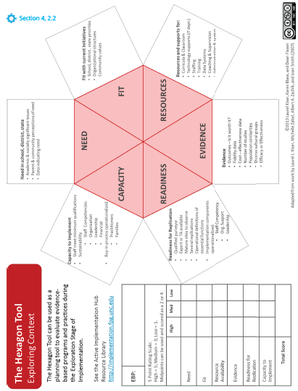
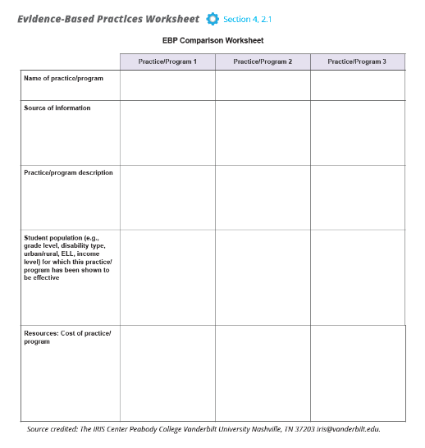
Evidence-Based Practices
Tools to Assist with the Selection of EBPs
EBP Comparison Sheet
Hexagon Tool
Handbook, pp. 26 - 28
Notes:
1 minute Running time = 33 minutes
Section 2
Slide intent: To provide an overview of the principles for using evidence-based practices (EBPs).
Presenter says: Section 4 of the Handbook has several tools that you might want to use when helping LEAs to determine which EBPs may be a good fit for them to use.
On pages 26 and 27, you will find the EBP Comparison Sheet. This tool is a matrix to compare programs and practices using a variety of factors including target student population, resources required for implementation, and time required.
Page 28 has the Hexagon Tool. It provides teams a structure for discussions around each of the six components: need, fit, resources, evidence, readiness, and capacity.

Slide 38
Notes:
1 minute Running time = 1 minute
Section 3
Slide intent: To introduce Section 3 that provides an overview of the key elements of the continuous improvement cycle.
Presenter says: Now let’s turn our attention to Section 3 of the document which addresses the phases in a continuous improvement model and describes the provides relevant background information for planning and improvement efforts.
Presenter says:
Materials required:

Slide 39
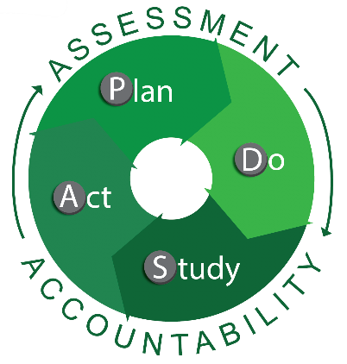
Handbook Contents
Section 3: Continuous Improvement Cycle (pp. 9 – 22)
Information, resources, and links for implementing a “Plan, Do, Study, and Act” cycle
Common school and district plans
Guidance for improvement teams (processes and actions)
Use of data: analysis, planning, and Improvement
Resources in the Section 4 Toolkit will be useful for implementing the “Plan, Do, Study, and Act” cycle.
Notes:
1 minute Running time = 2 minutes
Section 3
Slide intent: The purpose of this slide is to introduce the topics covered in Section 3.
Presenter says:
You will find Section 3 on pages 9–22. Information in this section describes practices for LEAs to use to implement elements of a continuous improvement process using a “plan, do, study, and act” cycle.
Section 3 Topics include:
The role of improvement teams, use of data and questioning strategies to identify root causes, the identification of evidence-based programs and practices, and the implementation of effective strategies within an MTSS framework.
Many of the related tools and resources in Section 4 will be useful for school and district teams to implement the Plan, Do, Study, and Act cycle to improve the performance of Students With Disabilities.
This section provides an overview of the planning process and highlights of the types of plans commonly developed by schools and districts (SPSA, LCAP) and those that are typically developed for SWDs (IEP).
Guiding questions, links to in-depth resources, and tools in Section 4 are provided for each component of this cycle.
Planning processes, regardless of the type of plan, share several common elements including input from stakeholders, measurable goals, implementation timelines, allocation of fiscal resources, and tools to monitor implementation and student performance.
Materials: Handbook

Slide 40
Continuous Improvement
Handbook, p. 9
Notes:
8 minutes Running time = 10 minutes
Section 3
Slide intent: The purpose of this slide is to introduce the continuous improvement framework.
Presenter says:
PDSA stands for Plan, Do, Study, Act. It's a model for testing ideas that you think may create an improvement. It can be used to test ideas for improvement quickly and easily based on existing ideas, research, feedback, theory, review, audit, lide or practical ideas that have been proven to work elsewhere. It uses simple measurements to monitor the effect of changes over time. It encourages starting with small changes, which can build into larger improvements in the service through successive quick cycles of change.
Step 1: PLAN Identify what change you think will create improvement and then plan the test of the change. What is your objective in introducing the change? It is important to establish the scope of the change to be introduced, and how you are going to collect information about the differences that occur, how will you know whether the change made has 'worked' or not? The change should bring about differences which are measurable. A major change could be broken down into smaller more manageable 'chunks'. Once the actual change to be introduced has been agreed, the following questions should be asked: What are we trying to do during this cycle? What exactly will you do? Who will be involved? Where will it take place? When will it take place? What do you predict will happen? What data/information will you need to collect?
Step 2: DO Put the plan into practice - test change by collecting the data. This stage involves carrying out the plans agreed in step 1. It is important that the Do stage is kept as short as possible. There may be changes that should only be measured over long periods. Record any unexpected events, problems, and other observations. Start analyzing the data.
Step 3: STUDY Review and reflect. Complete the analysis of the data. Has there been an improvement? Did your expectations match the reality of what happened? What could have been done differently?
Step 4: ACT Make further changes or amendments after you have decided what worked and what didn't and collect data again. Carry out an 'amended' version of what happened during the Do stage and measure any differences.
Completing a PDSA cycle can take several days or several years depending on the scope of the initiative.
PDSA cycles are more likely to result in improved outcomes or results if they are embedded within an improvement culture. According to a recent paper by Policy Analysis for California Education, characteristics of an improvement culture include collective responsibility for outcomes, learning from failure, transparency, humility, curiosity, and discipline.
Materials required: Handbook

Slide 41
Continuous Improvement: Plan
Handbook, p. 9
Notes:
1 minute Running time = 11 minutes
Section 3
Slide intent: The purpose of this slide is to introduce the continuous improvement framework.
Presenter says:
Typically, organizations spend a great deal of time in the plan phase to ensure improved chances that the intervention, program, or practice will actually lead to improved outcomes.
Materials required: Handbook

Slide 42
Continuous Improvement
The PDSA cycle ensures improvement teams develop and implement coherent systems that:
Provide ongoing review and assessment
Focus on plans to improve overall performance
Promote equity for all student groups
Implement actions and services that address targeted areas of need
Evaluate improvement efforts to inform next steps
Notes:
1 minute Running time = 12 minutes
Section 3
Slide intent: The purpose of this slide is to introduce the continuous improvement framework.
Presenter says: While using this cycle, teams can ensure that there is a coherent system for implementation, improvement, and reflection.
The elements listed on this slide are part of the coherent system.
Materials required: Handbook, page 9

Slide 43
Plan
Planning processes, regardless of the framework, share common elements:
Input from stakeholders
Measurable goals
Improvement timelines
Identified leads
Allocation of resources
Selection of tools to monitor improvement and student performance
Notes:
5 minutes Running time = 17 minutes
Section 3
Slide intent: The purpose of this slide is to introduce the Plan phase of a continuous improvement framework.
Presenter says: While your plans may vary, they all should share essential elements shown on this slide: input from stakeholders, measurable goals, improvement timelines, identified leads, allocation of fiscal resources, selection of tools to monitor improvement and student performance. Let’s take a few minutes as a group to discuss these elements in more detail.
Input from stakeholders: what methods would you use? Focus groups, teams, already structured stakeholder groups, surveys, etc.
Measurable goals: Your goal should be clear and specific, otherwise you won't be able to focus your efforts or feel truly motivated to achieve it. When drafting your goal, try to answer the five "W" questions:
What do I want to accomplish?
Why is this goal important?
Who is involved?
Where is it located?
Which resources or limits are involved?
Improvement timelines: is the timeline realistic, do you have checkpoints, who’s monitoring the timeline?
Identified leads: are all groups represented? Do the leads understand their role and responsibility? Do you have time built in for the leads to collaborate?
Allocation of resources: Items to consider-
Know Your Scope
Before you can allocate resources or manage them, you have to determine the scope of the plan. Is it a big or small project, long or short?
Identify Resources
Before you can allocate resources, you have to have them. So, make a list using the criteria above and then make sure it fits within the budget allotted for the project.
Don’t Procrastinate
In the planning process, you should take some time to research where and when you might have a blocked team member or task dependencies.
Think Holistically
It’s a problem when you’re so focused on the process that you neglect to lift your head up from the project plan to note what is actually happening. This isn’t merely checking your estimates against actual progress in the project, though that is important, too.
Track Time
You always want to keep a close eye on the time, how your team is working and if they’re being efficient.
Selection of Tools
You can see where your resources are allocated across a calendar that is color-coded to note whether they’re on- or off-task, on vacation or sick.
Don’t Over-allocate
Be Realistic
While it’s good practice to be prepared for issues that might arise in your project, you don’t want to hog resources by adding too many people or days to your schedule.
Have a Routine
Set up regular check-ins, say a specific day and time every week, to go through your resources, check your tools and make sure no one is over-tasked for the week’s work ahead.
. Know Your Resources
Tool to monitor student improvement: local data systems?
Materials: Handbook

Slide 44
District and School Level Plans
LCAP
IEP
SPSA
PIR
Notes:
10 minutes Running time = 27 minutes
Section 3
Slide intent: The purpose of this slide is to introduce the various plans within the educational system as it relates to students with disabilities.
Presenter says: Let’s review the plans that may encompass your work.
In education, an array of improvement plans exist to support improved outcomes for students. These plans all involve some components of improvement planning, including input from stakeholders, development of goals, implementation timelines, and allocation of resources.
Local Control Accountability Plan (LCAP): is a three-year plan that describes the goals, actions, services, and expenditures to support positive student outcomes that address state and local priorities. The LCAP provides an opportunity for local educational agencies (LEAs) to share their stories of how, what, and why programs and services are selected to meet their local needs. There are five components:
The Story
LCAP Highlights
Review of Performance
Increased or Improved Services
Budget Summary
Single Plan for Student Achievement (SPSA): The SPSA is a school-level blueprint to improve the academic performance of all students. SPSA specifics are also included in the Federal Program Monitoring process. It should be aligned with the LEA’s LCAP goals and priorities.
Performance Indicator Review (PIR):
Materials: Handbook, pages 9-10.

Slide 45
Questions to Consider During the Plan Phase
Did all of the appropriate stakeholders provide input and feedback on the plan?
Are the goals aligned to the data?
What is the intended result of the actions to be taken? (Tip – create an “if - then” statement).
Are timelines reasonable?
Will individuals assigned to tasks be able to implement the actions? (Do they have the necessary level of authority, knowledge, and skills for the task?)
Are sufficient resources allocated to support the full Improvement of the plan?
How will the plan be monitored for Improvement and effectiveness?
Notes:
5 minutes Running time = 32 minutes
Section 3
Slide intent: The purpose of this slide is to articulate questions that should be considered during the plan phase.
Presenter says: During the plan phase, consideration of some or all of these questions will guide the improvement process and insure that planning is comprehensive.
[Read questions]
Each of the questions tie back to the key elements of the planning stage:
Input from stakeholders
Measurable goals
Improvement timelines
Identified leads
Allocation of resources
Selection of tools to monitor improvement and student performance
Ask: Based on your experiences with planning, which of the questions noted on this slide have been particularly important? Share your thoughts with a partner.
Invite individuals to share out with the whole group.
Materials: Handbook page 9

Slide 46
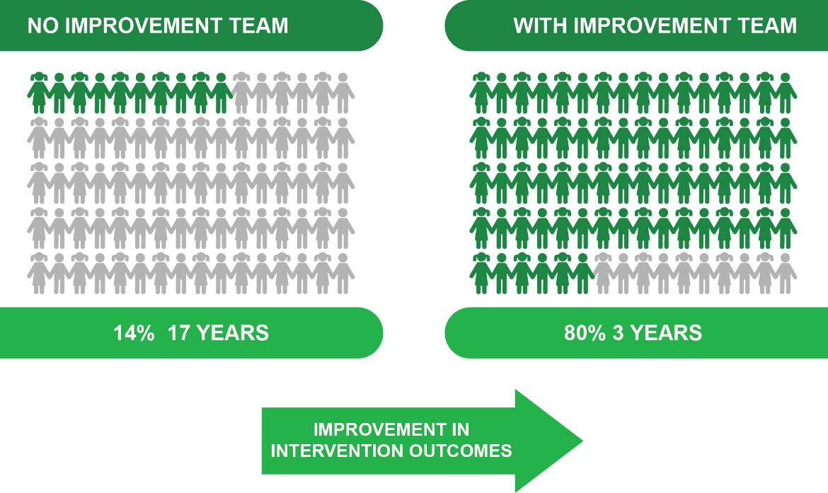
Improvement Teams dramatically increase the likelihood that the interventions will be
effective and lasting
Handbook, p.11
Notes:
1 minute Running time = 33 minutes
Section 3
Slide intent: The purpose of this slide is to provide a rationale for why improvement teams are needed and that they are effective.
Presenter says: Effective Improvement teams dramatically increase the likelihood that implementation will continue over time and achieve the desired outcomes.
Implementation teams provide an internal support structure to move selected programs and innovations through the stages of implementation. They also ensure that the implementation infrastructure is effectively used to support the programs and practices.
Without an improvement team , there is a 14% chance for the improvement effort to actually be implemented, and it may take 17 years for this to occur.
With an improvement team , there is a 80% chance that the improvement effort will reach full implementation within 3 years.
Materials: Handbook page 11
Relevant Links:
From the AI (Active Implementation) Hub
http://implementation.fpg.unc.edu/module-1/implementation-teams
http:// implementation.fpg.unc.edu/module-3/topic-1/ linked-implementation-teams.

Slide 47
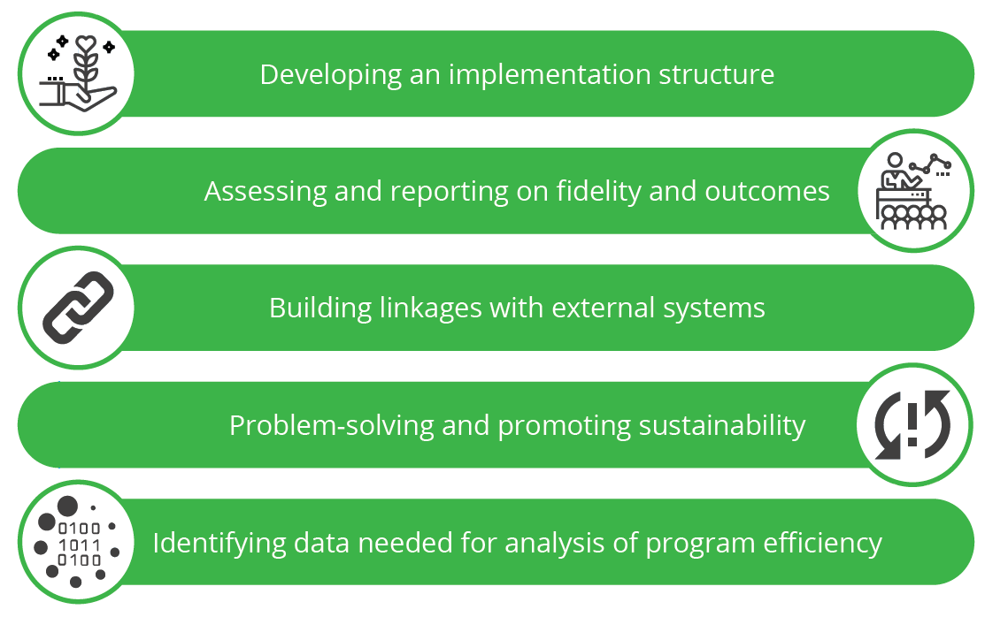
Improvement Teams Increase Readiness By…
Handbook, p.10
Notes:
2 minutes Running time = 35 minutes
Section 3
Slide intent: The purpose of this slide is to highlight the important role of the improvement team during the planning phase.
Presenter says: During the plan phase, improvement teams play a critical role in maximizing improvement efforts.
Improvement teams establish an aligned and linked teaming infrastructure that can help integrate, sustain, and scale-up innovations with fidelity over time. The improvement team increases the likelihood that interventions will be effective and lasting. In fact, the establishment of an improvement team increases the chances that the program, practice, or initiative will still be implemented with fidelity after three years increases to 80%.
These teams support and sustain the widespread use of EBPs/EIIs by leveraging improvement principles and using systems change best practices. Improvement teams “Make it Happen.”
Materials required: Handbook, page 10

Slide 48
Improvement Team Members Should Be…
Familiar with the data and identified problem that is driving the implementation of a new program or practice
Informed about the continuous improvement framework being utilized
Agents of change within the school and community
Aware of the role and responsibilities of the improvement team
Ultimately, the improvement team is responsible for ensuring that the improvement happens and that the innovations and implementation methods achieve the intended outcome at the student level.
Notes:
2 minutes Running time = 37 minutes
Section 3
Slide intent: The purpose of this slide is to describe the background, perspective, and skills of members of the improvement team.
Presenter says:
Improvement team members should represent a variety of stakeholders and different perspectives. Improvement team members might include:
General Education Teachers
Special Education Teachers
Other Certificated Staff (e.g. Counselors, Psychologists, Related Service Providers)
Site Administrators
Special Education Administrators
Classified Staff
Parents
Community Partners/Representatives
The Improvement Team needs to be comprised of individuals who, collectively, have the expertise necessary to implement the EBP/EII, and to develop and maintain the system and infrastructures to support effective Improvement. One or more members of the core Improvement Team should have competency in at least one of the following areas.
Improvement Team Members Should Be:
Familiar with the data and identified problem that is driving the implementation of a new program or practice – Improvement team members should not simply be responding to data or a problem that was identified or analyzed by another person or group. Ideally, improvement team members have a firm understanding of the data and assisted in using data to develop a clear problem statement that will guide the team’s work.
Informed about the continuous improvement framework being utilized – Team members should be well-versed in the key components of continuous improvement work and system change, regardless of the specific framework being employed by the site or LEA. The team should also make good use of Plan, Do, Study, Act cycles to continually identify and address challenges and barriers to effective improvement.
Agents of change within the school and community – They work at multiple levels of the system to create hospitable environments, cultures, policies, guidelines, data systems, and funding streams.
Aware of the role and responsibilities of the improvement team – Team members must understand their roles as described previously, including:
Developing an implementation structure
Assessing and reporting on fidelity and outcomes
Building linkages with external systems
Problem-solving and promoting sustainability
Identifying data needed for analysis of program efficiency
We recommend a minimum of 3 to 5 individuals serve as core Improvement Team members. Other individuals may be invited to participate in Improvement Team activities from time to time based on their expertise. However, these individuals may not have the same amount of time to participate in ongoing work (e.g., between meetings). We recommend 3 to 5 members so the Improvement Team is sustainable. As individuals leave, remaining members of the team can carry on while a new member is brought on and learns the complex sets of skills required of Improvement Team members.
For smaller school sites and districts, it can be challenging to identify members of the improvement team due to limited capacity and resources; however, it is important to remember that improvement teams need to represent a variety of perspectives and areas of expertise. Sites and districts with limited options might need to be more intentional about reaching out to members of the community.
Materials required: Handbook page 12.

Slide 49
Improvement Teams
Activate Improvement Frameworks at each level
Each team is charged with doing its part to
a) support the work of teams at the level “below” them
b) engage in activities that ensure that the overall Improvement infrastructure is developed
Support staff in delivering innovations as intended and improving outcomes for students
Sustain the innovation over time and across staff
Scale-up the innovation over time and across units
Ensure continuous improvement of fidelity and student outcomes
Handbook, p.13
Notes:
2 minutes Running time = 52 minutes
Section 3
Running time = 2 minutes
Slide intent: The purpose of this slide is to demonstrate the importance of improvement teams at all levels, including site, district, regional, and state.
Presenter says:
One Improvement Team is not enough to ensure excellent outcomes for all students. To use effective innovations on a useful scale requires a thoughtful arrangement of teams. While this may seem complicated, keep in mind that Improvement Teams make use of the same Active Improvement Frameworks at each level. Each team is charged with doing its part to a) support the work of teams at the level “below” them and b) engage in activities that ensure that the overall Improvement infrastructure is developed to:
Support staff in delivering innovations as intended and improving outcomes for students
Sustain the innovation over time and across staff
Scale-up the innovation over time and across units
Ensure continuous improvement of fidelity and student outcomes
An infrastructure of linked Improvement Teams contributes to creating coherent and aligned system functions. By working together with a singular focus on the quality of instruction and classroom management, the teams can help create a shared culture of innovation with good outcomes.
As shown in the figure, an infrastructure comprised of linked teams can help reduce isolated silos that typify large systems. By working simultaneously with multiple levels of an education system, Improvement Teams can help encourage greater integration, coherence, and focus to the system as whole. By aligning activities and functions with desired outcomes for students, Improvement Teams and leaders in education can build a lasting capacity for responsible change.
Materials required: Handbook, page 13

Slide 50
Develop a Problem Statement
Statements of quantity
Comparisons to prior years
Comparisons to reference groups
AVOID
Making inferences about the observations
Drawing conclusions
Notes:
1 minute Running time = 71 minutes
Section 3
Slide intent: The purpose of this slide is to point out the pitfalls to avoid when developing a problem statement.
Presenter says:
After an LEA completes the objective analysis of the data, they will transition to developing their problem statement. A problem statement answers the question; “What is the problem?” It’s written in the form of a statement. It may make comparisons to trends in the data or make reference to specific student groups. It’s a statement of quantity.
The pitfalls LEAs may encounter as they develop their problem statement include participants making inferences about why the problem is occurring or jumping to identify solutions to the problem before they’ve accurately defined the problem.

Slide 51
Sample Problem Statement
SWDs who are also long-term English learners (LTELs) in grades 7-8 performed on average 70 points below their non-SWDs and English-only SWDs peers in mathematics in 2017; their performance declined significantly from the prior year.
Notes:
1 minute Running time = 72 minutes
Section 3
Slide intent: The purpose of this slide is to provide an example of a problem statement.
Presenter says:
You’ll notice this sample problem statement is an objective statement. It quantifies the problem, specifically identifies a student group, compares student group performance, and indicates trends in performance. It does not identify what might be causing the problem. No inferences are made about the reasons for their performance. It simply states the problem.

Slide 52
Root Cause Analysis
Use the lens of an MTSS to identify the root cause of the problem.
Handbook, p. 17
Notes:
2 minutes Running time = 75 minutes
Section 3
Slide intent: The purpose of this slide is to share the elements of MTSS to ensure LEAs are looking through an MTSS lens as they examine the root cause(s) of their problem.
Presenter says:
As LEAs engage in discussions to determine the root cause(s) of the problem, the elements of MTSS can help keep the discussion focused on the elements of the system, not people within the system.
Think about our sample specific problem: SWDs who are also long-term English learners (LTELs) in grades 7-8 performed on average 70 points below their non-SWDs and English-only SWDs peers in mathematics in 2017; their performance declined significantly from the prior year.
Some of the elements of MTSS, such as the Quality of Professional Development Opportunities or Inclusive Policies & Practices, help to focus the discussion on the design of the system that is resulting in students with disabilities who are also LTELs performing lower than their peers.
Materials required:
Handout of the MTSS wheel graphic or refer to page 17 of the Handbook

Slide 53
Fishbone Diagram
Chart the MTSS categories on the spines of the fish
Ask questions through the lens of each MTSS category using the 5-Why Analysis Form to find the root cause(s) of the problem
Problem
Handbook, p. 48
Notes:
5 minutes Running time = 80 minutes
Slide intent: The purpose of this slide is to introduce the 5-Why Analysis Tool and Fishbone Diagram.
Presenter says:
The process that LEAs engage in to identify the root cause(s) of their problem uses the 5-Why Analysis Tool in combination with the Fishbone Diagram. In each of the small rectangles, LEAs record the categories of MTSS they would like to further explore as areas that may contain the cause of their problem. LEAs may select additional categories that are not from the MTSS chart, but as facilitators, it will be important to help the LEA identify categories that focus on the design of the system, not the people within the system.
The larger rectangle is where the LEA records the identified root cause within the MTSS category after they have completed the 5-Why Protocol. Please turn to Page 49 in the handbook to see a completed Sample 5-Why Analysis Tool. The Sample Problem Statement introduced earlier is recorded at the top of the tool and the MTSS category is recorded in the box labeled “Fishbone Diagram Area (Context).”
In this sample, the categories listed are “pedagogy, curriculum, ELD program, and assessments.” However, to align with MTSS, “Core Instructional Program” could be entered into this box.
The 5-Why Protocol begins with asking the question: SWDs who are also long-term English learners (LTELs) in grades 7-8 performed on average 70 points below their non-SWDs and English-only SWDs peers in mathematics in 2017; their performance declined significantly from the prior year. Why is that?
As the discussion continues, each response to the question “Why is that?” is followed with another “Why is that?” The purpose of this questioning strategy is to persist though a line of inquiry until an underlying root cause is revealed. You’ll know you have identified a root cause when you uncover a design in the system that is acting as a barrier to achieving higher results. It will be a cause that is within the LEA’s sphere of influence. Keep in mind that a root cause may or may not be identified for each category as LEAs pursue the different lines of inquiry.
The LEA will complete one 5-Why Analysis Tool for each category identified on the Fishbone Diagram. The Fishbone Diagram has room for 9 categories, however, the LEA may identify more categories or fewer categories to explore. Each root cause that is identified, is recorded in its respective category on the Fishbone Diagram.
Materials required:
Handbook: Pages 47 and 49, or one page handouts of these pages.

Slide 54
Fishbone Diagram
With a partner, record an MTSS category
Ask questions through the lens of this MTSS category using the 5-Why Analysis Form to find the root cause(s) of the problem
Problem
Handbook, p. 48
Notes:
9 minutes Running time = 90 minutes
Section 3
Slide intent: Activity: The purpose of this slide is for participants to engage in a practice conversation with a partner to identify root cause using the Fishbone Diagram and the 5-Why Analysis Tool. (COEs will not be able to complete this activity without their LEAs, but it will give them some experience with the tools and time to reflect on how they might facilitate the discussions with their LEAs.)
Presenter says:
Find a partner. Choose a different MTSS category than the one used in the sample and record it on the Fishbone Diagram. Now, using the 5-Why Analysis Tool, record the Sample Problem Statement and the MTSS category you selected. Determine who will be the facilitator and who will fill the role of the LEA.
Materials required:
Copy of Page 48 – Fishbone Problem Analysis Diagram: Template
Copy of Page 52 – 5-Why Analysis Tool: Template

Slide 55
Continuous Improvement: Do
Handbook, p. 9
Notes:
1 minute Running time = 101 minutes
Section 3
Slide intent: To introduce the “Do” component of the PDSA cycle
Presenter says: The degree to which a plan is implemented is directly linked to the overall success and effectiveness of program improvements.
The “Do” phase of the PDSA cycle focuses on identifying and implementing procedures to monitor the implementation and effectiveness of the plan at predetermined intervals (e.g., bi-monthly, monthly, quarterly, annually).
As part of the continuous improvement cycle, you will want to have a procedure in place to consider whether a specific action is implemented as planned, whether it is producing the desired results, and if adjustments need to be made along the way.
As implementation progresses, the evidence-based practices become more refined and begin to positively impact student performance.
The role of the improvement team is to provide structures to bridge the implementation gap. This is accomplished by ensuring that all staff using the EBPs have the necessary training, coaching and internal structures in place to make the EBPs teachable, learnable and assessable. Based on this data, future decisions are made to achieve fidelity of implementation.
Materials: Handbook, page 19

Slide 56
Elements of Implementation
Collect evidence to monitor quality and degree of implementation
Consider possible barriers to implementation and plans to address barriers, or possible alternatives
Develop rationale for actions to be taken
Create and monitor implementation timelines
Handbook, p. 19
Notes:
2 minutes Running time = 103 minutes
Section 3
Slide intent: To highlight the key elements of the “Do” phase in the PDSA cycle.
Presenter says:
Implementation doesn’t “just happen.” Consider the elements on this slide to help plan for the implementation of actions.
Identify the key elements for success – who will do what by when?
Materials: Handbook, page 19

Slide 57
Continuous Improvement: Study
Handbook, p. 9
Notes:
1 minute Running time = 109 minutes
Section 3
Slide intent: To introduce the “Study” component of the PDSA cycle
Presenter says: Now let’s turn to the “Study” phase of the PDSA cycle.
Materials: Handbook, page 21

Slide 58
Elements of “Study”
Review the evidence regarding the implantation of the plan at predetermined intervals.
Analyze student performance results at designated milestones.
Include all appropriate stakeholders in the “study” phase to share their perspectives, experiences, and insights.
Establish a process to consider what has been working, what has not been working, and why.
Create protocols to guide stakeholders through the process.
Notes:
1 minute Running time = 110 minutes
Section 3
Slide intent: To highlight the key elements of the “Do” phase in the PDSA cycle.
Presenter says: Taking the time to study the results to date for the various changes implemented. Take a look at the elements for the “study” phase on this slide.
Which of these elements have you experienced when implementing a new initiative?
[Invite volunteers to share examples as time allows]
Materials: Handbook, page 21

Slide 59
Continuous Improvement: Act
Handbook, p. 9
Notes:
1 minute Running time = 114 minutes
Section 3
Slide intent: To introduce the “Act” component of the PDSA cycle
Presenter says:
Materials: Handbook, page 22

Slide 60
Elements of “Act”
Consider all evidence of implementation efforts and effectiveness
Discuss outcomes with all appropriate stakeholders
Consult with other experts, as needed
Determine which actions will be continued, modified, or stopped.
Handbook, p. 22
Notes:
1 minute Running time = 115 minutes
Section 3
Slide intent: To highlight the key elements of the “Act” phase in the PDSA cycle.
Presenter says: Discussions during the Act phase should include the elements you see on this slide,
After studying the results to date for the various changes implemented, consider what actions should be continued, modified, or discontinued.
Which of these elements have you experienced when implementing a new initiative?
[Invite volunteers to share examples as time allows]
Materials: Handbook, page 22

Slide 62
Section 4: Toolkit
Resources to support the implementation of processes and actions described in the Handbook:
Tools to help identify and implement Evidence-Based Practices
Forms to guide the analysis and discussion of California School Dashboard data for Students with Disabilities
Resource to guide a root cause analysis process
Rubric for MTSS framework self-assessment
Checklists for implementation of practices
Annotated Resource List
Notes:
5 minutes Running time = 5 minutes
Section 4
Slide intent: To provide an overview of the resources in the Toolkit (Section 4) of the Handbook.
Presenter says: Although we shared a number of the resources that are in the Toolkit, Section 4 of the Handbook, I want to be sure you are aware of everything that is available. Let’s take a few minutes to thumb through pages 24 -63. The Toolkit includes rubrics, Dashboard analysis templates, tools, and links to a variety of resources that support the technical assistance and guidance strategies presented in the Handbook.
The contents of this section are noted on this slide.
Materials: Handbook, pages 24-63

Slide 63
Evidence-Based Practices Worksheet
Notes:
1 minute Running time = 6 minutes
Section 4
Slide intent: To share the Evidence-Based Practices Worksheet from the Toolkit (Section 4).

Slide 64
CA Dashboard: Data Observation Tool
Notes:
1 minute Running time = 7 minutes
Section 4
Slide intent: To share the CA Dashboard Data Observation Tools from Section 4.

Slide 65
Overall Data Observation Sheet
Notes:
1 minute Running time = 8 minutes
Section 4
Slide intent: To share the Overall Data Observation Sheet from the Toolkit (Section 4).

Slide 66
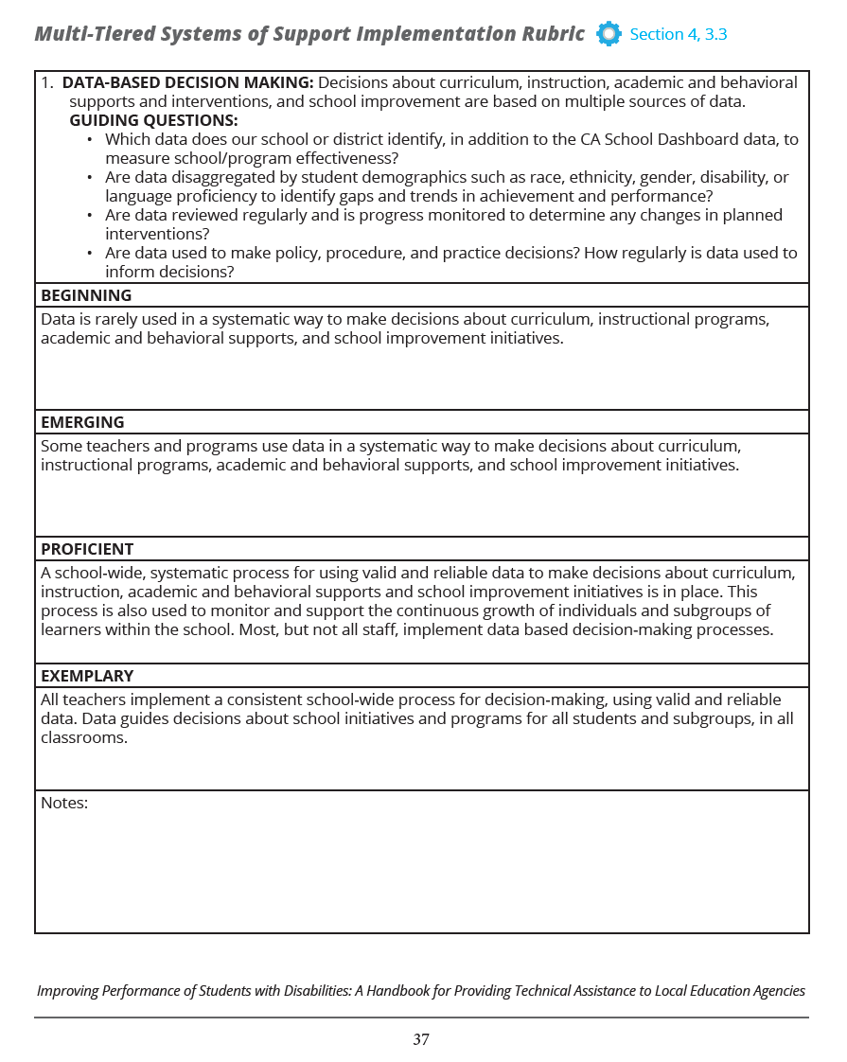
MTSS Implementation Rubric
Notes:
1 minute Running time = 9 minutes
Section 4
Slide intent: To share the MTSS Implementation Rubric from the Toolkit (Section 4).

Slide 67
Checklist for IEP Teams
Notes:
1 minute Running time = 10 minutes
Section 4
Slide intent: To share the IEP Teams Checklist for English learners from the Toolkit (Section 4).

Slide 68
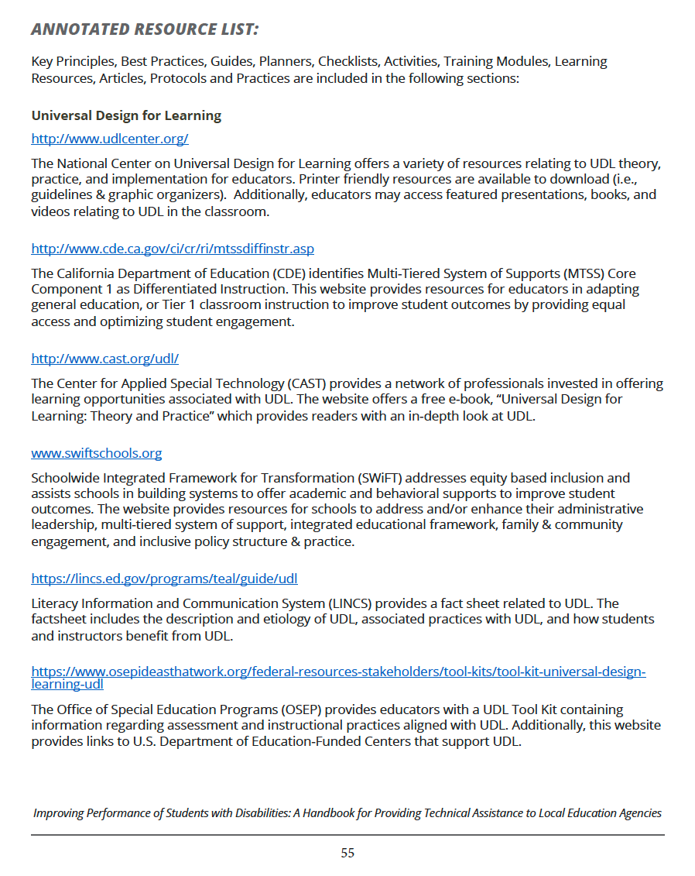
Annotated Resource List
Notes:
9 minutes Running time = 11 minutes
Section 4
Slide intent: To share the Annotated Resource List the Toolkit (Section 4).

