Slide 1
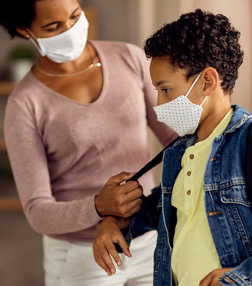
SAFE & SUCCESSFUL SCHOOLS
California Dept of Public Health
February 24, 2021

Slide 2
Epidemiology Updates
SAFE SCHOOLS FOR ALL

Slide 3
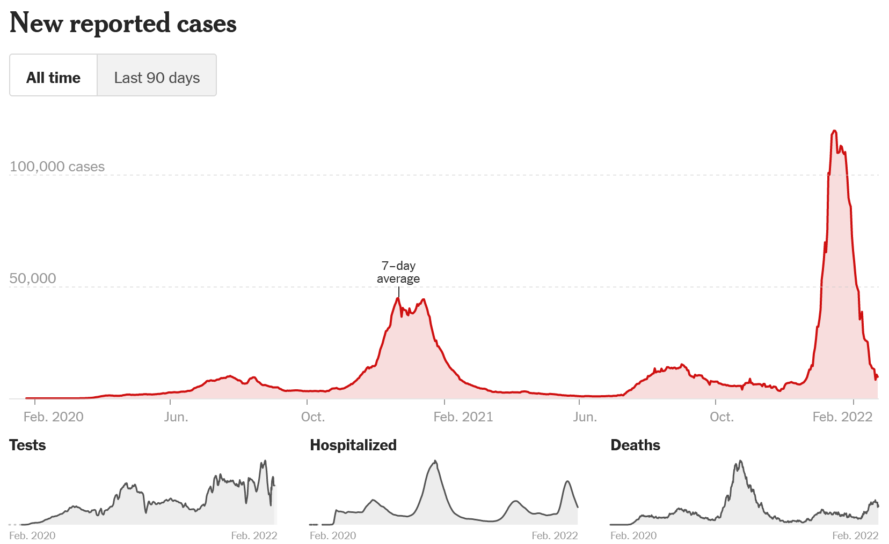
Epidemiologic Trends
Source: NYT
SAFE SCHOOLS FOR ALL

Slide 4
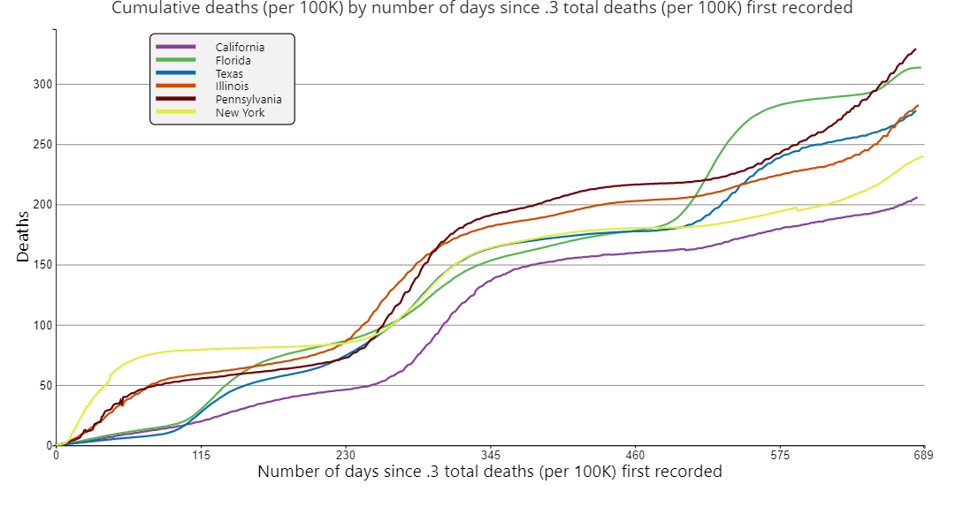
While the numbers are tragic, we can take consolation in knowing our collective efforts have averted more deaths
Source: CDC COVID Data Tracker
SAFE SCHOOLS FOR ALL

Slide 5
CA had among the lowest COVID-19 per-capita pediatric hospitalizations during both the delta and omicron surges, compared to other populous states
Hospital Beds utilized by COVID+ Pediatric Patients, per week per 1,000,000
Source: CDC, CDPH
SAFE SCHOOLS FOR ALL

Slide 6
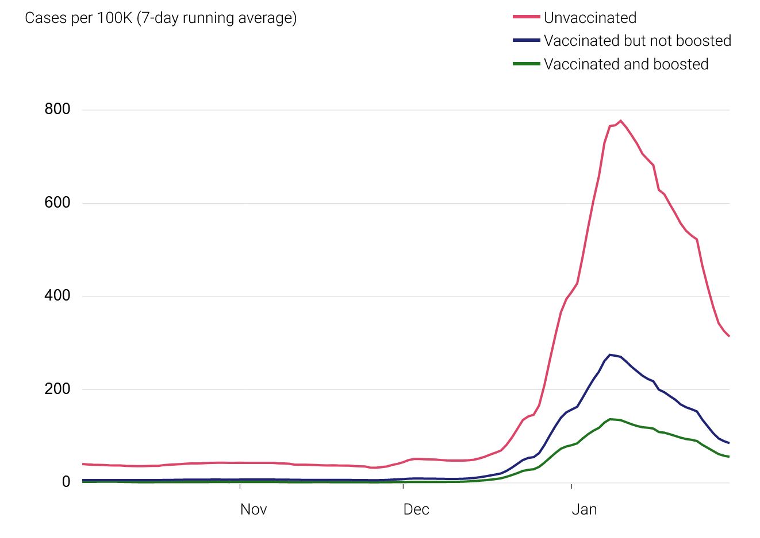
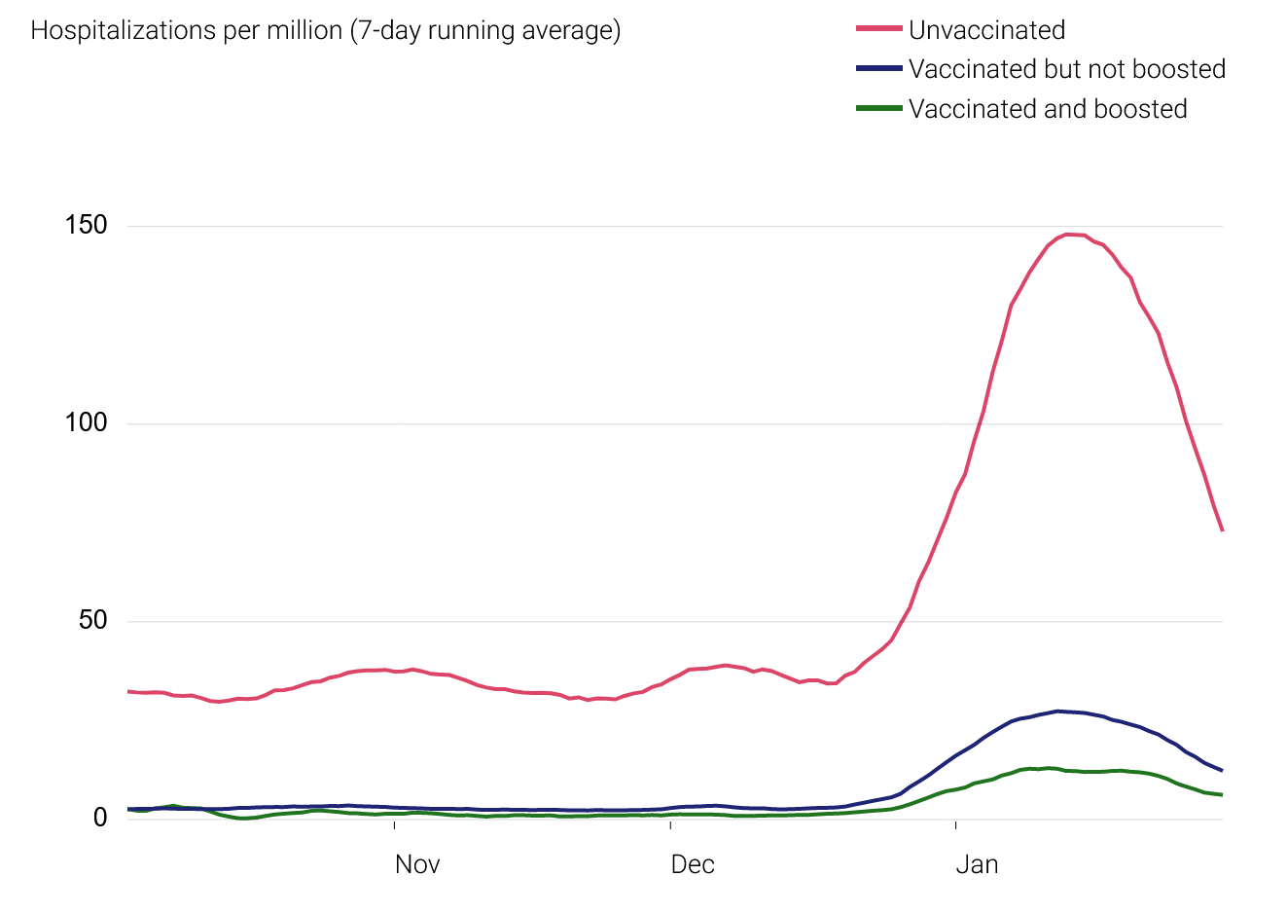
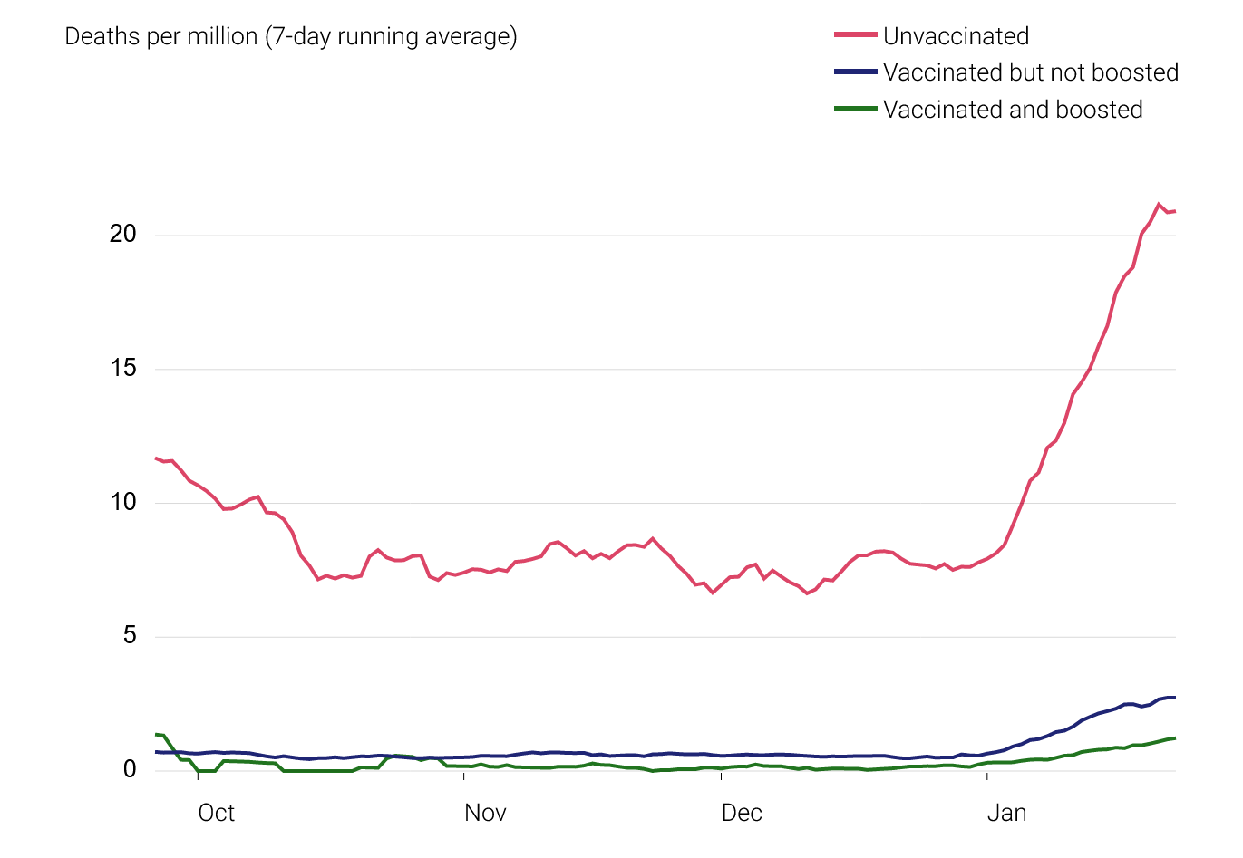
Vaccines have saved lives and reduced transmission
Cases
Hospitalizations
Deaths
Source: CDPH
SAFE SCHOOLS FOR ALL

Slide 7
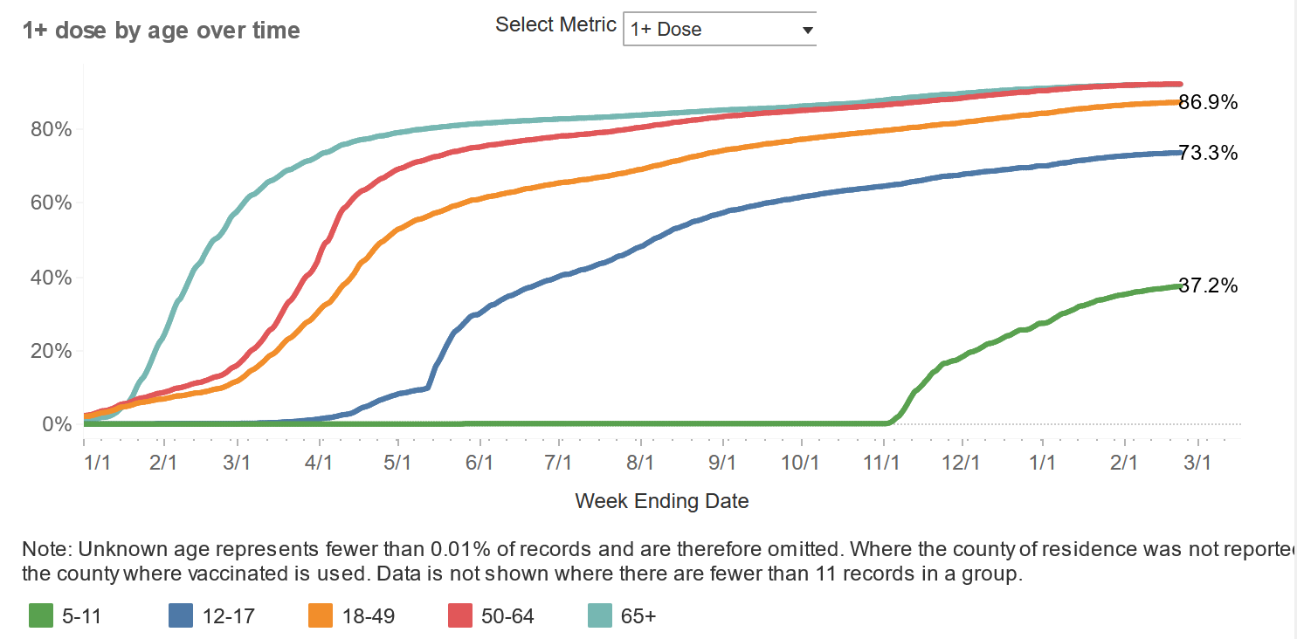
Vaccination rates are rising
SAFE SCHOOLS FOR ALL

Slide 8
Masks reduce your chances of getting COVID-19
Source: CDC Science Briefs [1], [2]
SAFE SCHOOLS FOR ALL

Slide 9
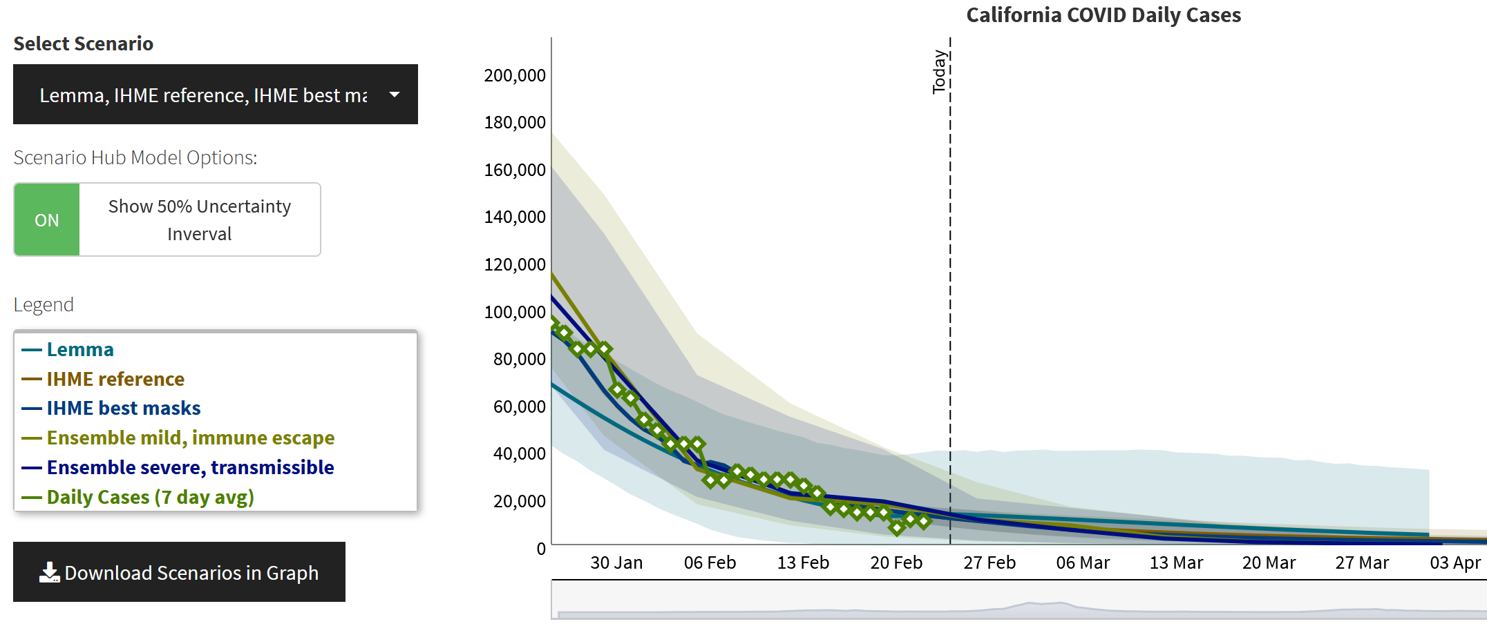
Models project ongoing decline in cases
Source: CalCAT, CDPH
SAFE SCHOOLS FOR ALL

Slide 10
What does masking look like after February 15?
Required
Strongly
Recommended
Recommended
Optional
Public Indoor
(Vaccinated)
Public Indoor
(Unvaccinated)
Health Care
(Vaccinated & Unvaccinated)
Schools & Childcare
(Vaccinated & Unvaccinated)
Long-Term Care
(Vaccinated & Unvaccinated)
NOTE: Local requirements may be additive to state requirements.
Jails & Prisons
(Vaccinated & Unvaccinated)
SAFE SCHOOLS FOR ALL

Slide 11
Future of school masking
FUTURE
Based on our data, it is reasonable that we’re getting close to a point where state masking requirements can be relaxed.
NEXT EXIT
Remaining vigilant on surveillance, continue to track data and conditions.
We must ensure that any decision protects the health and well being of students and staff.
We must remain humble to the unpredictability of this virus.
FEBRUARY 28
Reassess data/conditions (e.g., case rate, test positivity, hospitalizations, pediatric hospitalizations and vaccine rates) for future change to statewide school masking requirement.
FEBRUARY 15
No change to school masking requirement

Slide 12
The factors that inform our approach
Prioritizing in-person instruction
There is no substitute, particularly for vulnerable populations
Prioritizing safe in-person instruction
We must ensure that there is low risk of catching COVID-19 in school for students and staff
Masking requirements will expire as conditions improve
Masks are not intended to be in place in perpetuity
The question is when, not if
Remain prepared to adjust with conditions of the virus
SAFE SCHOOLS FOR ALL

Slide 13
No single indicator, composite look at conditions
Cases
The key is the direction and slope of the trajectory
Hospitalizations
Provides insight into disease severity
Ultimately what drives impact on health care delivery system
Must track closely pediatric hospitalizations and ICU admissions
Vaccination Rates
Vaccines save lives and reduce transmission
We will continue to prioritize getting vaccine rates up for students
National and Global Trends
Trends elsewhere may apply to California
Earliest impacted areas have continued to experience reductions
SAFE SCHOOLS FOR ALL

Slide 14
A winning formula: supporting mitigation efforts
By focusing on layers of mitigation, California has safely kept staff and kids in classrooms
31.1 million Californians have stepped up to get vaccinated
$850 million invested into school safety protocols
23.5 million high-quality masks sent to school staff
5.9 million tests have been administered at schools to-date, and
15.1 million at-home tests have been distributed to school communities
SAFE SCHOOLS FOR ALL

Slide 15
Our Actions Save Lives.

