Slide 1
California Collaborative for Educational Excellence:
Vision for the future of CCEE
CCSESA General Membership Meeting

Slide 2
Overview
90-Day Engagement Strategy
Stakeholder Engagement Activities (>130 stakeholders)
Feedback/Themes Findings
Innovation Ahead- Questions for the group
Next Steps

Slide 3
Our story…

Slide 4
Seeing the whole story..
If you can see the big picture. It is about getting off the “edge of the inside.”
Notes:
Inclusive of all partners even if you are the COE over to the right.

Slide 5
Purpose of 90-Day Engagement
Identify current strengths of CCEE
Identify current perspective challenges of CCEE
Identify future opportunities/direction of CCEE

Slide 6
A Systems View
A Systems View of School Reform
Adapted from the work of Margret Wheatley
Structure
Strategy
Operations
Information
Relationships
Identity
connections
Notes:
Technical vs cultural change
Cuture will out do structure everytime.

Slide 7
90-Day Stakeholder Engagement
State agencies (State Board of Education, CDE)
System of Support partners (county offices, Geo Lead representatives, SELPA lead representatives)
State Legislature
Statewide associations (CCSESA, ACSA, CTA, CSBA, CISC, BASC, others)
Local educational agencies (districts, charters)
Other stakeholder groups (Advisory Council, others)
> 19 Organizations
> 130 Individual Participants

Slide 8
Systemic 3-Phase Approach to Engagement & Transformation
Phase 1: August - September 2021
Review and identify system SWOT
Engage stakeholders (empathy interviews)
Identify changes for system efficiency
VMVG - design thinking
Phase 3: October - November 2021
Finalize Improvement Plan (quarterly monitoring)
Finalize stakeholder feedback recommendations
Finalize VMVG
Determine innovation recommendation
Phase 2: September - October 2021
In response to Phase 1 – develop improvement plan
Synthesis of stakeholder feedback
Develop high-level recommendations
Finalize VMVG recommendations
We are here!

Slide 9
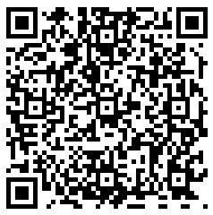
Notes:
Responses: https://PollEv.com/multiple_choice_polls/Kk5g1SK41jpnYmHoOvPGZ/respond
Results: https://www.polleverywhere.com/multiple_choice_polls/HhG0Q8ArPtN9GarMFRO6Q?preview=true&controls=none

Slide 10
Statements from our partners - Challenges
We still don’t know who you are and why you are here?
Are you a state agency or not- why compliance if not? Are we in competition or not?
Nothing I do requires help from your organization. I feel like you are in the way at times.
We don’t really need you.

Slide 11
Statements from our partners - Strengths
You really helped over the pandemic
Trust has been rebuilt
Your resources have really helped us
CCEE has a great and quality trainings

Slide 12
Opportunities
Actively solicit stakeholder needs
Identify models of continuous improvement
Collaborate and define CCEE’s role within Statewide System of Support

Slide 13
Threats
SSOS responsibility no authority
Perception varies across stakeholders on value
Perception of being spread too thin with state-level initiatives
Confusion of statewide agency, but not a statewide agency, Competitor or not Competitor
?

Slide 14
Debrief and Pause
Share at your table or in your breakout what you heard from Matt.
Add any statements to our strengths/challenges that might be helpful or might have been missed.
Jamboard- Virtual
Add a sticky note
Notes:
Breakout Rooms in Zoom
https://jamboard.google.com/d/1Mz4z-1iu5BwwG-KQDSyoY0s0_HIkZTA5m1ghjCXHrVk/edit?usp=sharing

Slide 15
Chris Hartley- New Deputy over SSOS
Essential questions for the SSOS.

Slide 16
Trailer Bills and CCEE
AB 130: Education Omnibus Budget Trailer Bill (2021-22)
Sec. 127: Evaluation of technical assistance
Sec. 144: High-quality instructional materials
Sec. 145: Literacy professional learning
Sec. 152: Evidence-based professional learning to support learning acceleration

Slide 17
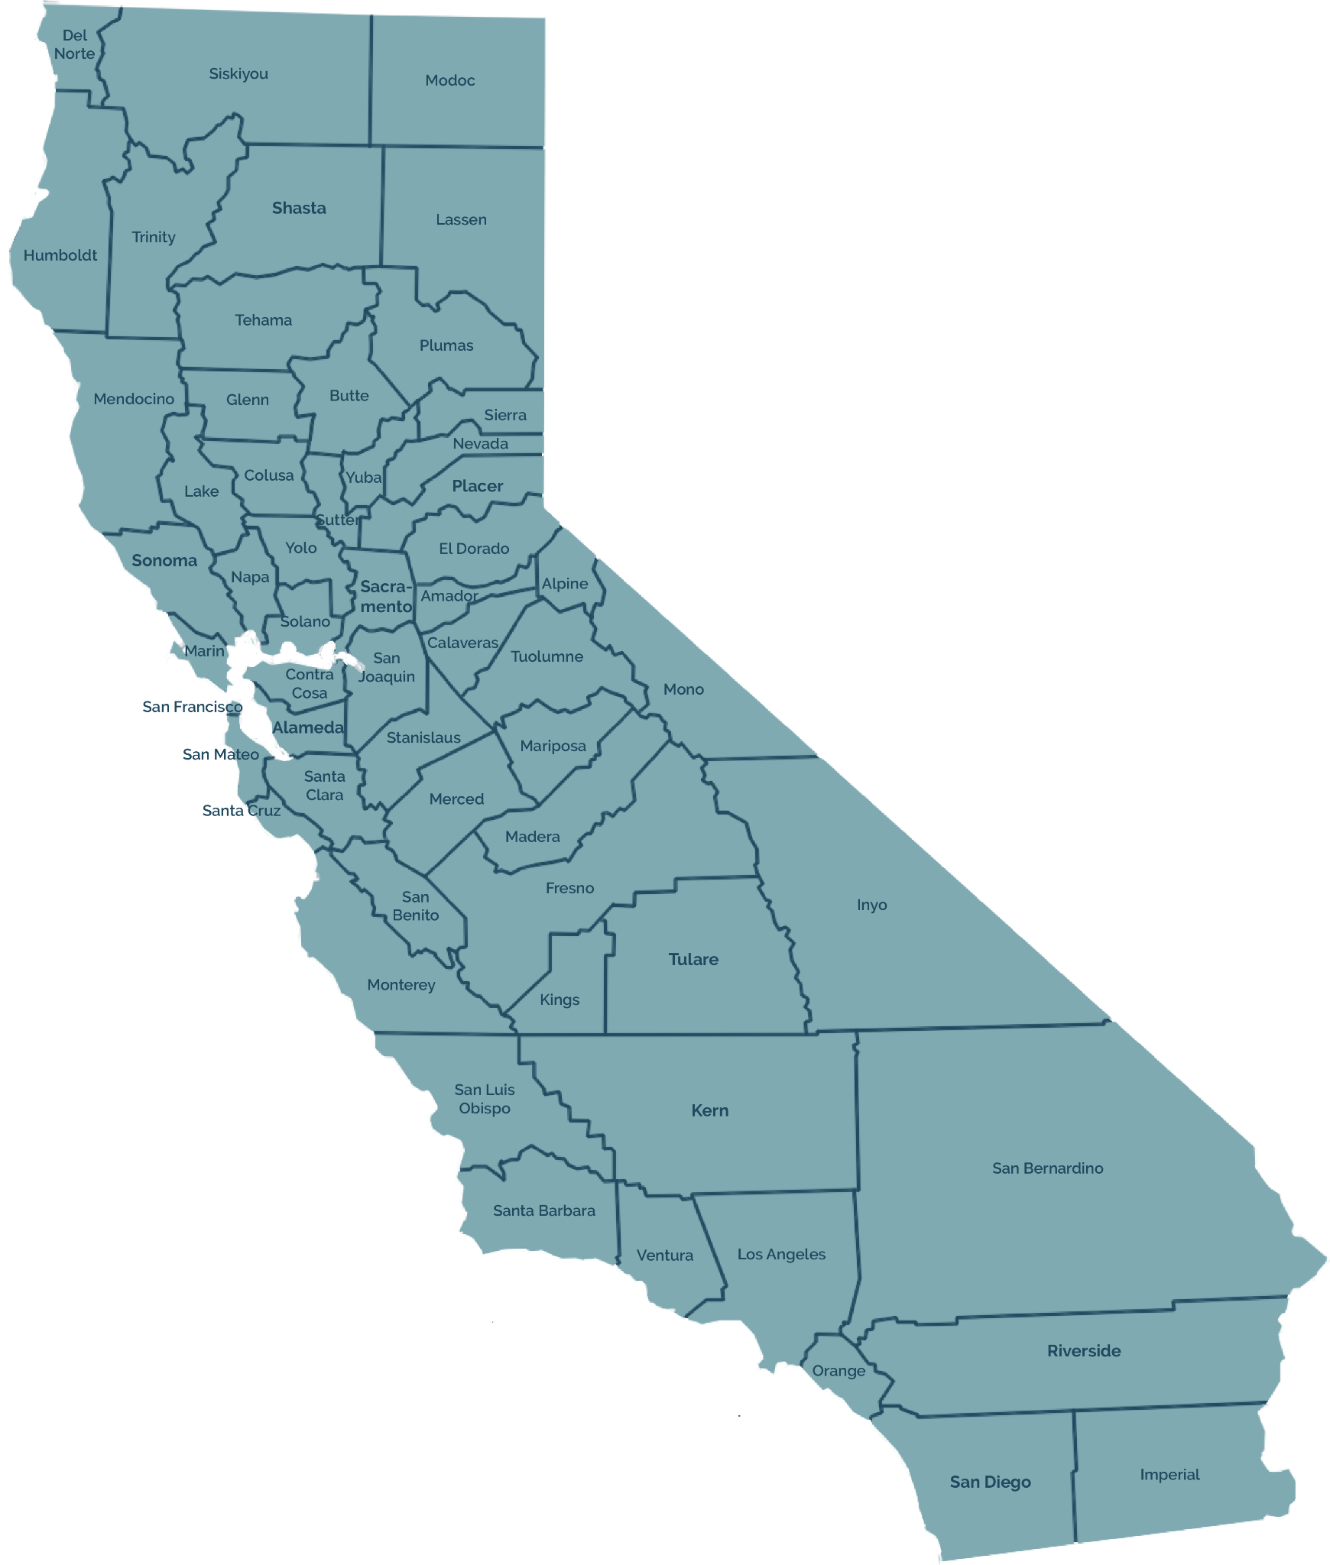
CCEE Organizational Structure & Locations
Auburn (1)
Eureka (1)
Sacramento (15)
2021-22 Organizational Chart
CCEE Staff Locations
Clovis (1)
Oakland (1)
Los Angeles (3)
San Bernardino (3)

Slide 18
Contact Information
Matt Navo
Executive Director, CCEE
Email: mnavo@ccee-ca.org
Phone: (559) 575-4706
Leighann Nguyen
Executive Assistant to Matt Navo
Email: lnguyen@ccee-ca.org
Phone: (916) 619-7488

