Slide 1
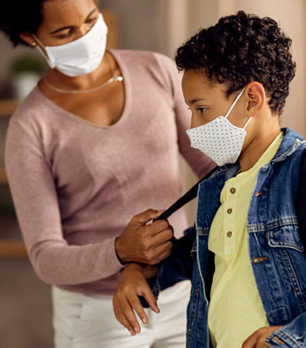
ACSA Lunch Break
School Vaccine Requirements
October 6, 2021

Slide 2
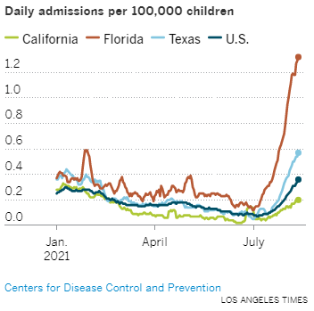
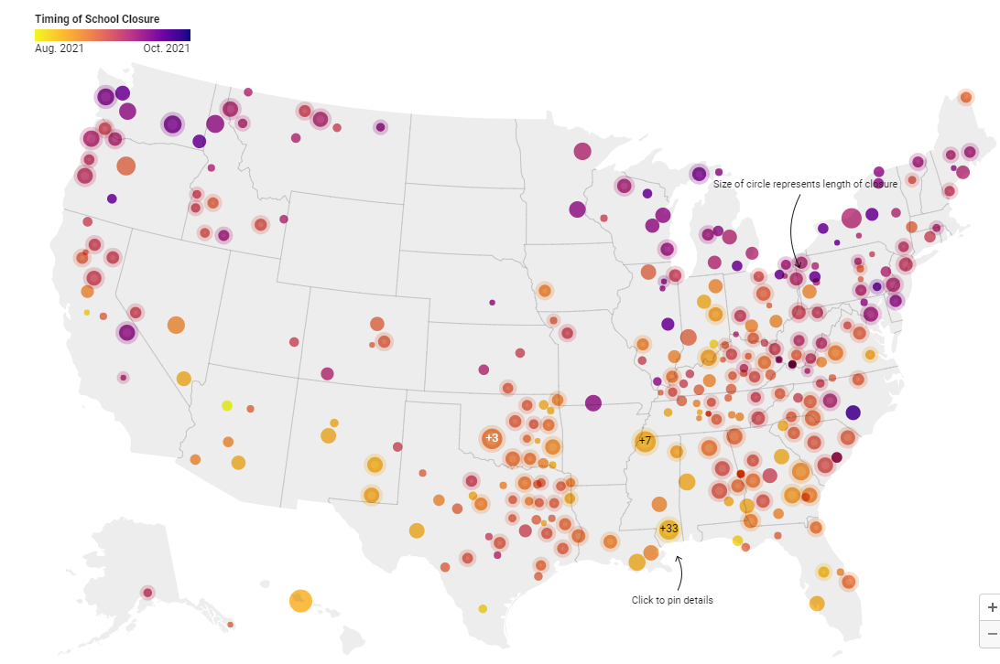
Background
Pediatric Hospitalizations
School Closures
SAFE SCHOOLS FOR ALL

Slide 3
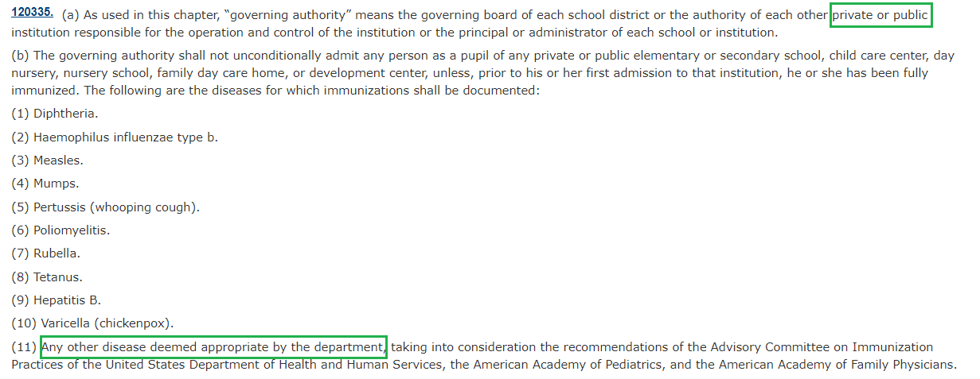
Health & Safety Code
SAFE SCHOOLS FOR ALL

Slide 4
What This Means for Students
If Done Through Regulation, Then Both Medical and Personal Belief Exemptions:
Absent an Exemption, Students May Choose Independent Study (HSC Section 120335):
SAFE SCHOOLS FOR ALL

Slide 5
What this Means for Staff
By the time the first student mandate becomes effective, the verify-or-test requirement for K-12 staff will be converted to a mandate.
SAFE SCHOOLS FOR ALL

Slide 6
Timing Background
Grade Spans:
FDA Authorization and Approval:
 | Grades 7-12 | Grades K-6
Current Status | Students ages 16+ are fully approved Students ages 12-15 have emergency use authorization | Students ages 5-11 are expected to receive emergency use authorization at the end of October
Expected Timeline | Full approval of ages 12-15 in the next months | Uncertain when full approval would follow
SAFE SCHOOLS FOR ALL

Slide 7
Timing
Full Approval for Grade Span
Rulemaking Process (Notice, Comment, etc.)
Effective the Following January 1 or July 1
Factors that Impact Timing:
FDA approval
Consider recommendations of the three entities named in the HSC Code
Time required for the rulemaking process
Reasonable time for implementation
Best Estimate:
7-12: July 1, 2022
K-6: Insufficient information to estimate
SAFE SCHOOLS FOR ALL

Slide 8
Local Action
Local health jurisdictions and school districts may accelerate vaccine requirements, as school districts have.
Some districts have established the requirement based on the Emergency Use Authorizations, and others based on Full Approval.
The statewide requirement is intended to follow established procedures to effectuate the Health and Safety Code’s goal of “total immunization of appropriate age groups against” harmful diseases.
SAFE SCHOOLS FOR ALL

Slide 9
THANK YOU

