Slide 1
$4B CHILDREN AND YOUTH BEHAVIORAL HEALTH INITIATIVE
PARTNERSHIPS & CAPACITY
STREAMLINE STATEWIDE
“To build partnerships, capacity and infrastructure supporting ongoing school-linked behavioral health services for children and youth”
“To build a statewide, community-based organization provider network for behavioral health prevention and treatment services”
PURPOSE
To increase the number of K-12 students receiving preventive and early intervention behavioral health services provided in schools.
WORKFORCE & ACCESS
DATA SYSTEMS & COORDINATION
“To expand access to licensed medical and behavioral health professionals, counselors, peer support specialists, community health workers, and behavioral health coaches”
“To enhance coordination and partnerships with respect to behavioral health prevention and treatment services…via appropriate data sharing systems.”

Slide 2
CHILDREN AND YOUTH BEHAVIORAL HEALTH INITIATIVE
6 PIECES DIRECTLY RELATED TO SCHOOLS
01.
MCO INCENTIVE
PAYMENTS - $400M
02.
PARTNERSHIPS, INFRASTRUCTURE & CAPACITY GRANTS - $550M
03.
WORKFORCE DEVELOPMENT GRANTS - $ 448M
04.
BEHAVIORAL HEALTH COACHES - $352M
05.
REIMBURSEMENT FOR SCHOOL-BASED SERVICES
06.
VIRTUAL PLATFORM - $750M
Note: Legislative language was very light on details. Details will be fleshed out through multiple stakeholder processes over the next couple years.

Slide 3
CHILDREN AND YOUTH BEHAVIORAL HEALTH INITIATIVE
ADDITIONAL PIECES
PUBLIC EDUCATION CAMPAIGN
BEHAVIORAL HEALTH INFRASTRUCTURE
NEW MEDI-CAL DYADIC BENEFIT
$125M
$800M
$310
EVIDENCE-BASED PROGRAMS
CalHOPE
$45M
$429M

Slide 4
CHILDREN AND YOUTH BEHAVIORAL HEALTH INITIATIVE
IMPLEMENTATION TIMELINE
Managed care required to reimburse for services
Virtual platform goes live
DHCS submits MCO Incentive proposal to CMS (feds)
Stakeholder engagement
Revise CYHBI implementation plan
JAN 2022
SUMMER 2022
JAN 2024
WINTER 2021
SPRING 2022
2023
Hire staff and contractors
Create project plan & schedule
Stakeholder workgroup on MCO Incentive Payments
Stakeholder engagement
Initial CYHBI implementation plan
RFPs and grants released
MCO incentives begin

Slide 5
TODAY’S GOALS
Children and Youth Behavioral Health Initiative
LEARN
Learn about the CYBHI, the pieces relevant to education, and how CYBHI could bring more services into schools.
DISCUSS
Break into groups to discuss one piece of the CYBHI and react to draft recommendations.
ADVISE
Provide feedback that will be used to inform CCSESA and COE staff engaged in DHCS & HHS stakeholder groups.
Notes:
Because most of the details of the initiative will be decided by stakeholder groups, your input is critical. We will make sure that CCSESA and COE staff are on these groups, but we’ll need to speak in a unified voice and use aligned talking points if we are going to influence stakeholder groups.

Slide 6
QUICK RECAP
Who has the legal and fiscal responsibility to pay for MH services?
PAYOR
COVERED SERVICES
HEALTH PLAN
MILD/MOD
01
Outpatient services, individual and group therapy counseling services, psychology services and testing
01
Medi-Cal managed care orgs, commercial health plans
COUNTY MENTAL HEALTH
MOD/SEVERE, EPSDT
02
58 county mental health plans (MHPs)
Inpatient services, acute/advanced psychosis, case management, Early Periodic Screening Diagnosis & Treatment
02
MHSA/ PROP 63
CSS/PEI/INNOVATION
03
Flows through the 58 MHPs. Allocation is decided locally.
Broad discretion, but generally: Community services, prevention & intervention, and innovation grants.
03
Notes:
A lot of nuance here, but general overview. Caveat: educationally related mental health services

Slide 7
QUICK RECAP
Understanding MCOs and their importance
What is an MCO?
MCO = Medi-Cal managed care organization. These are the health care plans that provide access to Californians that are insured through Medi-Cal. About 50% of students in CA are enrolled in an MCO.
What about students with private/commercial insurance?
About 40% of students have private/commercial health insurance and are enrolled in a commercial managed care plan (called an MCP).
Who are the MCOs in my county?
DHCS chooses the MCOs in each county. Many counties have just 1 MCO. Some have more than 6. To find the MCO(s) in your county, visit: https://www.dhcs.ca.gov/individuals/Pages/MMCDHealthPlanDir.aspx

Slide 8
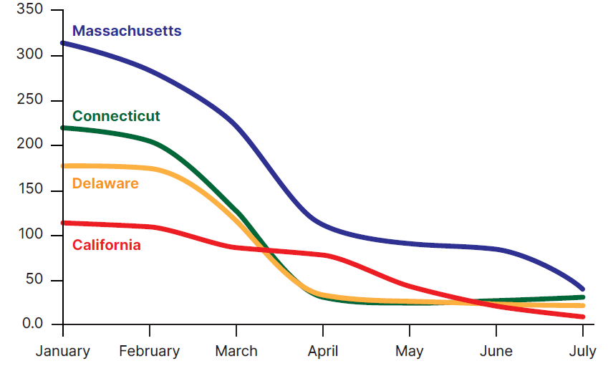
QUICK RECAP
Understanding MCOs and their importance
CALIFORNIA’S MANAGED CARE PLANS ARE AMONG THE WORST IN THE NATION AT MEETING CHILDREN’S BH NEEDS
Why is it important to be familiar with the roles and responsibilities of MCOs and MCPs?
In California, MCOs and MCPs and are legally and fiscally responsible for providing the short-term and mild/mod mental health services that children most frequently need. But they are currently doing a very poor job of getting these services to children.
https://www.medicaid.gov/state-resource-center/downloads/covid19-data-snapshot.pdf

Slide 9
CHILDREN AND YOUTH BEHAVIORAL HEALTH INITIATIVE
6 PIECES DIRECTLY RELATED TO SCHOOLS
01.
MCO INCENTIVE
PAYMENTS - $400M
02.
PARTNERSHIPS, INFRASTRUCTURE & CAPACITY GRANTS - $550M
03.
WORKFORCE DEVELOPMENT GRANTS - $ 448M
04.
BEHAVIORAL HEALTH COACHES - $352M
05.
REIMBURSEMENT FOR SCHOOL-BASED SERVICES
06.
VIRTUAL PLATFORM - $750M

Slide 10
CHILDREN AND YOUTH BEHAVIORAL HEALTH INITIATIVE
6 PIECES DIRECTLY RELATED TO SCHOOLS
01.
MCO INCENTIVE
PAYMENTS - $400M
REGIONS 1 & 4
PARTNERSHIPS, INFRASTRUCTURE & CAPACITY GRANTS - $550M
REGIONS 2 & 5
02.
03.
WORKFORCE DEVELOPMENT GRANTS - $ 448M
REGIONS 3, 6 & 11
04.
BEHAVIORAL HEALTH COACHES - $352M
REGIONS 3, 6 & 11
05.
REIMBURSEMENT FOR SCHOOL-BASED SERVICES
REGIONS 7 & 9
VIRTUAL PLATFORM - $750M
REGIONS 8 & 10
06.

Slide 11
Review the draft recommendations for your assigned topic(s) and discuss the following prompts at your tables:
01
Do the recommendations cover the important asks/points you want addressed in stakeholder implementation groups?
Do the recommendations align with our shared vision and goal to increase mental health services for students?
If enacted, would the recommendations create the systems changes necessary to increase mental health services for students?

Slide 12
01.
MCO INCENTIVE
PAYMENTS - $400M
PURPOSE
The state will offer incentive payments to Medi-Cal managed care plans that “increase access to preventative, early intervention and behavioral health services by school-affiliated behavioral health providers for K-12 children in schools.”
NEW & EXISTING
SUPPLEMENT, NOT SUPPLANT
Incentive payments shall be used to develop “new collaborative initiatives” and “build on existing school-based partnerships.”
Incentive payments must supplement, not supplant existing funding and services.
STAKEHOLDER INPUT
DHCS shall hold stakeholder workgroups to develop interventions, goals, and metrics used to determine eligibility

Slide 13
01.
MCO INCENTIVE
PAYMENTS - $400M
TECHNICAL ASSISTANCE
Technical assistance to increase coordination and partnerships between schools and health plans (e.g. contracts, MOUs, agreements)
PLANNING
Planning efforts to use data to identify needs, gaps, disparities, inequities, and resources and develop a framework for a robust and coordinated system of care
PROGRAMS
Developing or piloting behavioral health wellness programs in school settings (e.g. Mental Health First Aid, SEL).
EXAMPLES
Interventions, goals, and metrics include but are not limited to:
WORKFORCE
Expanding the workforce by using community health workers or peers
PREVENTION
Implementing suicide prevention strategies increasing access to substance abuse prevention, early intervention, and treatment
OUTCOMES
Improving performance and outcomes-based accountability for behavioral health access
TELEHEALTH
Increasing telehealth services in schools

Slide 14
02.
PARTNERSHIPS, INFRASTRUCTURE & CAPACITY GRANTS - $550M
Note: $400M earmarked for grants benefitting preschool to 12th grade students
PURPOSE
PARTNERSHIPS
ACCESS
Build partnerships, capacity, and infrastructure for ongoing school-linked BH services for children 0 to 25
Expand access to licensed medical and BH professionals, counselors, peer support, community health workers, and BH coaches
COORDINATION
NETWORK
Enhance coordination and partnerships providing BH prevention and treatment via data sharing systems
Build a statewide community-based provider network for BH treatment of children

Slide 15
02.
PARTNERSHIPS, INFRASTRUCTURE & CAPACITY GRANTS - $550M
ALLOWABLE ACTIVITIES INCLUDE, BUT ARE NOT LIMITED TO:
Addressing behavioral health disparities while providing linguistically and culturally competent services
Supporting administrative costs including planning, project management, training, and technical assistance
Linking plans, counties, and school districts with local social services and community-based organizations
Implementing telehealth equipment and virtual systems in or near schools
Implementing data-sharing tools, information technology interfaces, or other technology investments designed to connect to behavioral health services

Slide 16
03.
WORKFORCE DEVELOPMENT GRANTS - $ 448M
PURPOSE
Scholarships, loan repayment, coaching, and stipend programs
Training new and existing staff on working with youth
“Competitive grants to entities and individuals OSHPD deems qualified to expand the supply of BH counselors, coaches, peer supports, and other allied health care providers serving children and youth, including those at schoolsites”
Expansion of existing workforce programs and creation of new programs

Slide 17
04.
BEHAVIORAL HEALTH COACHES - $352M
The state agency shall create and define the qualifications for a new category of behavioral health provider that is trained to address the unmet MH and substance abuse needs of children and youth
Purpose: Increase the diversity and capacity of the MH profession
Engage and support youth in cultural, linguistic and age-appropriate services
Refer and link to higher levels of care
Included as members of a care team, supervised by licensed staff
Training and qualifications may include, but are not limited to, psychoeducation, system navigation, crisis de-escalation, safety, planning, coping skills, and motivational interviewing

Slide 18
05.
REIMBURSEMENT FOR SCHOOL-BASED SERVICES
HEALTH PLANS WILL BE REQUIRED TO REIMBURSE SCHOOLS FOR SERVICES PROVIDED TO YOUTH AGES 0 -25
Must be provided
By a licensed or
Authorized mental
Health provider
WHO?
WHAT?
Applies to MCOs, MCPs, and disability insurance plans
All mental health and substance abuse services that the plan is required to cover
WHERE?
WHEN?
Schools: A facility or location used for K-16 purposes and locations not owned or operated by an LEA if the LEA provides or arranges for the provision of the treatment
Starting January 1, 2024

Slide 19
05.
REIMBURSEMENT FOR SCHOOL-BASED SERVICES
A
CURRENT :
SCHOOLS SUBMIT CLAIMS, HEALTH PLANS DENY OR IGNORE THEM
CYBHI :
HEALTH PLANS CAN ONLY DENY A CLAIM FOR 3 REASONS
VS
Denied for out of network provider
Not a member of the health plan
Denied for lack of preauthorization
Services were not actually provided
Denied for lack of diagnosis
Not a licensed or authorized MH provider
Ignored for claim in wrong format
*Caveat: Does not relieve an LEA from the requirement to “accommodate or provide services” to a student with an IEP. However, the Medi-Cal for Students report makes clear that schools are the payor of last resort even when a student has an IEP .

Slide 20
05.
REIMBURSEMENT FOR SCHOOL-BASED SERVICES
AMOUNT
PREAUTHORIZATION
The health plan shall reimburse the greater of either the state-established school-linked fee or the health plan/LEA negotiated rate.
The health plan cannot require preauthorization. (Caveat- DHCS stakeholder group will decide if there are an exceptions to this rule.)
TIMELY PAYMENT
CO-PAYMENTS
The health plan must pay claims in a timely manner (generally 30 days).
Neither the plan nor the LEA may charge a copayment, deductible, or any other form of cost sharing.

Slide 21
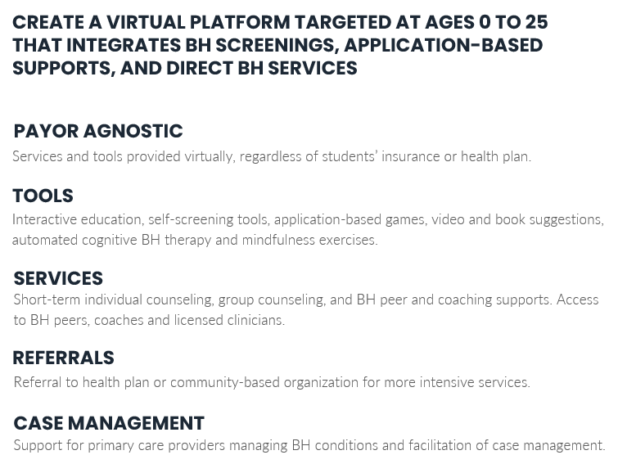
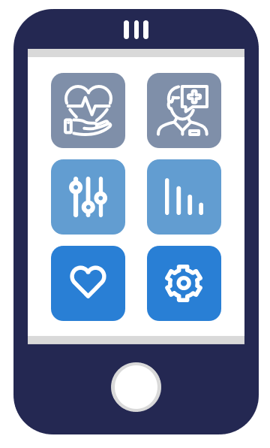
06.
VIRTUAL PLATFORM - $750M

Slide 22
CHILDREN AND YOUTH BEHAVIORAL HEALTH INITIATIVE
6 PIECES DIRECTLY RELATED TO SCHOOLS
01.
MCO INCENTIVE
PAYMENTS - $400M
REGIONS 1 & 4
PARTNERSHIPS, INFRASTRUCTURE & CAPACITY GRANTS - $550M
REGIONS 2 & 5
02.
03.
WORKFORCE DEVELOPMENT GRANTS - $ 448M
REGIONS 3, 6 & 11
04.
BEHAVIORAL HEALTH COACHES - $352M
REGIONS 3, 6 & 11
05.
REIMBURSEMENT FOR SCHOOL-BASED SERVICES
REGIONS 7 & 9
VIRTUAL PLATFORM - $750M
REGIONS 8 & 10
06.

Slide 23
Review the draft recommendations for your assigned topic(s) and discuss the following prompts at your tables:
01
Do the recommendations cover the important asks/points you want addressed in stakeholder implementation groups?
Do the recommendations align with our shared vision and goal to increase mental health services for students?
If enacted, would the recommendations create the systems changes necessary to increase mental health services for students?

