Slide 1
California Community Schools Partnership Program Alameda County Office of Education & Student Health and Wellness PLN

Slide 2
California Community Schools Partnership Program (CCSPP)
State Transformational Assistance Center (S-TAC)

Slide 3
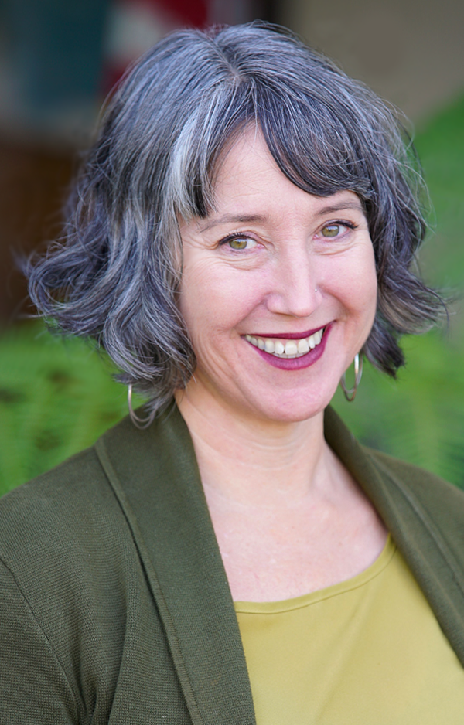
Alameda County Superintendent of Schools
Alysse Castro
PRIORITIES
Be the safety net for our most vulnerable students by centering their needs & success
Build the partnerships that remove barriers to learning: families, providers, & educator pipeline
Break the school-to-prison pipeline: Safety comes from support
Innovate to efficacy, efficiency, and equity
PATH
Principal of Alternative Programs
Alameda Unified School District
Director of Student Programs and Services
Alameda County Office of Education
Instructor, Principal Leadership Institute
UC Berkeley
Executive Director of Court, County and Continuation High Schools
San Francisco Unified School District
Alameda County Superintendent of Schools
Notes:
Intro of herself as the new Alameda County Superintendent
Enthusiasm toward leading the state in the transformational assistance of the California Community Schools Partnership Program, partnering with UCLA, Californians for Justice, National Education Association, along with the Regional Transformational Assistance Centers and the partners they bring to the work.
Opportunity we have to promote coherence among the states whole child investments (UPK, ELO-P, CYBHI, Universal Meals, etc.) using the community schools framework
Intro to me to present

Slide 4
S-TAC Update
August
Launched monthly COE Community of Transformative Practice (CoTP) and weekly Collective Learning Space
November
Launched S-TAC Webpage and design of Community Schools Implementation Growth Chart
December
Facilitated UCLA Community School study tour
January
Collaboration with CDE and WestEd on data collection
Notes:
May SBE Meeting-Approval of S-TAC

Slide 5
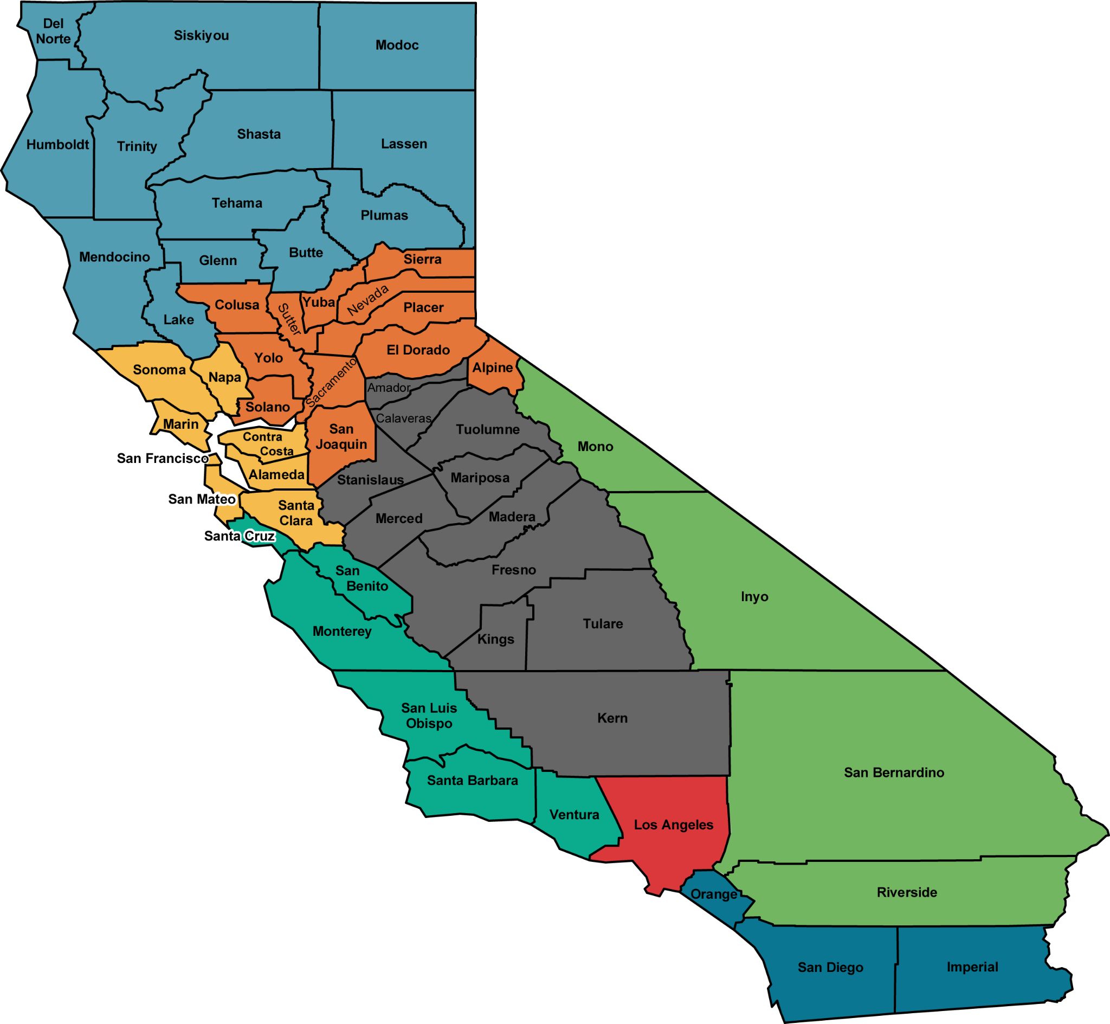
Regional Transformational Assistance Centers (R-TACs)
Shasta COE Northern CA
Sacramento COE Capitol Area
Santa Clara COE Bay Area
Monterey COE Central Coast
Fresno COE Central Valley
San Diego COE Southern Coast
San Bernardino COE Southern Inland
Los Angeles COE Greater Los Angeles
5
Notes:
Meet and Greets
Monthly Meetings
Collaboration on survey, Implementation Growth Chart, resource curation, etc.
S-TAC/R-TAC Summit

Slide 6
COE Coordination Grant Allocations
Alameda | $ 425,000
Contra Costa | $ 375,000
Fresno | $ 375,000
Humboldt | $ 375,000
Imperial | $ 200,000
Kern | $ 425,000
Kings | $ 250,000
Lake | $ 300,000
Los Angeles | $ 500,000
Madera | $ 300,000
Marin | $ 200,000
Merced | $ 300,000
Monterey | $ 300,000
Napa | $ 300,000
Orange | $ 425,000
Riverside | $ 350,000
Sacramento | $ 350,000
San Benito | $ 200,000
San Bernardino | $ 375,000
San Diego | $ 375,000
San Francisco | $ 375,000
San Mateo | $ 250,000
Santa Barbara | $ 200,000
Santa Clara | $ 375,000
Santa Cruz | $ 200,000
Shasta | $ 300,000
Siskiyou | $ 200,000
Trinity | $ 200,000
Tulare | $ 200,000
Yolo | $ 200,000
Yuba | $ 200,000
Notes:
CDE GANS are is in process of sending out allocations-five year funding cycle
Legislation: Ed Code 8902: Up to 140 million shall be allocated to COEs with at least two or more Planning and/or Implementation Grantees
31 COEs Allocated Funding Totaling $9,400,000
Grant awards must be between $200,000 and $500,000 per COE annually for seven years, and must be based on the number of community schools at grantee LEAs and the number of students served in those schools, using an allocation formula determined by the Superintendent.
The CDE has developed an equity-based funding formula to distribute this coordination funding to eligible COEs. The 2022-23 allocations are listed in the attachment, “2022-23 CCSPP COE Coordination Grants Allocation.”
Data Sheet: https://www.cde.ca.gov/ci/gs/hs/ccspp.asp
To coordinate county-level governmental, nonprofit community-based organizations, and other external partnerships to support community school implementation at grant recipients in their county. This shall include designating a county-level community schools liaison to coordinate with the department and technical assistance centers in capacity building, resource connection, and continuous improvement activities consistent with supporting grant recipients in their county in implementation of community schools, as specified in subdivisions (g) and (h).”
COEs receiving funds pursuant to this paragraph shall support centralized grant recipient communications with county-level governmental partners and funding sources, which may include, but not be limited to, pupil support and health care service billing and billing practices technical assistance.”
COEs receiving funds pursuant to this paragraph shall support local educational agency planning and use of pupil and campus data for integrating community school, expanded learning, early childhood education, county behavioral health, educator professional development, and other state-funded initiatives integral to the four pillars of a community school approach as described in subdivision (b) of Section 8901, which may be part of the qualifying entity’s LCAP process…”

Slide 7
COE Coordination Grant Allocations (cont'd)
Coordinate county-level governmental, nonprofit community-based organizations, and other external partnerships to support community school implementation at grant recipients in their county. This shall include designating a county-level community schools liaison to coordinate with the department and technical assistance centers in capacity building, resource connection, and continuous improvement activities consistent with supporting grant recipients in their county in implementation of community schools.
Support centralized grant recipient communications with county-level governmental partners and funding sources, which may include, but not be limited to, pupil support and health care service billing and billing practices technical assistance.
Support local educational agency planning and use of pupil and campus data for integrating community school, expanded learning, early childhood education, county behavioral health, educator professional development, and other state-funded initiatives integral to the four pillars of a community school approach.
Ed Code 8902
COE CCSPP Liaisons

Slide 8
Opportunity for Coherence
Expanded
Learning Time & Opportunities
Collaborative Leadership & Practices
Integrated
Student Supports
Family & Community Engagement
Expanded Learning Opportunities Program
Universal PreKindergarten
Transitional Kindergarten Expansion
Preschool and Childcare
CalHOPE
Behavioral Health Workforce
Educator Effectiveness Block Grant
Anti-Bias Education
Mental Health Student Services Act
CalAIM
Student Behavioral Health Incentive Program
Transportation
Universal Meals
Community Engagement Initiative
School Climate Survey
Alternative Dispute Resolution & Family Empowerment Centers
Notes:
The four pillars and connection to other statewide priorities

Slide 9
CCSPP Cohort 2 Update
NOVEMBER 2022
DECEMBER 2022
JANUARY 2023
MARCH 2023
MAY 2023
Planning Grant Applications Due
20th
Planning Grant RFA Released
Planning Grant
Approval
1st
Implementation
Grant
Approval
Implementation Grant RFA Release
Notes:
Implementation Grant
Intent is to support LEAs in establishing new and/or expanding and continuing existing community schools
Grant Cycle: Five Years
Up to $500,000 per school site

Slide 10
CCSPP LIAISON ROLE
Legislatively Defined Activities | Staff/Program
Coordination & Comm. with Managed Care Plans (MCPs) | SBHIP staff lead CCSPP Liaison
Coordination & Comm. with County Behavioral Health Dept. | MHSSA staff lead CCSPP Liaison
Coordination with County Health and Social Services | AB 2083 staff lead (foster youth integrated services) Alternative Education Dept. CCSPP Liaison
Coordination with Non-Profits and Other Community Based Orgs | PBIS staff lead MTSS staff lead CCSPP Liaison Other COE Divisions & Depts
Coordination & Comm. on Health Care Billing | Special Education Dept. Business Division CCSPP Liaison
Integration of Planning & Data re Community Schools, Expanded Learning, Early Learning, Behavioral Health, PD, & Other State Initiatives | All COE Divisions & Depts CCSPP Liaison
Overlap and alignment with other program and staff activities and requirements
Notes:
Presenter: AD

Slide 11
CCSPP LIAISON OVERLAPS WITH OTHER PROGRAMS
CCSPP CALLS FOR INTEGRATION/ALIGNMENT WITH OTHER PROGRAMS
Student Behavioral Health Incentive Program (SBHIP), part of the CYBHI
Mental Health Student Services Act (MHSSA)
AB 2083 (requirement to work with the county to coordinate/integrate social services for foster youth)
Expanded learning
Early learning and UPK
Behavioral health
Professional development
Medi-Cal billing
Positive Behavioral Interventions and Services (PBIS)
Multi-Tiered Systems of Support (MTSS
Notes:
Presenter: ML

Slide 12
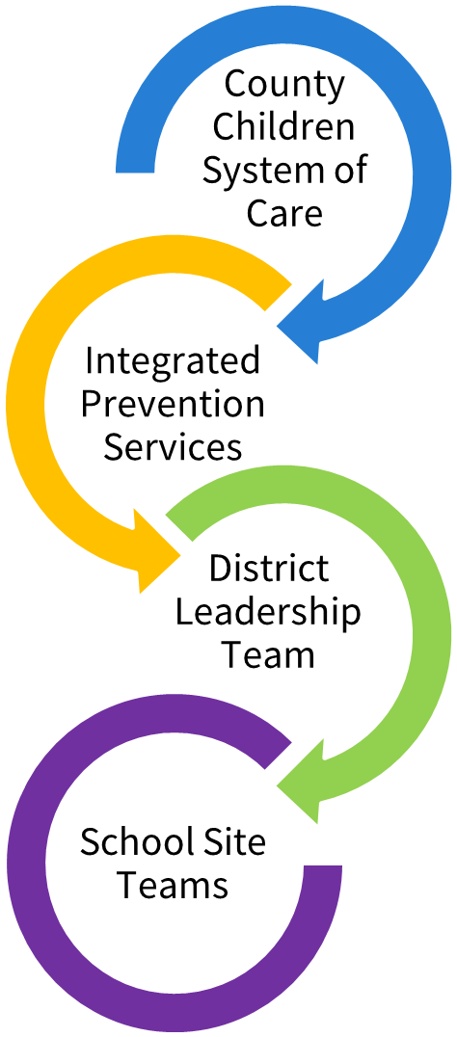
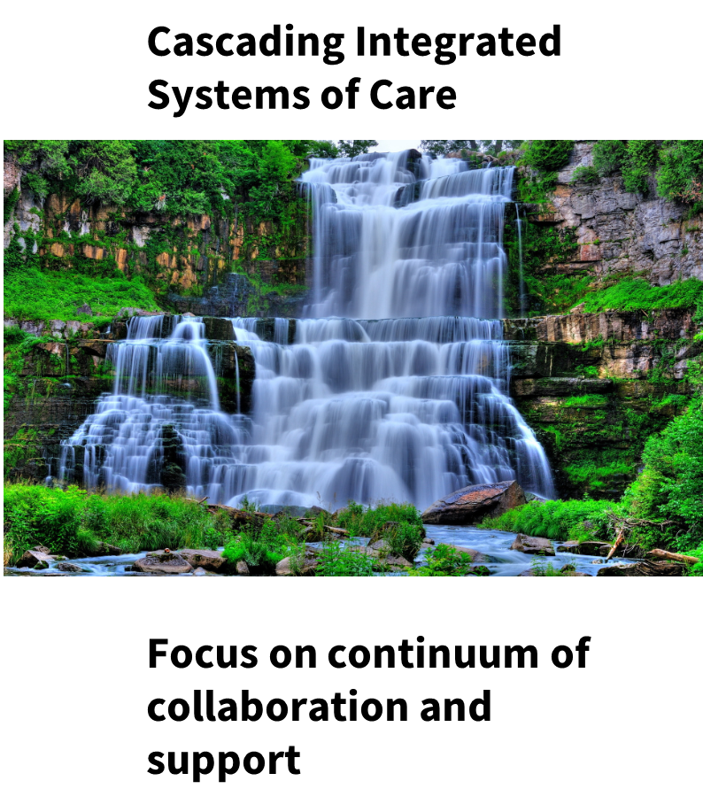
Organization | Models for Implementing Effective Internal Whole Child Coordination (Placer County Integrated Mental Health Example)
Notes:
Presenter: ML to open with Placer example

Slide 13
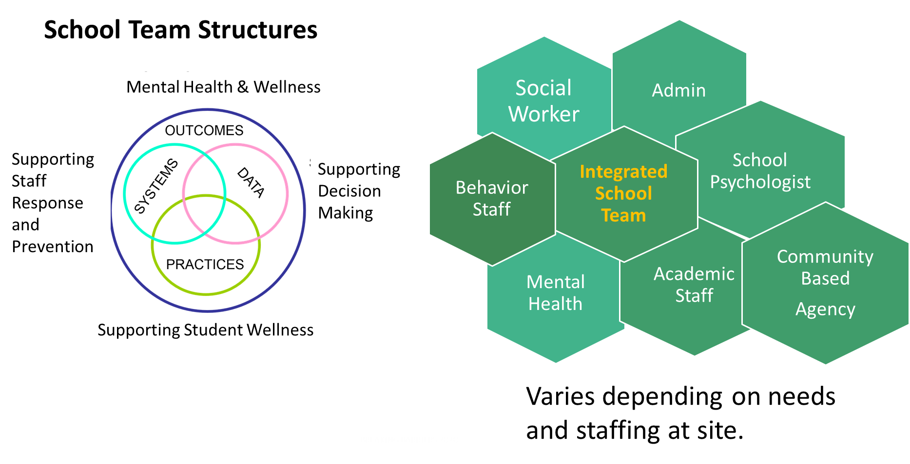
Organization | Models for Implementing Effective Internal Whole Child Coordination (Placer County Integrated Mental Health Example)
Notes:
Presenter: ML to open with Placer example

Slide 14
Organization | Models for Implementing Effective Internal Whole Child Coordination (Placer County Integrated Mental Health Example)
PCOE collaboration with LEAs, County Behavior Health, Children System of Care, and Community Based Agencies
Goals for Wellness Center / Campus
Improved academic outcomes | Increase promotion/graduation rates
Reduced absenteeism | Reduced suspensions
Create positive engaged school climate | Improve staff and student wellness
Notes:
Presenter: ML to open with Placer example

Slide 15
COE Models for Implementing Effective Internal Whole Child Coordination
Model A: All staff related to health, behavioral health, student wellness, Medi-Cal, and community schools are organized under a Director of Student Health and Wellness. The Department is housed in the Executive Services Division and meets monthly with the other Divisions that house other whole child programs (eg early and expanded learning, etc).
Model B: All staff related to student wellness, community schools, and SEL are organized under the Community Schools Liaison and housed under the Curriculum & Instruction Division. Staff related to Medi-Cal, health, and behavioral health stay under Student Services, but the two teams meet bi-weekly. Both teams meet monthly with other Divisions that house other whole child programs.
Model C: The COE creates a Whole Child Division which houses all whole child programs, including early learning, expanded learning, health, behavioral health, community schools, Medi-Cal, PBIS, MTSS, etc. The Whole Child Division meets monthly with other Divisions (eg curriculum, professional learning, etc).
Notes:
Presenter: AD

