Slide 1
Williams Case 2022 - AB 599
Why, Who, How, When

Slide 2
Why Williams Visits?
Williams Lawsuit History
REMINDER - ALL schools are Williams schools, not just those reviewed by a County Office
From the Law with references to Ed Code: The priority objective of the visits made pursuant to this paragraph shall be to determine the status of all of the following circumstances:
(i) Sufficient textbooks, as defined in Section 60119 and as specified in subdivision (i).
(ii) The condition of a facility that poses an emergency or urgent threat to the health or safety of pupils or staff, as described in school district policy or paragraph (1) of subdivision (c) of Section 17592.72.
(iii) The accuracy of data reported on the school accountability report card with respect to the availability of sufficient textbooks and instructional materials, as defined by Section 60119, and the safety, cleanliness, and adequacy of school facilities, including good repair, as required by Sections 17014, 17032.5, 17070.75, and 17089.

Slide 3
Who Is Visited?
AB 599 was signed by the Governor on October 8, 2021. It includes some major changes to Williams Legislation:
Charters are now included in the Williams County Reviews
Updated Williams list to be based off of California’s “new” accountability system along with additional criteria
schools identified for comprehensive support and improvement (CSI) and additional targeted support and improvement (ATSI) or as low-performing pursuant to specified federal laws, and to additionally include on the list schools where 15% or more of the teachers are holders of a permit, certificate, or any other authorization that is a lesser certification than a preliminary or clear California teaching credential

Slide 4
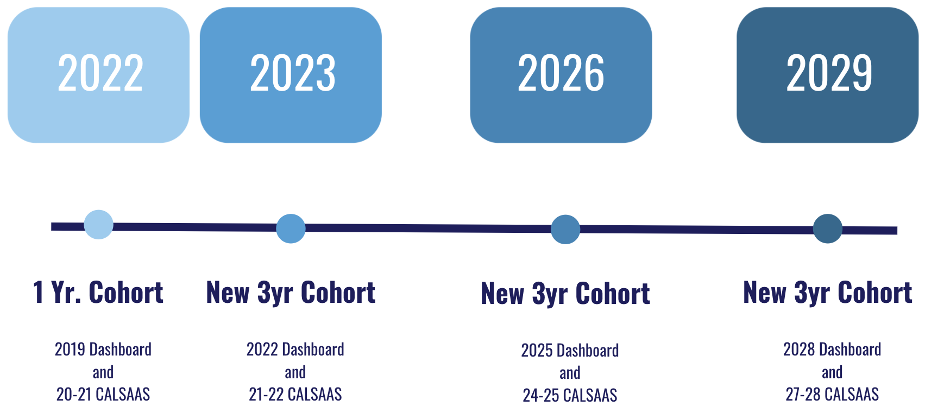
How Long Will This Last?
Initial list established in the 2021–22 fiscal year for review in the Fall of 2022
based on the 2019 Dashboard and 20-21 CALSAAS monitoring
CDE to identify a list of these schools again in the 2022–23 fiscal year based off of the 2022 Dashboard and CALSAAS monitoring from the 2021-2022 school year
The list will be updated every 3 fiscal years thereafter, thus creating a 3-year cohort of Williams monitored schools
Next cohort would begin in 2026, based off of the 2025 Dashboard and CALSAAS monitoring from 2024-2025 school year
CDE Williams Monitoring FAQ

Slide 5
When Do The Visits Occur?
Williams reviews take place between the 10th and 20th day of instruction for the school year
If first day of instruction is 8/24/22; then visits will occur between 9/7/22 and 9/21/22
Notes:
Due to the passage of SB 820 and the added EC Section 1241(b). The provision in EC Section 1240(i)(3)(B), which permits COEs to use written surveys as a means of gathering information to review instructional materials for COEs who monitor 200 or more schools, has been extended to all COEs.

