Slide 1
The California Way:
Taking Equity to Scale by
Making high standards and powerful learning
opportunities available to ALL students

Slide 2
The challenge:
Pursuing Excellence and Equity at a time of growing inequality
Turning around under-performing schools and providing tangible help to districts
Moving from compliance driven practice to capacity building
Responding to pressure from a frustrated public

Slide 3
The question:
Why isn’t California making more progress?

Slide 4
Equity is:
Addressing the needs of all students
Academic, psychological, emotional, social
Recognizing differences, compensating for disadvantages, and mitigating harm, hardships and risks to all students
Leveling the playing field in education so that all kids have the opportunity to succeed
Staying focused on outcomes – academic and developmental
Discussion: What is your COE doing to drive equity?

Slide 5
New California Accountability Framework
Embedded in LCFF
State assessments (AP, IB, Eng. Proficiency, etc.)
Student persistence and graduation
Student inclusion (suspension and expulsion rates)
Access to qualified teachers, adequate facilities, necessary learning materials
Student access to a broad curriculum, including core subjects, arts and physical education
Evidence of parent participation and opportunities for input

Slide 6
How the state monitors progress

Slide 7
Child Development – a holistic approach to learning (social and emotional factors) and the need for differentiation
Neuroscience – elasticity of brain requires the use of strategies to promote cognitive development and mitigate harmful factors in the environment
A Framework for Pursuing Equity
Relationships – Understanding and responding to the way students are affected by family, peers, community, and society

Slide 8
AN Equity Centered approach:
Capacity Building - a process that requires sustained focus on measurable areas of improvement
A coherent instructional guidance system
Development of the professional capacity of faculty
Strong parent-community-school ties
A student-centered learning climate
Leadership that drives change

Slide 9
Building school capacity requires an understanding of how to:
Build partnerships between schools, local government and CBOs in response to:
Health and social needs of children – PS 188
Extended learning plan aligned to the academic plan - PS 28 Brooklyn, NY;
Provide professional development for teachers based on student needs – Serving ELLs at Edison Elementary School in Portchester, NY, Multicultural HS
Ability to implement and modify reforms based upon demonstrated effectiveness
Literacy across the curriculum at Brockton HS

Slide 10
collaborative problem solving with schools
Helping schools to identify measurable problems to focus on
Identifying high leverage interventions to further improvement
Utilizing guidance to empower principals
Developing leadership through mentorship
Promoting an equity vision and concrete plans with support from school board

Slide 11
Identifying Measureable Problems
Start with issues
School culture
Black / Latino Discipline Referrals
Special Education Referrals
9th grade math or literacy
Drill down problem
How is the problem manifest? Symptom or cause?
Where and how does it occur?
What would improvement look like?
Who is responsible for carrying out the strategy? What is a reasonable time frame to evaluate?

Slide 12
Learn from Success: Sustained Progress in Toronto
Strategic actions to build coherence at every level of the system— classroom, school, district and provincial levels
Using multiple overlapping strategies to learn from within the system during implementation.
Sharing ideas about what works best in practice relative to each priority.
Leadership from the middle’: districts develop greater intra-district capacity, inter-district networks of learning, and become better partners to schools.
Investment of resources targeted to address areas of strategic importance.

Slide 13
Toronto: A culture of professional collaboration
A small number of ambitious goals
A focus on leadership and capacity building related to effective pedagogy: developing school principals as lead learners
A new unit within the Ministry of Education focused on Literacy Numeracy Secretariat (LNS) and the Student Success branch that included a number of skilled practitioners.
Utilizing data and intervening in a non-punitive manner, establishing principles of trust, transparency and urgency, monitoring progress at every level of the system.

Slide 14
Sustained progress in Ontario

Slide 16
What doesn’t work:
Punitive accountability
Standards by themselves
Compliance driven cultures
Silver bullet fixes and programs
Solutions based on a view that teachers cannot change
Systems in which teachers get little feedback or where the principal is the only source of feedback
The absence of mechanisms for teachers, schools and districts to learn from each other,
Competition where there are only a few winners,

Slide 17
Time to focus on supporting highly effective teaching and measurable evidence of learning. We need targeted interventions.

Slide 18
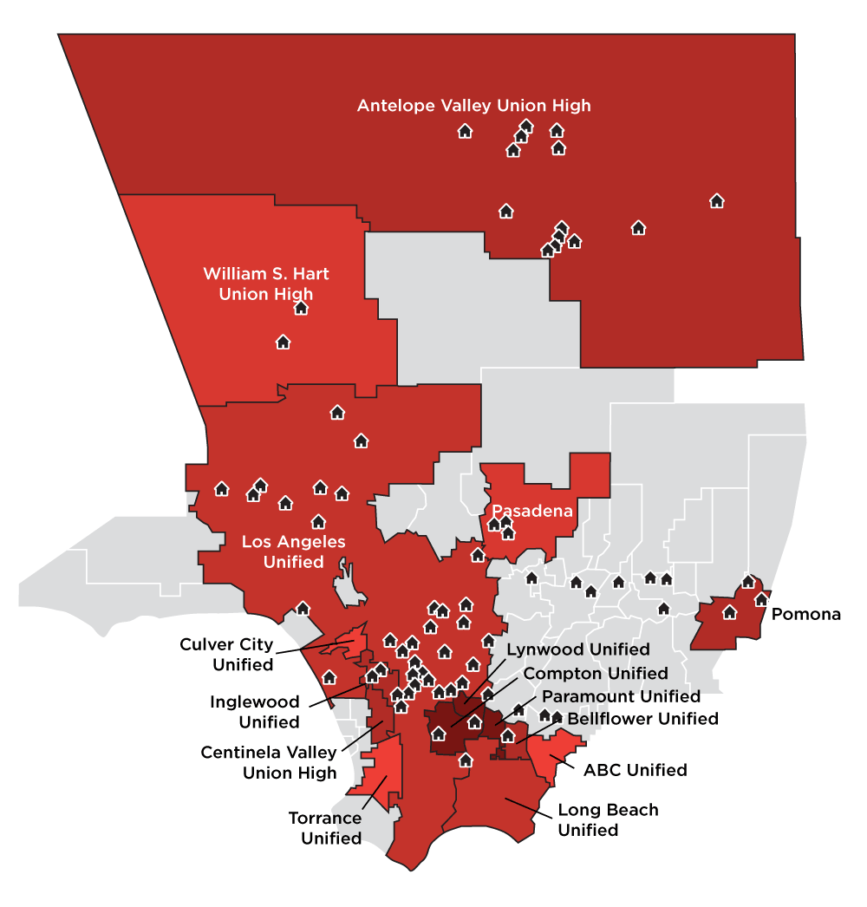
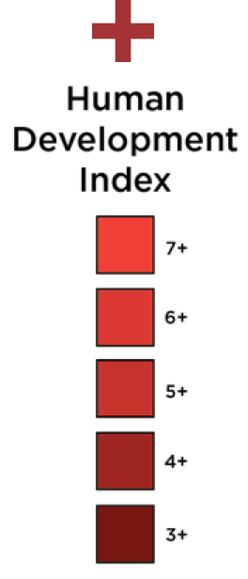
Finding 1: Place Matters
Human Development Index for LA County School Districts with 800 Black Students or More
Notes:
Add map of just counties and schools

Slide 19
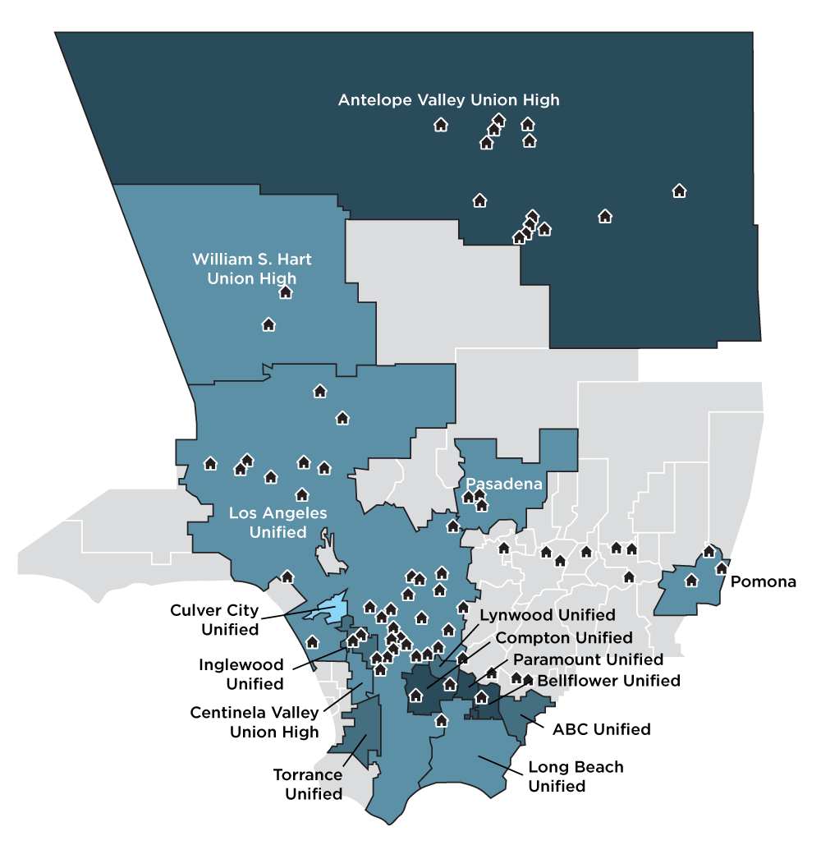
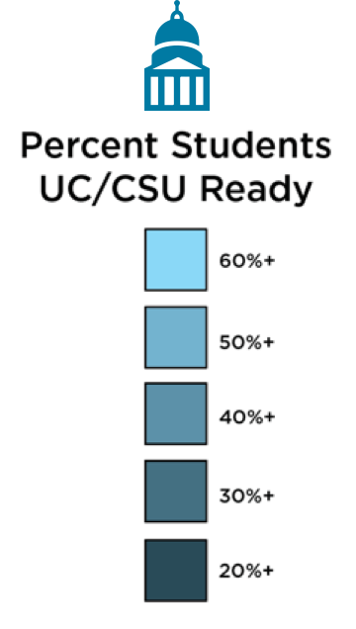
Finding 1: Place Matters
UC/CSU Readiness for LA County School Districts with 800 Black Students or More
Notes:
Add map of just counties and schools

Slide 20
County of Los Angeles
Create a County-wide strategic plan to address the needs of Black children.
Work with districts to develop a strategic approach to racial and socioeconomic integration in schools.
Solicit the expertise and perspectives of Black youth, families, community and faith-based organizations regarding their needs.
Ensure better coordination across departments to ensure more efficient service delivery in high impact communities.
Engage LACOE in the implementation of the Healthy Neighborhoods Plan in targeted communities.

Slide 21
Access to high standards is an equity issue
We have used assessment to rationalize sorting/tracking students (and often teachers)
We have traditionally “dumbed down” the curriculum for those we thought were not “college material”
We have confused academic performance with intellectual ability and potential
We have not given teachers sufficient guidance in how to teach in heterogeneous classrooms

Slide 22
Teachers Focus on Evidence of Learning
Make expectations clear and standards explicit
Model and expose students to high-quality work
Utilize diagnostic tools to check for understanding
Learn about student interests to make lessons relevant
Expect students to revise and resubmit work
Solicit feedback and questions from students
Analyze student work with a focus on evidence of competence and mastery, and with a willingness to reflect on efficacy of methods

Slide 23
Behavioral Engagement
Preparation
Persistence
Instrumental Help Seeking
Cognitive Engagement
Deep Processing
Meta-Cognition
We Must Focus on Engagement
Affective Engagement
Interest
Value

Slide 24
Students in Control of Learning
Hollenbeck Middle School, LA

Slide 25
Align the Skills of Teachers with the Needs of Students
Differentiate professional development – content, pedagogy and relationships
Align PD to student needs
Provide access to mentors and content area coaches – selected based upon a record of effectiveness and an ability to work well with colleagues
Provide time for observation and feedback – from veteran teachers and knowledgeable administrators
Provide time to plan and collaborate with colleagues and learn from student work
Don’t assign new teachers to teach the most challenging classes

