Slide 1
Discussion re: CDPH COVID-19 Guidance for K-12 schools
July 15, 2021

Slide 3
Framework and Rationale for CDC and CDPH guidance
SARS-CoV-2 causes damage directly and indirectly
Infections, hospitalizations, death, long COVID
School closures, distance learning, loss of school days—Substantial educational losses, inequity, social and emotional consequences
The goal of the K-12 Schools guidance is safe and successful schools
Full, in-person instruction for all students, with minimized school days lost, safely
CDC and CDPH: layered approach to safety
Notes:
COVID is the enemy. The goal is to get through this last piece together, with a more aggressive variant.

Slide 4
CDPH Tools in the tool kit, Weapons in the arsenal
Vaccination for all eligible individuals to get COVID-19 rates down throughout the community
Universal masking in schools
Simple and highly effective, and which enables:
No minimum physical distancing, allowing all students access to full in-person learning, and
More targeted quarantine practices, keeping students in school
Prevents outbreaks, avoiding many days of missed instruction
Contact tracing, isolation, quarantine, including modified quarantine to allow students to stay in school if mask on mask (in schools with universal masking policy)
Access to a robust COVID-19 testing program as an available additional safety layer and to optimize school days

Slide 5
Additional considerations
Current unknowns associated with more transmissible variants, including the Delta variant
Operational barriers of tracking vaccination status, classroom and hallway monitoring
Potential detrimental effects of differential mask policies based on vaccination status (high schools and middle schools, since all elementary school students not yet eligible)
Will revisit mask guidance no later than November 1, 2021
Notes:
Some parents want to get rid of masks, some want to keep them. Everyone should feel safe coming back to school. Masks are simplest and most effective intervention. We are hopefully at the end of the fight with COVID and vaccines are helping us win, but we need to protect our kids still with the other tools in the arsenal. 100% of the elementary and 60% of adolescents.

Slide 6
Current and projected pandemic metrics

Slide 7
Vaccine metrics as of mid-July, 2021
Statewide fully vaccinated people: 52%
Statewide fully vaccinated 12-17 year olds: 36%
By age:
65 or older = 73%
50 - 64 = 62%
18 – 49 = 44%
17 or younger = 3%
Notes:
https://covid19.ca.gov/vaccination-progress-data/#progress-by-group

Slide 8
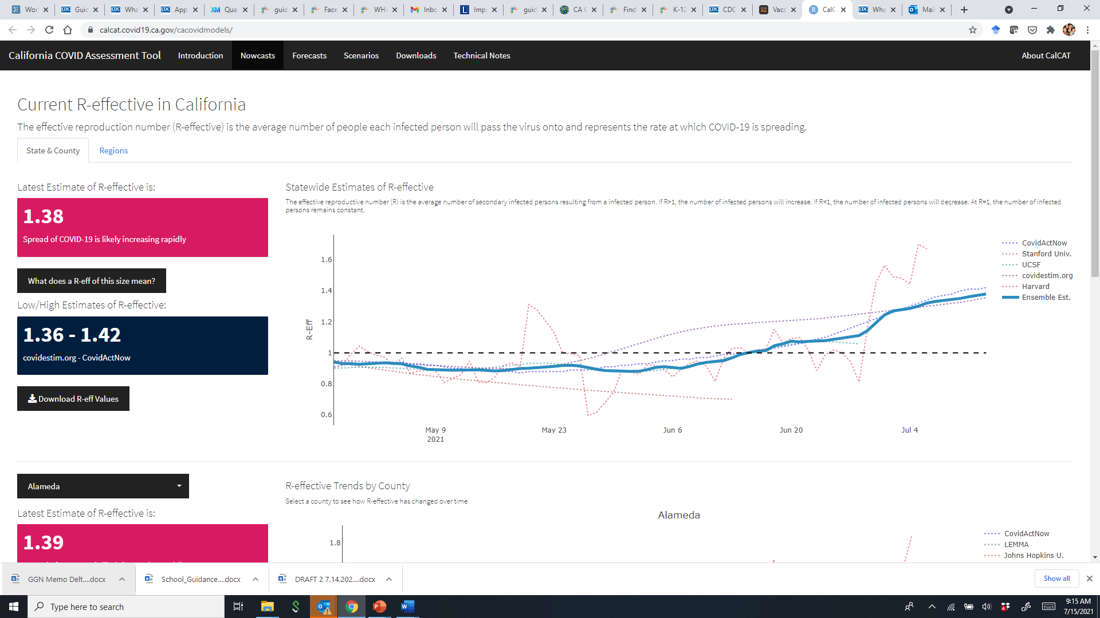
Reproductive rate of the virus in CA: The Spike is Starting

Slide 9
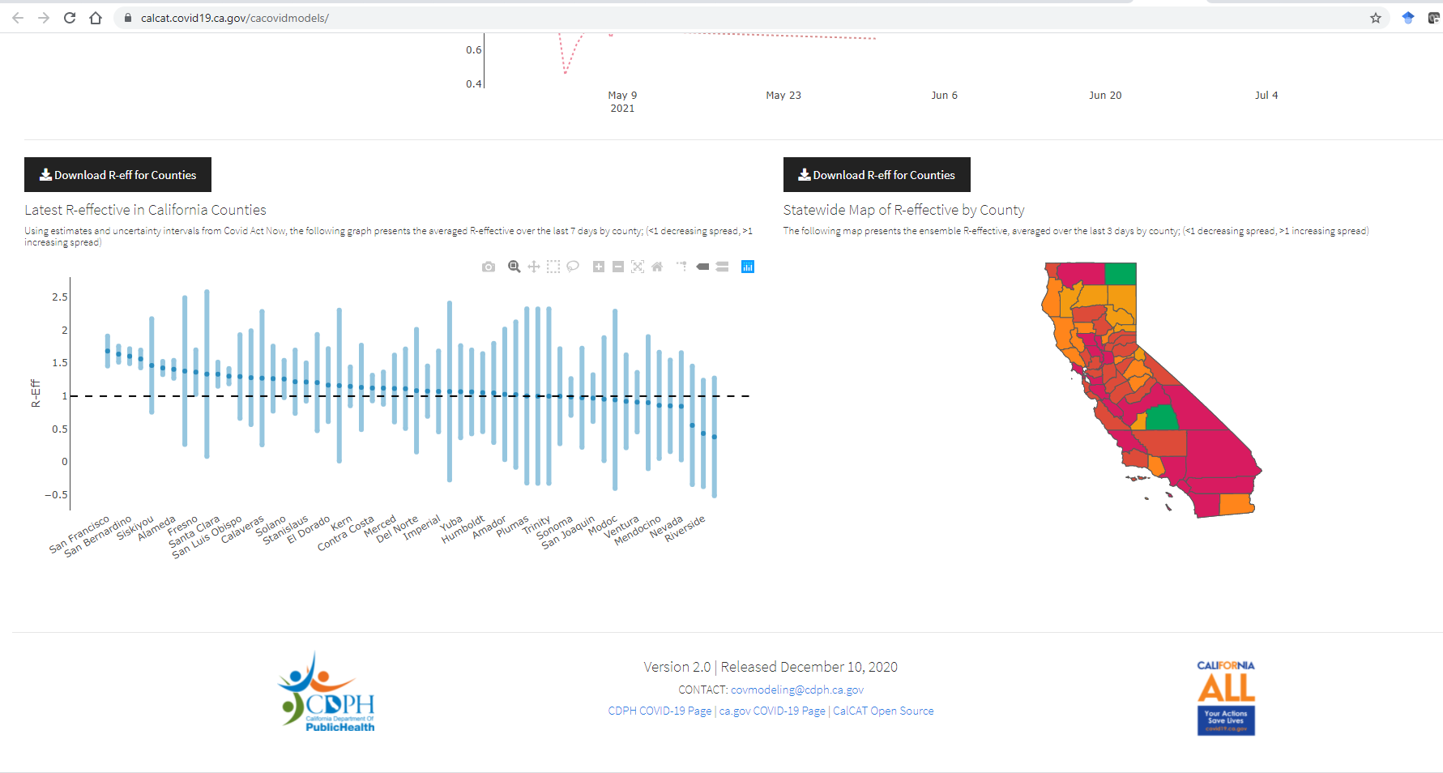
Reproductive rate of the virus by county in CA
Notes:
https://calcat.covid19.ca.gov/cacovidmodels/

Slide 10
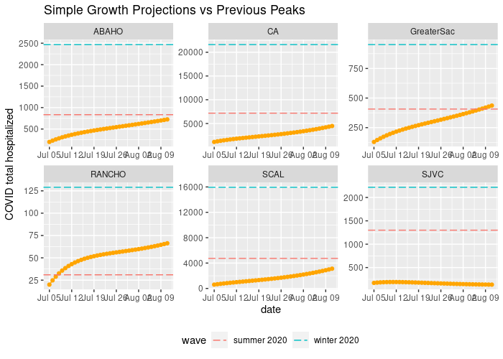
Reproductive rate of the virus in CA: We are likely to approach – and in some places surpass – last summer’s spike
Notes:
https://calcat.covid19.ca.gov/cacovidmodels/

Slide 11
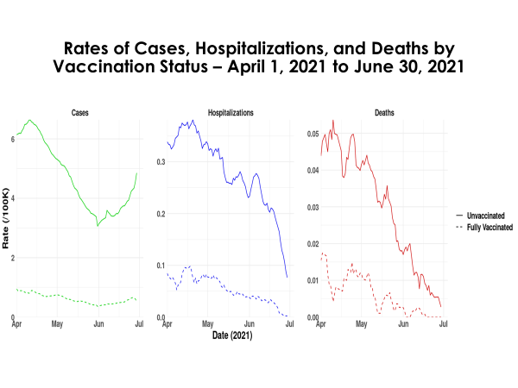
Cases are Increasing Sharply for Unvaccinated People; Hospitalizations Will Follow
Notes:
https://calcat.covid19.ca.gov/cacovidmodels/

Slide 12
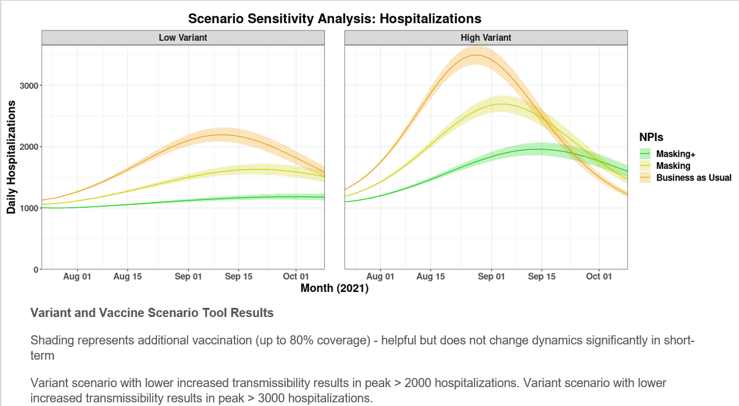
Hospitalization Increases Depend on Masking + Other Mitigation Policies
Notes:
https://calcat.covid19.ca.gov/cacovidmodels/

Slide 13
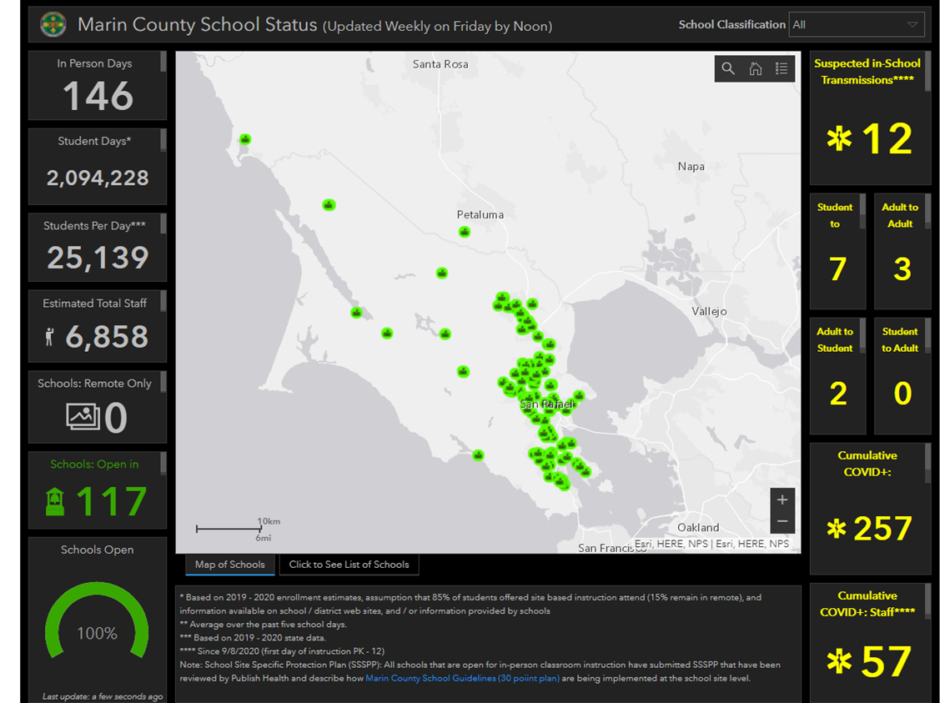
Prior to Outbreak: Marin County Schools
Last Year:
Over 2M “student days”
12 cases confirmed in-school transmission
Generally high adherence to infection prevention

Slide 14
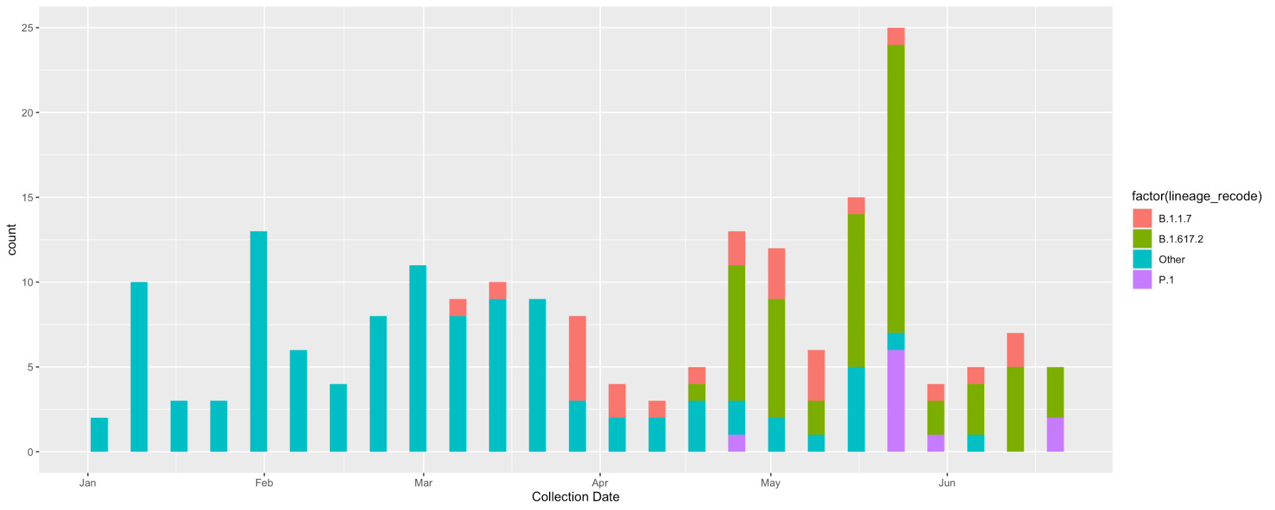
Increasing local prevalence of delta variant
Since May 1, 70% of samples sequenced in Marin are delta
Approximately half of all cases are sequenced
Data accessed 7/6/2021

Slide 15
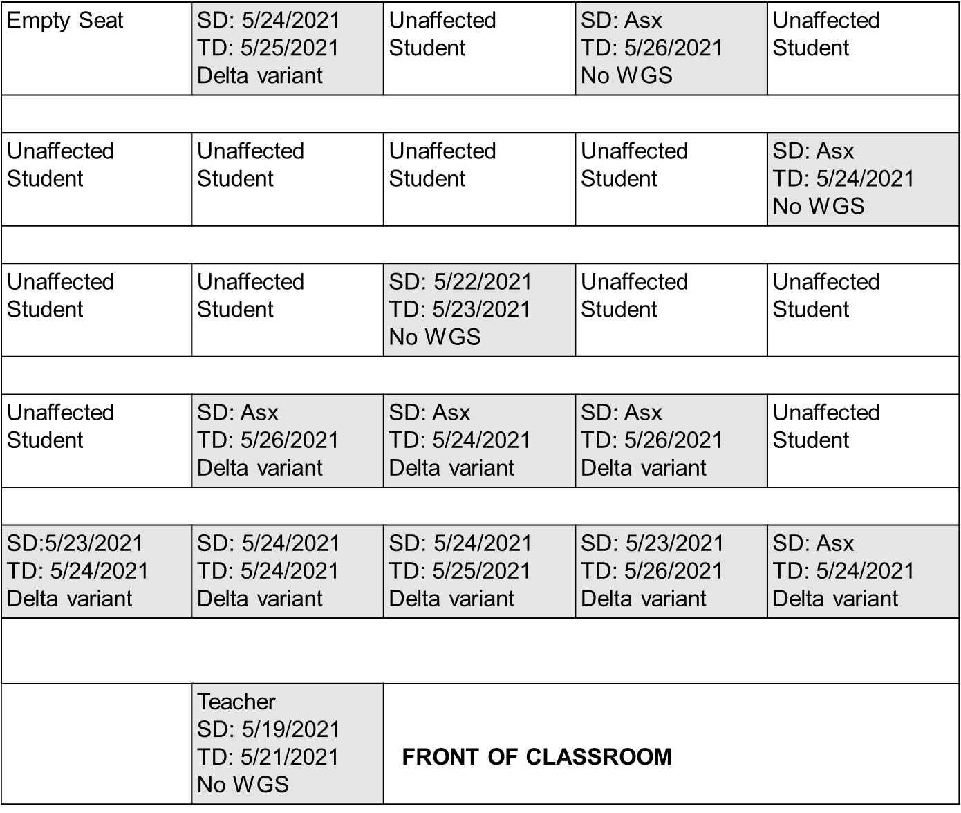
Seating chart
An Illustrative School Case: An unmasked teacher infected with Delta Variant
Attack rate: Percentage of
children who contracted
COVID-19
1^{st-}2nd row 80%
3^{rd-}5th row 28%
Delta (9/9)
Takeaway:
Very High Rates of Infection,
Especially Without Distancing

Slide 16
Marin County Primary School Outbreak
2nd Grade cluster – 20 persons
12 students
5 siblings
2 parents {1 vaxxed, 1 unvaxxed}
5th Grade cluster– 7 persons
2 classmates
3 students who attended sleepover on 5/21
1 sibling
1 parent {vaxxed}
No hospitalizations or deaths
Last linked case diagnosed 20 days after first

Slide 17
Take Home Messages
High rate of transmission of delta among unvaccinated persons
Even vaccinated people can become infected
Double down on fundamentals in school settings
Facial covering
Vaccination of adults and children who are eligible
Stay home with symptoms
Timely and complete cycles of testing
Whole genome sequencing can describe links not apparent through contact investigation
In school outbreaks, transmission occurs within and outside of school
High vaccination rates limits wider spread

Slide 18
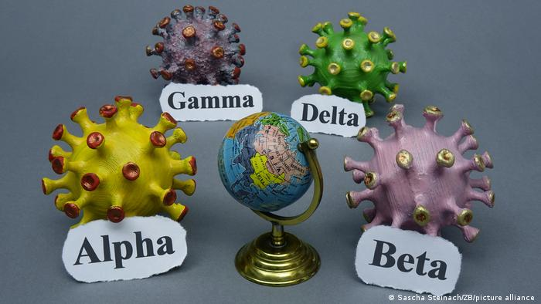
Additional Delta information
Percent of Delta-related cases in CA >40% and rising
Vaccines are still key prevention
Two doses provide high levels of protection from severe illness and hospitalization
Breakthrough cases do occur, however, especially in crowded contexts without masking

Slide 19
US Trends: Cases Up, Deaths Rising, Community Transmission “Substantial”
Trends in Number of COVID-19 Cases and Deaths Reported to the CDC as of July 15, 2021
Case rate on July 15, 2021: 58/100,000 ~ Case rate on April 5, 2020
Up 70% from the week before

Slide 20
Delta Surge Causes Seven Bay Area County Health Departments to Join SoCal Counties in Returning to Indoor Masking as of Friday

Slide 21
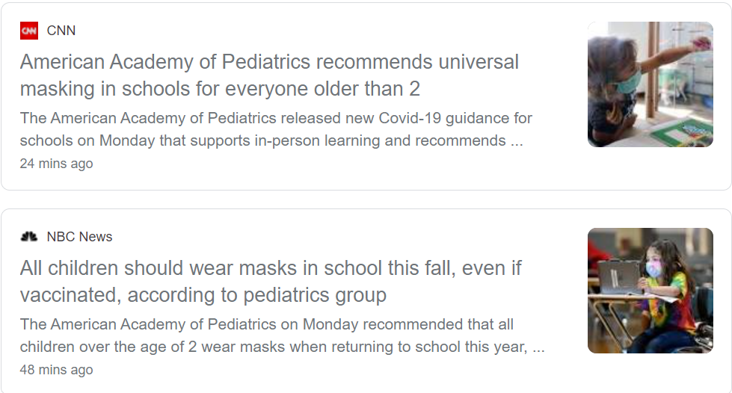
American Academy of Pediatrics Today Recommends Universal Masking in School

Slide 22
Summary
The goal is safe, full, in-person instruction, with minimized missed school days due to quarantine or due to outbreaks that send a lot of kids out of school
Most K-12 students are not vaccinated, making masks one of the most effective, simplest interventions available
Even vaccinated adults and children are vulnerable to infection
Flexibility in other strategies (e.g. distancing, cohorting makes masking even more essential until vaccinations go up and rates go down
Notes:
We are close to the end of the fight against COVID19, but not yet done. Our best chance of winning is to stick together and hold on tight.

