Slide 1
Safe Schools for All Stakeholder Convening
Monday, October 25, 2021

Slide 2
Meeting Agenda
Introduction
Landscape Update
Timeline (Questions)
VA58 Campaign Update (Questions)
School Operations (Questions)
Resources
Notes:
Ben

Slide 3
Introduction
Big Goal: Maximize (a) accurate information about and (b) access to the vaccine for youth and families.
Over the next two weeks, expect significant media coverage about vaccines for youth ages 5-11.
Meeting Objectives:
Make sure this is on your radar;
Supply you with information on what we know, so you can answer questions from membership, convey accurate information, etc.; and
Continue conversations and spur new collaborations.
Notes:
Ben

Slide 4
Introduction (Cont.): Forthcoming Requirements
Today’s discussion is not about forthcoming vaccine requirements. But here’s a quick overview.
As here, we are committed to educating and engaging families to get vaccinated. And the forthcoming requirements will be the surest path back to pre-pandemic school life.
What this means:
The COVID-19 vaccine will be added to the list of required vaccinations for in-person school -- public traditional, public charter, and private. This will be done through the public rulemaking (or legislative) process.
Depending on federal actions, this requirement will become effective for students in grades 7-12 on July 1, 2022. The requirement for grades K-6 will be implemented thereafter (again, depending on federal timing).
Before the first student requirement becomes effective, the staff verify-or-test requirement will be converted to a mandate.
Under current law, requirements implemented through rulemaking must include a personal belief exception.
Notes:
Ben

Slide 5
Landscape Update: Safe and Open Schools
California schools lead the nation in:
Safety: Through the start of the school year, California children were hospitalized for COVID-19 at less than one-half the national rate and one-fourth the rate in states like Florida.
Child COVID-19 Hospitalization Rates Hit Record in U.S. -- But Not in California. Here’s Why. (LA Times)
Being Open: California schools have closed due to COVID-19 at one-twelfth the national rate.
California Accounts for 12% of U.S. Students, but Only 1% of Covid School Closures (NY Times)
Three recent CDC studies have confirmed that universal mask mandates reduce in-school transmission. One study based in California attributed a school outbreak to an unvaccinated staff-person who temporarily removed her mask for a read-aloud .
Studies Show More COVID-19 Cases in Areas Without School Masking Policies (CDC)
CDC Study Finds Unvaccinated Marin Co. Teacher Infected 22 Elementary School Students with COVID (ABC)
Notes:
Tom

Slide 6
Landscape Update: Youth Vaccination Rates
Data on 12-17 age group as of October 19th:
1,834,792 fully vaccinated (58.2% of eligible population)
247,818 partially vaccinated (7.9% of eligible population)
1,072,526 not yet vaccinated (34% of eligible population)
Notes:
Tom

Slide 7
Timeline
Key Dates:
10/26 FDA Advisory Committee
10/27 - ? FDA Emergency Use Authorization
11/2 - 11/3 CDC ACIP Meeting
11/3 - ? CDC Recommendations
11/3 Western States Scientific Review Workgroup Meeting
11/4 Key date
Notes:
Devon

Slide 8
Questions?

Slide 9
VA58 Campaign Update
VA58 Team has been actively preparing for 5-11 EUA. Activities we’ll be
focusing on in the coming weeks include:
Paid media campaign in multiple languages launching when EUA
takes effect (TV, radio, digital, paid social, paid search, and out
of home).
Earned media engagement including securing interviews for state
doctors and community partners, ethnic media briefings and op-eds.
Messaging focused on addressing parent concerns about the vaccine
Digital engagement with parent influencers.
Community engagement with CBO network to engage community
partners.
Preparing medical providers to administer
vaccines. This work has been underway for
several months, and will continue.
Engaging schools for vaccine clinics and to
serve as trusted messengers
Notes:
Devon

Slide 10
VA58 Campaign - Research Findings
WHAT WE LEARNED
Perceived “newness” of vaccine is a primary concern amongst parents.
Fear and anxiety over possible long- and short-term side effects are a key deterrent.
Physicians and youth play key role in influencing decisions.
Concerns about ingredients in the vaccines.
Parents feel they have a right to vaccinate their children when they are ready.
RECOMMENDATION
Integrate scientific information into messaging that reassures parents the vaccines are not a new development. Share that vaccine development/technology has been underway for 20+ years. Use facts to counter misinformation and overcome concerns.
Emphasize messages regarding safety of vaccine. Develop messages that respond to questions about risks of youth getting sick from COVID vs. vaccine side effects (i.e. Long COVID and Myocarditis)
Utilize science/medical professionals as messengers wherever possible. Encourage pediatricians to proactively reach out to patients to encourage vaccination and reaffirm safety. When possible, explore using youth themselves as messengers.
Simplify the information of what’s in the vaccines. Normalize vaccine ingredients with connections to other trusted medications. Use this sparingly to not inadvertently drive mistrust in other treatments.
Continue offering and promoting a variety of options, including those that don’t need an appointment. Remind parents that vaccines are the safest way to keep their whole family safe from COVID-19, especially during the holidays.
Notes:
Devon

Slide 11
VA58 Campaign - Research Findings
Notes:
Devon

Slide 12
Questions?

Slide 13
Operational Supports to Maximize Access
State is investing in resources to help schools play a role in 5-11 vaccination.
How to host a school-based vaccine clinic:
Visit the CDPH website: https://www.shotsforschool.org/k-12/clinics/
View the CDPH webinar: https://www.youtube.com/watch?v=_9a9IOFDWjk
State has reached out affirmatively to hundreds of schools in Q1 and Q2 neighborhoods under the Vaccine Equity Metric.
State is also working with non-school partners, including pediatricians and CBOs statewide.
Notes:
Devon

Slide 14
Communications Resources for Family Engagement
Resources in English/Spanish will be posted on on a rolling basis: https://toolkit.covid19.ca.gov/partners/
Content Being Developed (based on Safe for Schools feedback):
Newsletter Content
Fact Sheets
Key Talking Points for Schools
Email Templates
Presentation Template
Social Media Assets
Suggested School Website Content
*** Materials will be uploaded on a rolling basis, with key materials available before November 4, 2021.
Notes:
Devon

Slide 15
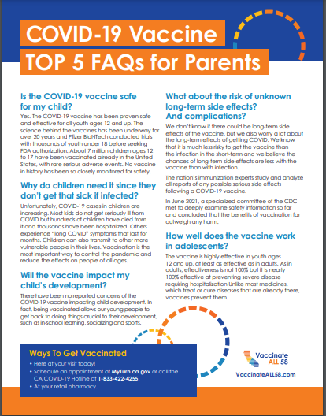
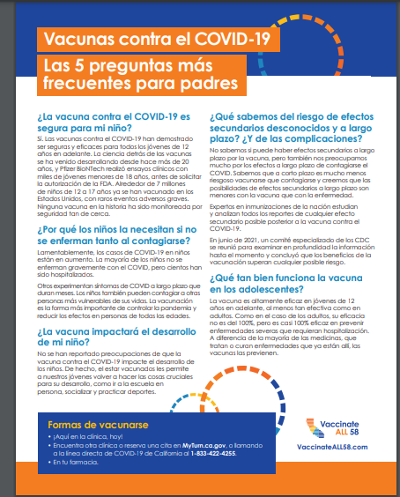
Sample Materials
Notes:
Devon

Slide 16
Questions?

Slide 17
Points of Contact
Operations
Aubrie Fong: Aubrie.Fong@cdph.ca.gov
Communications
Devon Keeler: devon.keeler@cdph.ca.gov
Resources
Toolkit: https://toolkit.covid19.ca.gov/partners/

Slide 18
THANK YOU!

